Slide 1

GRADE 8 LESSON
News in Indian Country

Slide 2
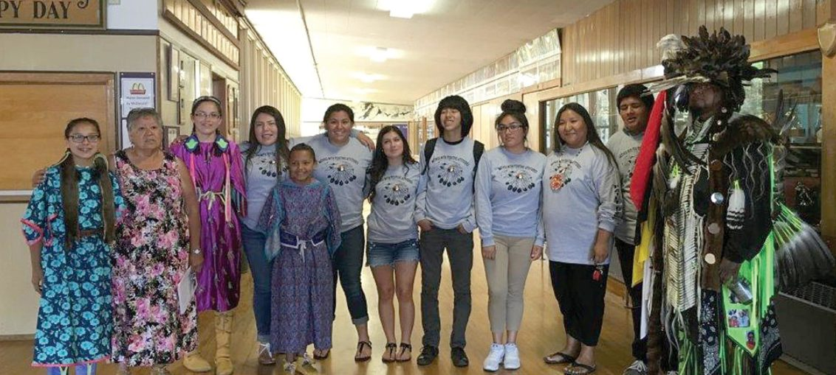
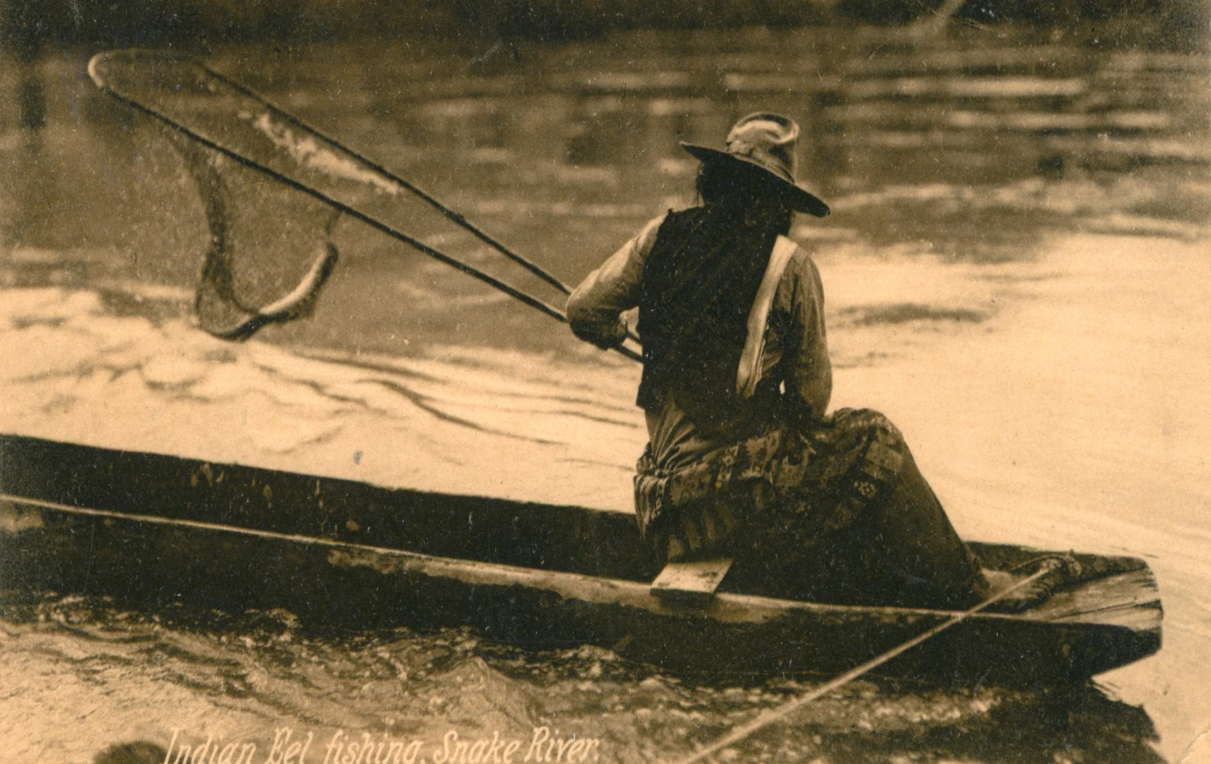
“The active sense of presence, the continuance of native stories, not a mere reaction or a survivable name. Native survivance stories are renunciations of dominance, tragedy, and victimry.”
https://btimesherald.com/2016/10/05/burns-paiute-tribe-flag-on-display-in-bhs-gym/

Slide 3
Chalk Talk
There are three posters in the room. Each one has a prompt. Please provide written responses to the prompts and to the responses of your classmates.
Think about the definition of tribal survivance. How does the preservation of language support tribal survivance?
Why is language important to the preservation of
Native culture?
How is the Siletz language (Athabaskan) being revitalized? What specific acts or efforts support
this movement?
Notes:
Chalk talk is a way to interact and get thoughts, questions, or considerations out on a topic without talking. You are expected to respond or ask a question to at least one of the prompts in your own thoughts and words. The cool thing about chalk talk is that you can read what others wrote and add to it, by giving additional information or insight, examples, ask questions. It’s about having a conversation with others without talking. It doesn’t have to be direct, as you can choose which parts to respond to and how.
You must add at least one original thought to the prompt and respond to at least two other classmates’ thoughts that you see on each poster.

Slide 4
Key Vocabulary
Banner – A prominent headline on the front page (or home page) of a newspaper, usually stretching across the full width of the page or screen.
Byline – The name of the person or people who wrote the story.
Caption or cutline – The text beneath a photograph that explains who is in the photo, provides any necessary context, and gives credit to the photographer.
Headline – The title given to a newspaper story.
Lead – The first few sentences or opening paragraph of a news story, which usually includes an interesting detail, anecdote, or quote that attempts to peak the reader’s interest and pull them into the story.

Slide 5
Read All About It!
Native American Tribes Gaining Recognition for Timber and Forestry Practices
Fish and Wildlife Students Learn Traditional Ecological Knowledge on the Siuslaw
Governor, Oregon members of Congress affirm treaty right to healthcare
Notes:
These three headlines introduce new reports about powerful examples of current day acts of survivance. The first article explores how the Cow Creek Band of Umpqua Indians are managing their ancestor’s territory so that tribal members and come and use the land as they have since time immemorial. The second news report from the Confederated Tribes of Coos, Lower Umpqua & Siuslaw Indians describes educating young people how to navigate the Siuslaw River and how to actively care for this land by removing invasive species and planning western red cedar trees. The third is a press release from the Confederated Tribes of the Umatilla Indian Reservation to voice opposition to efforts to alter the way healthcare is provided to American Indians. This opposition is to maintain the sovereignty of their Tribe and the right to manage a healthy and vibrant community.

