Slide 1
Memoranda of Understanding/Agreement
Presenter
Date
Conference/Meeting Name

Slide 2
Presentation Overview
Today’s Agenda
Before we begin
Purpose of MOUs or MOAs
Community Partners
MOUs: What to include
MOU/MOA updates
Conclusion

Slide 3
Before we begin…
Coordination With Community Partners
Your school will not experience a disaster alone. Even in the event of a site-specific emergency (e.g., fire or targeted violence) your school will not respond to the emergency by itself. So…
Ensure you coordinate with your community partners for response.
Codify those agreements in writing.

Slide 4
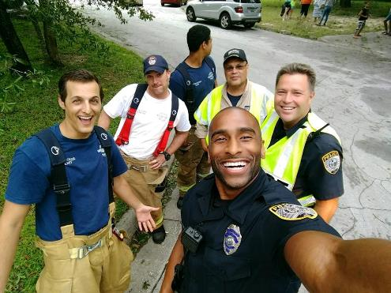
Purpose of the Memorandum of Understanding
Memorandum of Understanding/Agreement: Why?
An MOU is important because it defines the responsibilities of each party.
An MOU provides the scope and authority of the agreement.
An MOU clarifies terms and outlines compliance issues.

Slide 5
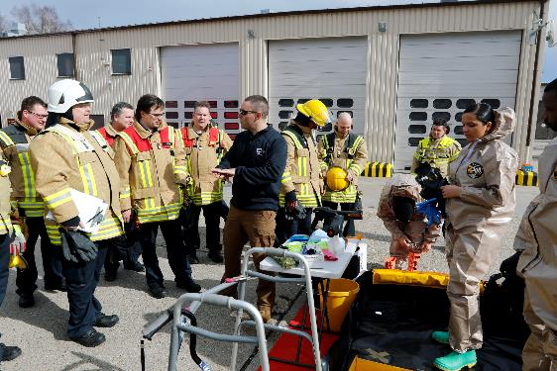
Understanding or Agreement?
A Memorandum of Agreement is used to cooperatively work together:
Each party commits to duties or obligations to the other party, and the parties are bound by the terms of the agreement.
A Memorandum of Understanding is:
A bilateral statement of the parties’ positions, interests, and activities or duties.
Used to recognize what each party might do.
Notes:
When duties and obligations need to be agreed to, an MOA is likely the best choice: “What MUST we do?”
If there is no repercussion, consequence, or penalty for a party failing to meet or fulfill some duty or obligation, MOU is likely the best choice: “What MIGHT we normally do?”

Slide 6
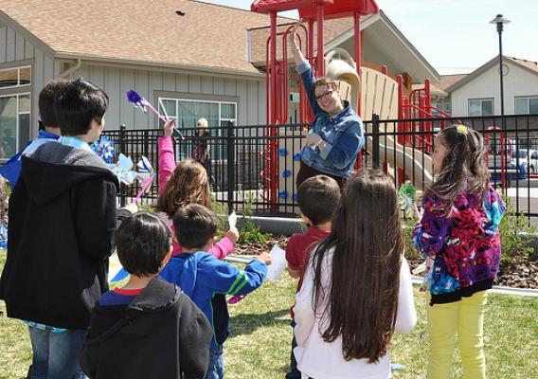
Community Partners
Who should YOU include?
Emergency responders:
Fire.
Police.
EMS.
Partner schools.
Facilities or facilities support organizations.
Notes:
Any organization outside of your own district that might interact with your school in an emergency.
Spend time going over the different community partners who could be collaborators in a disaster. Whether that includes assistance to the school, or facilities use by the community.

Slide 7
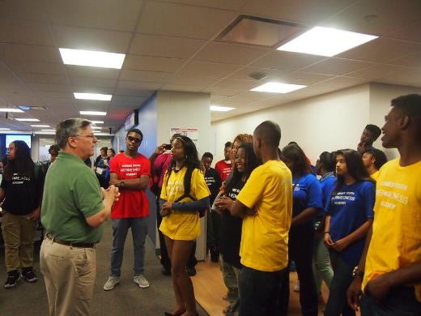
MOUs/MOAs: What to Include
Lay out exactly what the agreement involves:
Introduction: Who is involved and why are they involved.
Purpose: What this new combined capability is supposed to accomplish.
Scope: Who is involved and at what levels.
Definitions: If there are any community-specific definitions or acronyms, define them here.

Slide 8
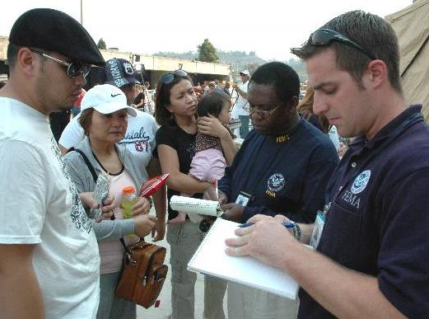
MOUs/MOAs: What to Include (continued)
Lay out exactly what the agreement involves:
Policy: What circumstances can this agreed upon capability be used?
User procedure requirements: What do the participants agree to maintain or provide?
Training, material or resources.
Maintenance: Who is responsible for maintaining equipment, systems, and licenses?
Oversight: Who is responsible for enforcing or carrying out this agreement?

Slide 9
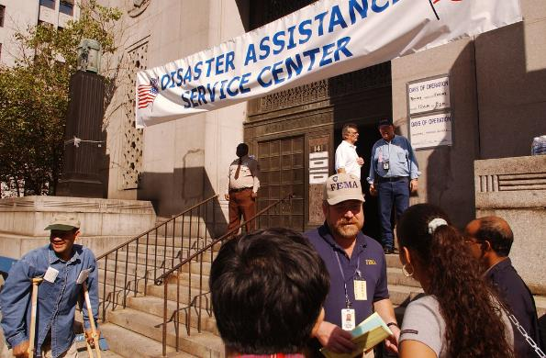
MOUs/MOAs: What to Include (continued 2)
Lay out exactly what the agreement involves:
Responsibility for SOP compliance: Who is responsible for ensuring SOPs are drafted and are applicable; who’s responsible to ensure compliance.
Updates to the MOU: Who is responsible for modifying or updating the MOU?

Slide 10
Updates and Inspections
Routinely review and update
Don’t let your MOU get moldy.
Consider:
What happens in a few years when ...
People change roles.
Organizations change addresses.
Agencies change rules or policies.

Slide 11
What Can You Do?
Who should be in the loop?
Think of some of the specific disasters you are preparing for. Who will you rely on?
Review the sample MOU that has been handed out. Are there any alternate sites you need to coordinate with?

Slide 12
Conclusion
Federal Emergency Management Agency Resources
Department of Homeland Security writing guide for MOUs: https://www.dhs.gov/xlibrary/assets/foia/mgmt_directive_0450%201_mou_moa.pdf
Lesson learned white paper on a community response that resulted in the recommendation to include communication in their MOAs: https://rems.ed.gov/docs/FEMA_ProceduresMOU.pdf

Slide 13
End on a Quote!
“If everyone is thinking alike, then somebody isn’t thinking.”
-George S. Patton (General, US Army)
Notes:
This is not a joke. Everyone start thinking differently right NOW!

