Slide 1
Exploring Student Incentives, Part II
May 9, 2023

Slide 2
Agenda for Today’s Session
Recap of April 18th Student Incentives Discussion
Questions to Consider
Sample Scenarios
GOAL: Build Oregon’s incentive guidance together
Notes:
Clarify:

Slide 3
April 18th Recap
What we know for sure:
Incentives can improve student outcomes when strategically used
Allowable = Necessary + Reasonable + Allocable
Communication from USED
Things that are less clear:
Food
Entertainment
Determining what is “reasonable”

Slide 4
Student Incentives: What the USED says
Letter to Anderson (January 2008)
Question: What are the rules governing the use of Title I funds for rewards and incentives? How can a district judge whether a particular initiative is allowable?
USDE’s Response:
May reward for effort and achievement, not participation
Must be nominal and non-monetary
May not be “entertainment”
May not be used to pay students stipends or provide an award for attendance
Notes:
The Letter to Anderson was a response to an inquiry from the state of Wisconsin. According to the letter to Anderson, “Title I-A funds may be used for non-monetary reward of nominal value (e.g. a plaque, gift certificate for a pizza, or a book) to recognize Title I-A students for good performance unless prohibited under state or local law. Title I-A funds may not be used to pay students a stipend or provide some other type of award as an incentive for participation as that is tantamount to paying students to attend class.”

Slide 5
Allowable =
Necessary:
Is the cost needed for the operation of the program?
What does your needs assessment and plan say?
Reasonable:
Does the purchase exceed the cost of what a “prudent person” would incur?
Headline test and Cost/Benefit Analysis
Allocable:
Does it serve the purpose of the program?
Is the cost permissible under federal, district, state, and local policies?
Necessary
+
Reasonable
+
Allocable
Notes:
Necessary:
Is the cost included and identifiable in your agency’s plan and allowable under the program?
In the district or school level plan?
If something is not in the plan, it is not necessary. To be necessary it should be connected to the needs assessment.
Reasonable: “ordinary”. How does the amount of money being spent compare to the number of people who will benefit? Was the item purchases consistent with your agency’s procurement or purchasing procedures? Would you be able to defend the cost if it was in the paper?
Allocable: This is the clearest of the three. Does the purchase serve the purpose of the program? Will the item benefit Title I, Part A in proportion to the percentage that Title I, Part A pays for the item?
Will any use by another program be allocated out if that use is not deemed an incidental benefit?

Slide 6
Necessary & Allocable: Questions to Consider
What in our needs assessment got us here?
What are the goals in our school plan?
How do student incentives help us achieve those goals?
How will we know if the incentives are working?
Notes:
Let’s break these three into practical questions.
These are internal questions you should be asking yourselves. If ODE does ask these questions, be prepared to share your answers.

Slide 7
Reasonable: Questions to Consider
Why did we pick these particular incentives?
How many students would benefit from this expenditure?
What is the cost of this item in comparison to the overall budget?
Would this pass the headline test?
Notes:
Are the students motivated by the incentive? How is the incentive connected to the goal we are trying to achieve?
Equity: Are there barriers to some students earning this incentive? High value items where only a few students benefit would not be equitable.
Is it a huge portion of a school’s budget for supplies/materials?
Headline test – What would this purchase look like in the newspaper?

Slide 8
Scenario Questions
Is the request necessary, reasonable, and allocable?
What is a strength of this idea?
What concerns do you have about this idea?
Is more information needed to make a decision?

Slide 9
Scenario 1: Tablet Raffle
Apple Elementary School wants to purchase multiple tablets (e.g. Samsung, Kindle type device) for an attendance incentive
All students with perfect attendance during the school year are entered into a drawing
1 student from each classroom with perfect attendance wins the tablet
$100 per tablet
15 classrooms
Total cost: $1500
Notes:
Is this incentive necessary? reasonable? Is it equitable?

Slide 10
Scenario 2: Incentives Store
Ball Elementary School has an established PBIS system and is looking to replenish their incentive store. Student council has selected a variety of items of interest for students to “buy.”
Per the budget narrative, the school’s budget for supplies/materials is $20,000
$5,000 of the supply is spent on student incentives
Each item costs between $1 and $10
Notes:
How many students are at the school?
What does the needs assessment and school plan say?
How many students would benefit?
Is it $5,000 on 500 incentives worth $10 each?
What is being incentivized?

Slide 11
Scenario 3: 8th Grade Graduation Trip
All graduating 8th graders at Cat Middle School are going to the movies!
Federal funds pay for tickets, popcorn and soda for each student as well as transportation to the theatre
Celebrating moving to high school
Notes:
Is this “entertainment”? Is there any circumstance (e.g.; content of the movie) in which this would not just be entertainment and could be necessary, reasonable and allocable?

Slide 12
Key Takeaways & Next Steps
When using federal funds, ensure incentives are “Necessary, Reasonable, and Allocable”
Consider other funding sources
District policies, needs assessment, and school plans help drive decisions
ODE’s Next Step: Create a draft brief for feedback
Notes:
Some of the scenarios we talked through today would not meet the necessary, reasonable and allocable measures set out in Uniform Grants Guidance. However, districts have other funding sources they may consider using. Whatever the funding source, asking thoughtful questions about incentives can be helpful in making determinations about the best way to maximize funding and support student outcomes.

Slide 13
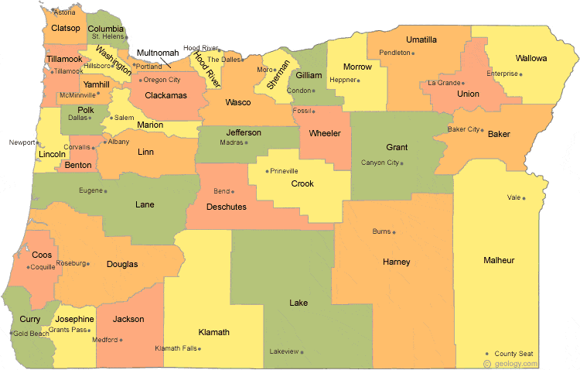
Regional Contacts by ESD
Amy Tidwell
Grant, Harney, High Desert, InterMountain, Jefferson, North Central and Region 18
Jen Engberg
Clackamas, Columbia Gorge, Multnomah and Northwest Regional
Lisa Plumb
Lane, Linn Benton Lincoln and Willamette
Sarah Martin
Douglas, Lake, Malheur, South Coast and Southern Oregon
Notes:
We have divided up the state into four sections. Each of us serves as the primary contact for the districts in these ESDs

Slide 14
Please reach out!
Amy Tidwell amy.tidwell@ode.oregon.gov
Jen Engberg jennifer.engberg@ode.oregon.gov
Lisa Plumb lisa.plumb@ode.oregon.gov
Sarah Martin sarah.martin@ode.oregon.gov

