Slide 1
SUMMER LEARNING BEST PRACTICE GUIDE
Session 2 - Practical Tools to Support Effective Programming
November 12 & 16, 2021

Slide 2
Today’s Goals
Upon the conclusion of today’s presentation, participants will be able to:
Dream, conceptualize and remain curious about the possibilities of equity-driven summer programming.
Explore some practical tools for centering student voice, choice and interest through a strength-based approach in summer programming.
Gain a deeper understanding of co-creation as a foundational component to equity-driven summer programs.

Slide 3
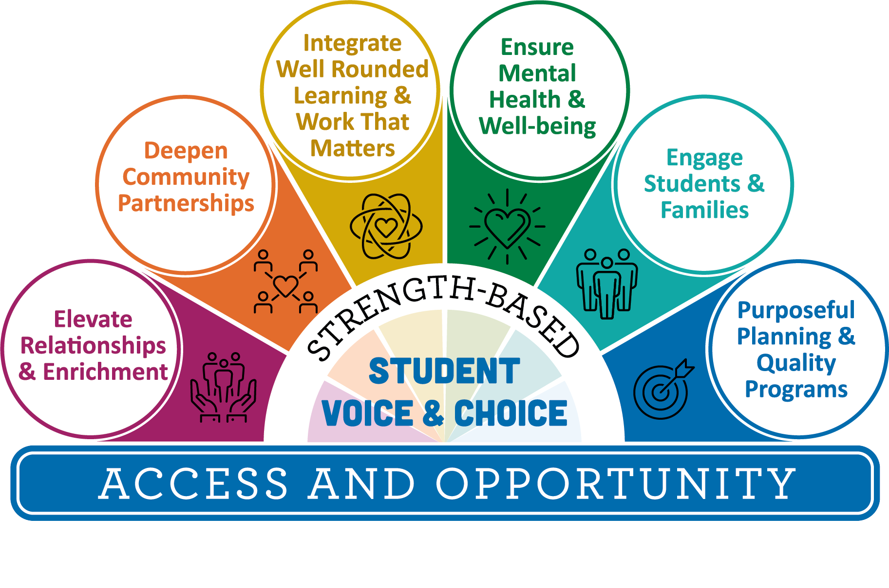
Agenda
3:00 Welcome and Introductions
3:05 Mix & Mingle
3:15 Strengths-Based, Student Voice and Choice
3:25 Co-Creation of Summer Programming
3:35 Explore Tools & Resources
3:40 Small Group Discourse
3:55 Debrief, Next Steps, Questions
4:00 Thank you!

Slide 4
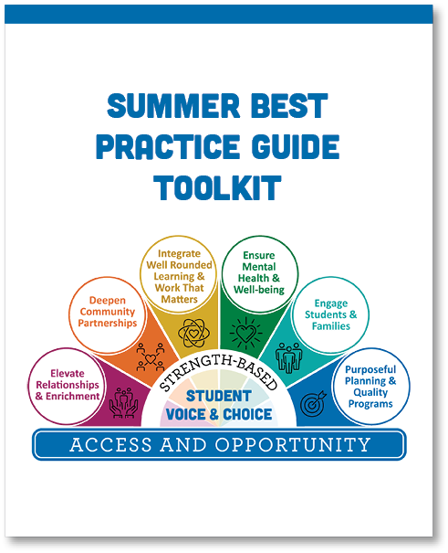
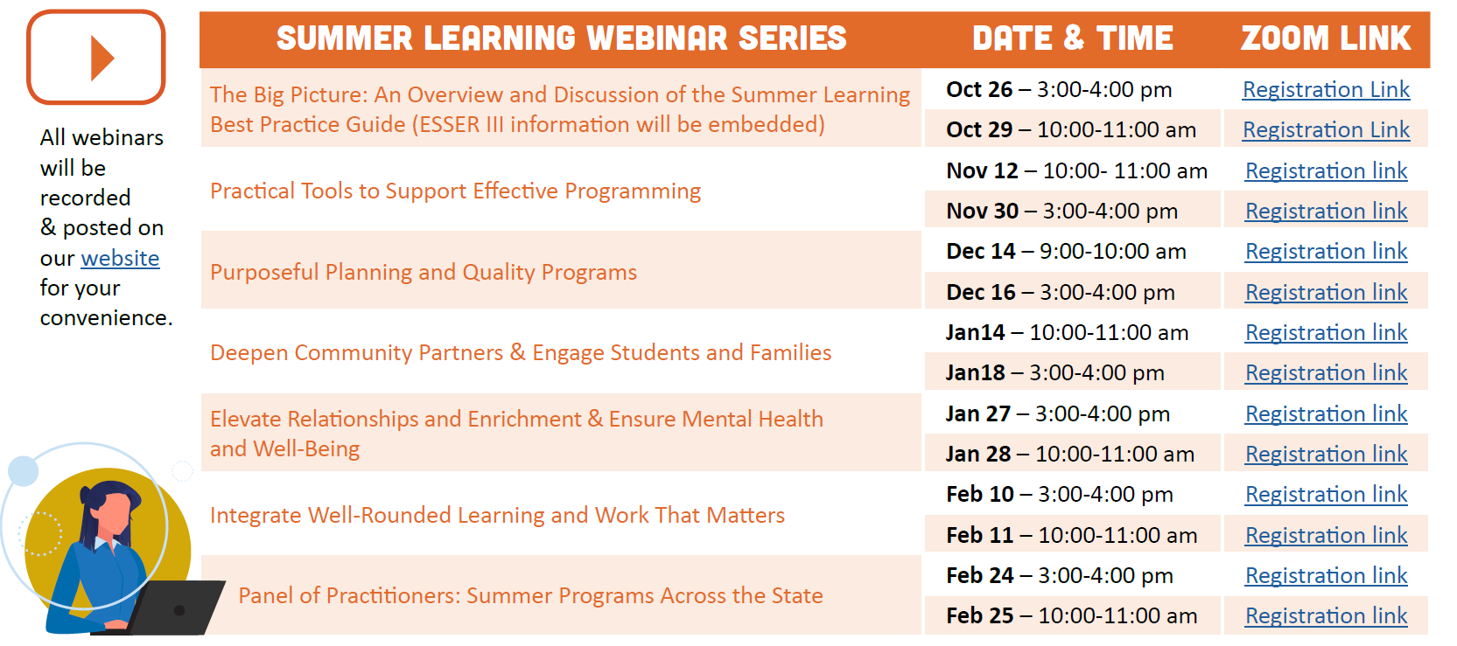
Summer Learning Webinar Series
Coming Soon!
Notes:
Framing the series, discourse,

Slide 5
Summer Learning Resources
Notes:
Summer Learning Best Practice Guide came out in April 2021
Moving from a COVID response to an Anchor Document we will update each year
4 community engagement sessions
national collaboration

Slide 6
Equity-Driven Summer Programs

Slide 7
Connection Mix and Mingle
Getting to know your colleagues:
What is your role and how are you connected to summer learning?
How do you see the vision of equity-driven summer learning currently in your program, school or district and/or how are you building toward that for summer 2022?

Slide 8
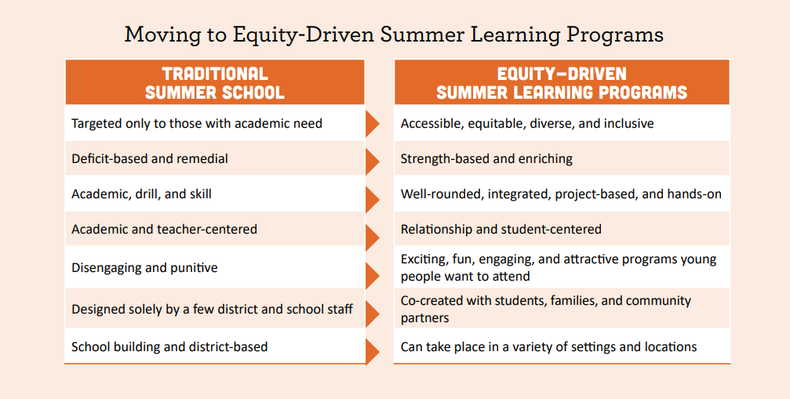
Centering Equity

Slide 9
Opportunity Gaps
Virtually all of the advantage that wealthy students have over poor students is the result of differences in the way privileged kids learn when they are not in school… America doesn’t have a school problem. It has a summer vacation problem.
-Malcolm Gladwell
Outliers: The Story of Success (pp. 258-260)

Slide 10
Student-Centered Learning
How would you describe student-centered learning?
In a truly student-centered environment, teachers and students work collaboratively to co-create a learning plan or pathway that best suits the strengths and needs of each individual learner.
Strengths-Based Student Voice, Choice and Interests

Slide 11
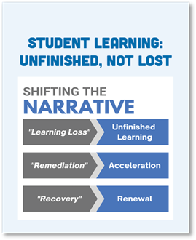
A Vision for Equity-Driven Summer Learning
Building on Student Strengths
Students come with a wide range of experiences, beliefs, skills, values, and interests. Learning is an integrated endeavor where students make sense of new experiences in relation to previous experiences and knowledge. Learning happens best when educators actively engage a student’s prior knowledge and view it as an asset for learning rather than a problem to overcome.

Slide 12
Funds of Knowledge Toolkit
Funds of Knowledge Inventory Matrix
Funds of Knowledge | Home/Community Practices | Classroom Application
Economics
Geography
Politics
Agriculture
Sports
Technology
Religion
Language
Health
Childcare
Art
Cooking
Entertainment
Funds of Knowledge | Home/Community Practices | Classroom Application
Economics | When Ruby's parents lived in El Salvador the currency was different. They had saved their old money in a small box. | We could use this in math, money in math is very common but using different currencies would bring in their funds of knowledge, especially if we have other cultures in our classroom that we may not know about.
Geography | There were a lot of maps around their home. I saw a large world map of South and North America. I also saw small maps on key chains of El Salvador. Ruby's mother also brought out a towel that resembled the Salvadorian flag. | This could be used in social studies. We could look at cities in Washington and take it a step farther and move from each continent and have table groups look closer at cities in specific continents or regions.
Politics | Ruby's family has Direct TV so they got to watch news that came right out of El Salvador. Her mother and father even recorded the news so they would not miss it when it came on. | We could use this in social studies, young students most likely will not be very interested in the news but they could have an assignment that has them work with their parents to choose a topic or find a story in the news together that is relevant to today's dates.

Slide 13
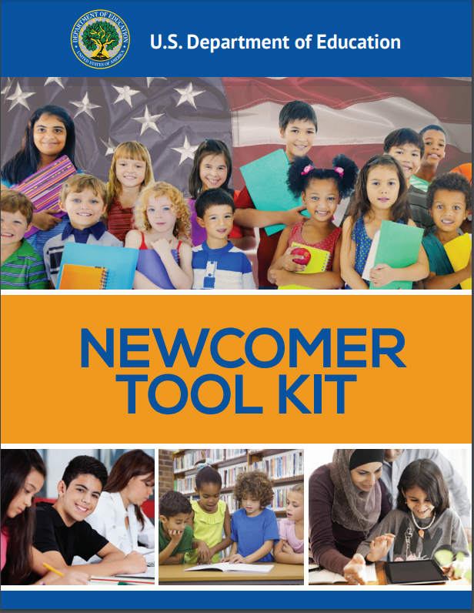
Professional Reflection and Discussion
US Department of Education Newcomer Toolkit

Slide 14
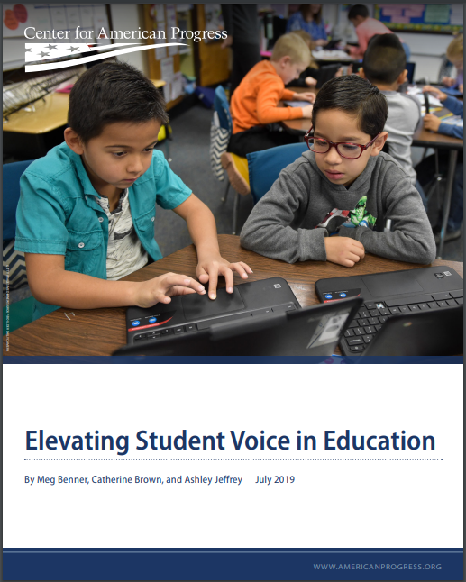
Elevating Student Voice
Center for American Progress
Elevating Student Voice in Education
July 2019
This report outlines strategies to increase authentic student voice in education at the school, district, and state levels.
Notes:
Https://cf.americanprogress.org/wp-content/uploads/2019/08/StudentVoice-report.pdf?_ga=2.143070325.1132709748.1636672522-1612841301.1635974628
All forms of student voice can be important and can meaningfully influence instruction, schools, and policies. But each approach has trade-offs, and one may be more appropriate to achieve certain goals than others. For example, schoolwide or districtwide surveys provide a snapshot in time with answers to a limited number of largely multiple-choice questions and often measure changes in the views of a large group of students over time. Student leadership through governing bodies or YPAR can allow for meaningful and extended conversations about complex topics and implementation; in most instances, however, this approach engages fewer students.

Slide 15
Student Interest Defined Programs
You for Youth (Y4Y) is a contractor for the United States Department of Education to provide resources and tools for 21st CCLC (Title IV-B) out-of-school time programs. They have templates you have permission to take and adapt for your programs needs as well as other professional development resources.
You for Youth Summer Learning Website
Notes:
https://y4y.ed.gov/summerlearning

Slide 16
Y4Y Leadership Roles
Ideas for Leadership Roles
Leadership Roles | Responsibilities | Core Skills Required or To Be Taught
Youth Ambassadors | ● Act as recruitment leads for the program, spreading the word in formal and informal ways. ● Man the table at outreach and recruitment events. ● Present on the program at meetings, assemblies, events. ● Act as welcoming liaison for new or potential program participants. ● Give feedback and help develop outreach materials. | ● Effective communication ● Listening ● Organizational and interpersonal skills ● Dependability ● Teamwork ● Public speaking
Peer-to-Peer Mentors | ● Older/veteran participants pair with younger/newer participants. ● Help give advice, tutoring and pathways for navigating high school. ● Engage in formal and informal enrichment and social-emotional activities. ● Increase connections and community within the program and within the school day. | ● Positive attitude ● Self-motivation ● Interpersonal and communication skills ● Trustworthiness ● Responsibility
Service Learning Project Leaders | ● Help to lead and design. ● Specify roles for all team members (e.g., project manager, researcher, administrative assistant, writer, graphic designer, social marketer, community outreach coordinator, marketing coordinator). ● Develop connections in the community. ● Earn service hours needed to graduate. | ● Creativity ● Teamwork ● Problem solving ● Planning and organizing ● Time management
Internship Opportunities | ● Participate in job readiness training and learn job skills. ● Gain real-world experience. ● Take a 4- to 8-week placement with program partners. ● Benefit from stipend options. | ● Time management ● Productivity ● Organizational skills ● Critical thinking ● Interpersonal skills ● Responsibility ● Problem solving
Notes:
https://y4y.ed.gov/summerlearning

Slide 17
Youth Ambassadors
Youth Ambassador Job Description
Youth Ambassador Action Template

Slide 18
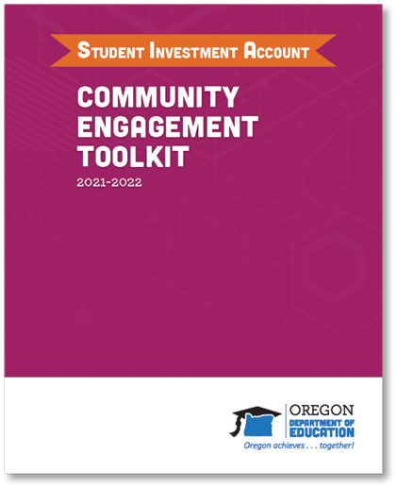
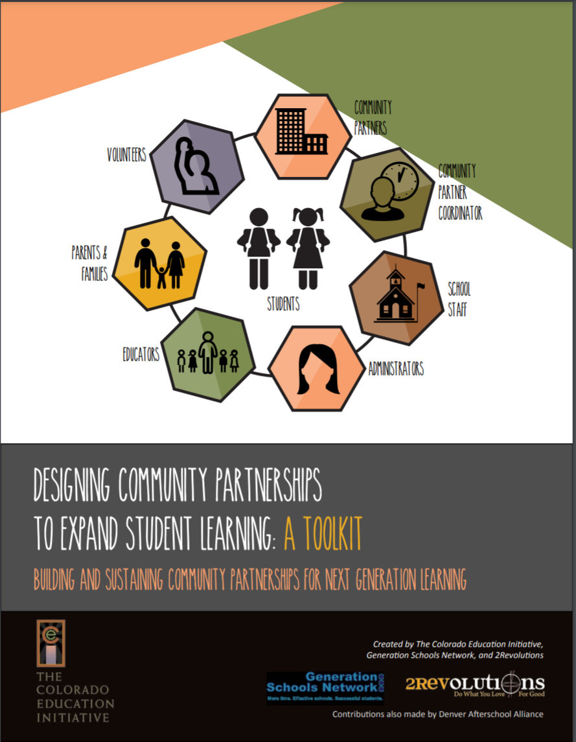
Co-Creation and Innovation
In a co-created summer learning program, teachers, school leaders, families, students and community partners all contribute to create transformative learning environments. Program offerings should be diverse as the community itself and reflect the voice, choice, and interests of its students and families.
Notes:
http://www.coloradoedinitiative.org/wp-content/uploads/2019/03/CEI_CommunityPartnershipToolkit.pdf

Slide 19
Community and Family Voice
Levels of Community Engagement
0 | 1 | 2 | 3 | 4 | 5
Stance Towards Community
Ignore | Inform | Consult | Involve | Collaborate | Defer
Intention
Protecting school/District Interests | Keeping Communities Updated | Receiving Community Input | Meaningfully Engaging Community Voice | Collaborating and Sharing Power with Communities | Communities Drive and Own the Work
Unintended Impact to Consider: Marginalizing Communities | Unintended Impact to Consider: Placating & Underestimating Community Wisdom | Unintended Impact to Consider: Tokenizing & Gatekeeping Community Engagement | Unintended Impact to Consider: Community Voice is Not Heard | Unintended Impact to Consider: Collaborative Process Derailed by Power Dynamics & Lack of Relational Trust | Unintended Impact to Consider: Sovereignty and Core Agreements are Not Honored
Notes:
Https://cf.americanprogress.org/wp-content/uploads/2019/08/StudentVoice-report.pdf?_ga=2.143070325.1132709748.1636672522-1612841301.1635974628
All forms of student voice can be important and can meaningfully influence instruction, schools, and policies. But each approach has trade-offs, and one may be more appropriate to achieve certain goals than others. For example, schoolwide or districtwide surveys provide a snapshot in time with answers to a limited number of largely multiple-choice questions and often measure changes in the views of a large group of students over time. Student leadership through governing bodies or YPAR can allow for meaningful and extended conversations about complex topics and implementation; in most instances, however, this approach engages fewer students.

Slide 20
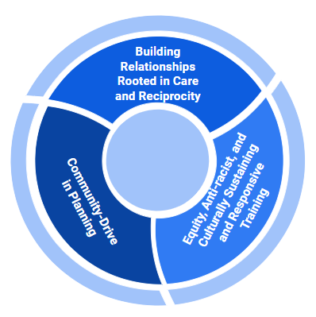
Co-Creation and Co-Learning Environment

Slide 21
Welcoming Environment
SFUSD Family Partnership Toolkits Webpage
How Family Friendly Is Your School Checklist
Notes:
https://www.sfusd.edu/sfusd-family-partnership-toolkits
https://docs.google.com/document/d/1nImIFxU-Ud2ehV23yKxmcq00okNkAbp76vh9ALiDC-8/edit
Pull out aspects from SIA toolkit (Communicating with Tribes,

Slide 22
Community Driven Planning
What it takes to be an effective community partner coordinator
Community partner program coordinators play a unique role. They are by nature boundary-crossers. They are able to work in the school and the community to bridge the culture of each. They have the skills to reach in to teachers and school staff, and reach out to families, residents, and community groups. They possess the planning and organizational ability to bring school staff and partners together to work toward student achievement goals.
Oregon Example
Morrow County CARE Coordinators are one arm of our multidisciplinary CARE program. The CARE coordinators are bilingual staff that are dedicated to working with buildings and families and addressing any barriers that are preventing students from attending school and learning. They build relationships with families and work in partnership with our other wrap-around partners to get families the services they may need. On an average day they will be assisting with families with attendance; helping families through the OHP application process; assisting with scheduling medical/counseling appointment; helping with housing searches; and making connections with students at lunch and recesses.
Notes:
http://www.coloradoedinitiative.org/wp-content/uploads/2019/03/CEI_CommunityPartnershipToolkit.pdf

Slide 23
Who is on Your Summer Learning Core Team?
Principal of Summer Program
Coordinates schedule and Summer Learning Team
Plans professional development and oversees summer learning on site, budget, etc.
Who?
What?
Where?
When?
Why?
Summer Program Director (Coordinator)
Special Education, Title Programs, Curriculum and Instruction, Mental Health and SEL support team members, McKinney-Vento Liaison, Emerging Bilingual Staff, Transportation, Nutritional Services
Key District Team Members
Community Partner Coordinators (CBO, FBO, For Profit, etc.)
Family Advisory Team (PTO/PTA, Family Leadership)
Family Liaisons
Community and Family
Student Voice
Youth Ambassador, Student Governance, Student Representative, Student Surveys

Slide 24
Check Out These Resources!
Please take the next five minutes to explore the items in the Google Folder.
Notes:
https://docs.google.com/document/d/1ClcSMV1wZmqoGFLEJloXtAeldFG9m_DRp3T7AjFC1Tg/edit?usp=sharing

Slide 25
Small Group Discussion
Choose your break-out room:
Strength-Based Student Voice and Choice
Co-Creation

Slide 26
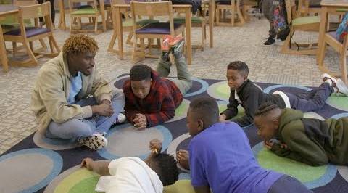
Cultivating Joy, Connection and Curiosity through Well-Rounded Summer Learning
Edutopia How Learning Happens Video Series
Notes:
https://www.edutopia.org/how-learning-happens
Video to play: https://www.edutopia.org/video/learning-opportunities-out-school-time

Slide 27
Summer Learning Webinar Series
Coming Soon!
Notes:
Framing the series, discourse,

Slide 28
Thank you!
Raquel Gwynn, Education Specialist
Office of Teaching, Learning and Assessment
raquel.gwynn@state.or.us
Sophie Hilton, Program Analyst
Office of Teaching, Learning and Assessment
sophie.hilton@state.or.us

