Slide 1
State School Fund
Advisory Committee
Friday, October 29, 2021
9 am to 12 pm
Notes:
Colt
Link to Sldiedeck - anyone can view https://www.oregon.gov/ode/schools-and-districts/grants/Pages/SSFAC.aspx
Waiting Room - Cindy and Natalie
Slides - Tamara
Chat monitoring - Ben and CIndy
Breakout groups and minutes - Natalie

Slide 2
Virtual Community
Keep camera on (unless you need to step out or you have bandwidth challenges). It’s tough to build community if we can’t see each other!
Be aware of your background / surroundings to minimize distractions to others. Children and pets are always welcome!
Mute your microphone when not speaking.
Notes:
Be sure to clarify adults taking care of own needs, planned breaks, restrooms, snacks....Review these daily

Slide 3
Land Acknowledgement
Notes:
Colt
I’d like to acknowledge the many Tribes and bands who call Oregon their ancestral territory and honor the ongoing relationship between the land, plants, animals and people indigenous to this place we now call Oregon. We recognize the continued sovereignty of the nine federally recognized Tribes who have ties to this place and thank them for continuing to teach us how we might all be here together.

Slide 4
Today’s Agenda
Welcome & Introductions
01
02
Group Agreements
03
Overview of Legislation and Process
State School Fund Overview
04
Essential Questions: Small Group Breakouts
05
Closing & Next Steps
06
Notes:
Colt

Slide 5
Welcome & Introductions
Thank you so much for being with us today. Please share:
Your name
Your role
Your organization
After you’ve introduced yourself, please select who will go next.
Notes:
Colt

Slide 6
Background
01
The committee was created by a Budget Note from HB 5006
A one-time $500,000 General Fund appropriation was approved for a study of the impacts of State School Fund spending and to determine if this spending pattern results in disparities between students who are black, indigenous or people of color (BIPOC) and those who are not BIPOC students.
The Oregon Department of Education will award a contract to an experienced researcher who has done research on exploring and modeling education finance policy and practice including research on the effects of fiscal policies and implications on resources at the school and classroom levels. The researcher awarded the contract should have completed at least one multi-year study of weighted student funding. The Department is to provide support and data for the researcher(s).
The Department should also appoint an advisory committee with representatives from various educational advocacy and community groups with experience working with historically underserved students. This committee is to review variations in school level spending across multiple types of expenditures across 25 school districts, and to review the proportion of diverse teachers and students.
The Department is to submit a report with the results and findings of the study and advisory committee by December 15, 2022.
Notes:
Colt
Welcome attendees and thank committee members for their service
Brief Background of how this Advisory Committee came to be
Discuss broader engagement

Slide 7
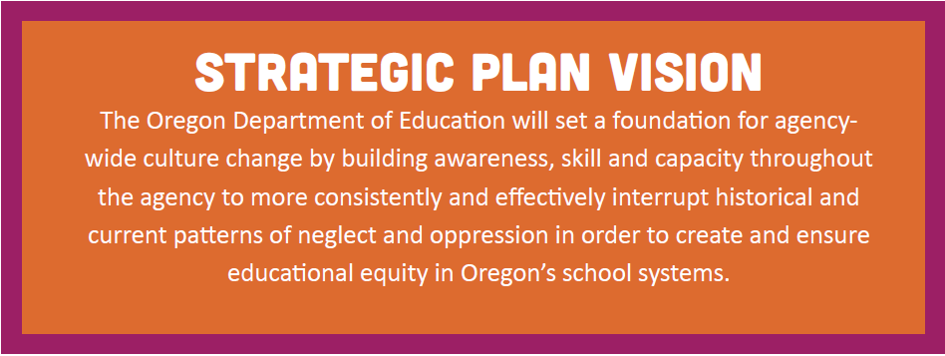
Vision for our Process
01
Our System Change Driver at ODE: Advance Equity, Racial Equity and Antiracist Policy and Practices
Notes:
Colt
Equity Lens and Strategic Plan - Decision Tool
Education equity is the equitable implementation of policy, practices, procedures, and legislation that translates into resource allocation, education rigor, and opportunities for historically and currently marginalized youth, students, and families including civil rights protected classes. This means the restructuring and dismantling of systems and institutions that create the dichotomy of beneficiaries and the oppressed and marginalized.

Slide 8
Aim for our process
01
ANTI-RACIST IN POLICY MAKING
Antiracist Policy
Antiracist
An antiracist policy is any measure that produces or sustains racial equity between racial groups.
Policy: Written and unwritten law, rules, procedures, processes, regulations, and guidelines that govern people.
One who is supporting an antiracist policy through their actions or expressing an antiracist idea
Notes:
Colt
Equity Lens and Strategic Plan - Decision Tool

Slide 9
A Tool for our Process
01
1. Decision Tree
Helps spot patterns or gaps in our thought process. The decision tree is accompanied by a set of starting conditions to review and reflect on at the beginning of the process.
2. Deepening Questions
Offers a raft of prompts to deepen reflections or bring to
community to help get underneath core decision making challenges.
3. Consultancy Protocol
An adaptation of the “Consultancy Protocol,” with credit to the School Reform Initiative, for use in bringing a small group together in consideration of the most difficult design and decision-making dilemmas.
Notes:
Colt
Equity Lens and Strategic Plan - Decision Tool
Self-Care and Readiness in this time:
Toolkit: Communicating about Racial Equity in a Charged Environment - https://content.govdelivery.com/attachments/ORED/2021/08/06/file_attachments/1899611/COSA%20ODE%20Toolkit%20Communicating%20about%20Racial%20Equity%20in%20a%20Charged%20Environment.pdf
ODE PERSONAL SECURITY PLANNING
Personal Security Planning Template: https://docs.google.com/document/d/1ZR_2U2Vwt5njKKVSIJbMIXSmf60xE5TTsu6ezBwcREA/edit?usp=sharing
Slides: Digital Security and Privacy Planning - Google Slides
Script: Digital Security Presentation Script - Google Docs

Slide 10
Take a Stretch Break

Slide 11
Proposed Group Agreements
02
Leave positionality behind: We come to this team as equals, we strive to bring our perspectives and knowledge forward while leaving our positional power behind.
Stay engaged: Staying engaged means “remaining morally, emotionally, intellectually, and socially involved in the dialogue”. Setting our email and phones to the side in critical conversations.
Speak your truth and hear the truth of others: This means being open about thoughts, feelings, and what you think you know and not just saying what you think others want to hear. It also means listening closely to others and trying to understand their perspective without forming your next thought or response in your mind.
Expect and accept non-closure: This agreement asks participants to “hang out in uncertainty”, rumble with problems, and not rush to quick solutions, especially in relation to racial understanding, which requires ongoing dialogue.
Notes:
Carmen

Slide 12
Proposed Group Agreements
02
Experience discomfort: This norm acknowledges that discomfort is inevitable, especially, in dialogue about equity (race, ethnicity, disability, gender, sexual orientation, privilege, etc.), and that participants make a commitment to bring issues into the open. It is not talking about these issues that create divisiveness. The divisiveness already exists in the society and in our schools. It is through dialogue, even when uncomfortable, the healing and change begin.
Commitment to building our trust: All members hold trust or faith with one another to lead with integrity around our decisions. This also means when there is disagreement, discomfort, and hurt that our commitment is to care-front one another with.
All data and information requests will be made through advisory committee facilitators and not directly to ODE staff and results of that request will be shared with the entire committee.
Notes:
Carmen

Slide 13
Proposed Group Agreements
02
What are you letting go of? … How are you transitioning to be fully present today?
What words/phrases stuck out to you when reading the agreements and what resonates with you from these proposed agreements?
After processing the community agreements, determine a focus for you today. Which one will you focus on?
Is there another agreement you need in order to feel fully present and safe?
Notes:
Carmen
It will take a few minutes to put people in groups
Group 1: Ben
Paul Coakley
George Mendoza
Neelam Gupta
Jon Bullock
Cynthia Richardson
Carlos Sequeira
Group 2: Carmen
Toya Fick
Amanda Manjarrez
Kali Ladd
Heather Oliver (FACT Oregon)
Group 3: Tamara
Sonya Moody-Juardo
Jennifer Scurlock
Scott Overton
Margaret Peoples
Angie Peterman
Mike Wiltfong (observer)
Group 4: Cindy
Laurie Wimmer
Morgan Allen
Jim Green
Iris Chavez
Jessica Ventura (observer)

Slide 14
Overview of HB 5006 and Process
03
HB 5006 & Budget Note Summary
ODE’s Role
Timeline
Notes:
Cindy

Slide 15
Oregon Department of Education’s role
03
A one-time $500,000 General Fund appropriation was approved for a study of the impacts of State School Fund spending and to determine if this spending pattern results in disparities between students who are black, indigenous or people of color (BIPOC) and those who are not BIPOC students.
The Oregon Department of Education will award a contract to an experienced researcher who has done research on exploring and modeling education finance policy and practice including research on the effects of fiscal policies and implications on resources at the school and classroom levels. The researcher awarded the contract should have completed at least one multi-year study of weighted student funding. The Department is to provide support and data for the researcher(s).
The Department should also appoint an advisory committee with representatives from various educational advocacy and community groups with experience working with historically underserved students. This committee is to review variations in school level spending across multiple types of expenditures across 25 school districts, and to review the proportion of diverse teachers and students.
The Department is to submit a report with the results and findings of the study and advisory committee by December 15, 2022.
Notes:
Cindy
HB 5006 appropriated $500,000 to ODE for a study of the SSF
Attached in the accompanying budget documents was further direction to ODE about the study
This direction is not law but expresses legislative intent

Slide 16
Oregon Department of Education’s role
03
A one-time $500,000 General Fund appropriation was approved for a study of the impacts of State School Fund spending and to determine if this spending pattern results in disparities between students who are black, indigenous or people of color (BIPOC) and those who are not BIPOC students.
Ensure that the objectives of the legislation are met
Ensure that this direction is centered in the work of the contract researcher and the advisory group
Notes:
Cindy
ODE asked proponents of this note if this was intended to include funding formula inputs into the SSF or expenditures by districts. There was general agreement that it was both.

Slide 17
Oregon Department of Education’s role
03
The Oregon Department of Education will award a contract to an experienced researcher who has done research on exploring and modeling education finance policy and practice including research on the effects of fiscal policies and implications on resources at the school and classroom levels. The researcher awarded the contract should have completed at least one multi-year study of weighted student funding.
Conducting a fair, competitive process that adheres to Oregon’s Procurement laws
Soliciting Proposals through a Request for Proposal process consistent with the objectives of the budget note
Ensuring accountability by establishing deliverables for the researcher
Selecting a contract researcher
Paying the contract researcher based on the contract
Notes:
Cindy
Procurement process applies to this

Slide 18
Oregon Department of Education’s role
03
The Oregon Department of Education will award a contract to an experienced researcher who has done research on exploring and modeling education finance policy and practice including research on the effects of fiscal policies and implications on resources at the school and classroom levels. The researcher awarded the contract should have completed at least one multi-year study of weighted student funding.
Risks and challenges:
Timeline
Procurement backlog at ODE, DAS and DOJ
Limited number of researchers with expertise
Notes:
Cindy
Timeline 6-9 months for over $150,000 contract
A risk is that no qualified bidders respond to the request for proposal

Slide 19
Oregon Department of Education’s role
03
The Department is to provide support and data for the researcher(s).
ODE stands ready to provide required data to both the contract researcher and the advisory committee
Risks and challenges:
Data requests may need to be prioritized due to staffing or time to pull data
Limited data at the school level
Consistency of data across the state
Consistency varies depending on the data collected and the purpose
2020-21 school year was anomalous and has incomplete data in many areas due to pandemic
Data suppression rules to protect student privacy
Notes:
Cindy
Consistency - some data is submitted and is high stakes. For example money is attached to it. This data tends to be more reliable. Whereas other data is less reliable based on how it is collected or the stakes involved

Slide 20
Oregon Department of Education’s role
03
The Department should also appoint an advisory committee with representatives from various educational advocacy and community groups with experience working with historically underserved students. This committee is to review variations in school level spending across multiple types of expenditures across 25 school districts, and to review the proportion of diverse teachers and students.
Appoint advisory committee
Ensure advisory committee is diverse and all voices are heard
Ensure advisory committee meetings are conducted as public meetings
Facilitate advisory committee meetings
Contract for facilitation services
Notes:
Cindy
Public meetings were not required but we felt it was important for a larger group to have access to these meetings for transparency
Meetings are accessible to members of the public. This does not mean that they can participate or disrupt
Send notices of the meetings - two forums for protection
Members of the public may submit written comments to ODE which we will share with the group

Slide 21
Oregon Department of Education’s role
03
The Department is to submit a report with the results and findings of the study and advisory committee by December 15, 2022.
Ensure report is drafted and reflects contract researcher findings and advisory committee findings
Ensure there is a process for seeking and hearing input on draft report
Ensure timeline is met
Present report to legislative committees upon request
Notes:
Cindy

Slide 22
Timeline (Draft)
03
Oct/Nov - 2021 - Advisory committee meets
Request for Proposal process for contract researcher is started
Request for Proposal process for facilitator is started
April 2022 - Contracts awarded
May, June, July - Advisory committee meetings, working with researcher, developing findings, seeking input from community
July 2022 - Researcher submits findings to committee
Notes:
Cindy

Slide 23
Timeline (Draft)
03
Aug 2022 - Draft report open for public comment
Sept 2022 - Feedback incorporated into report, Report finalized
Oct 2022 - Report completed and submitted
Nov 2022 - Legislative days - report presented
Dec 15, 2022 - Report due
Notes:
Cindy

Slide 24
State School Fund: Overview
04
The State School Fund (SSF) represents the State’s largest investment and is the primary source of funding for K-12 public education for approximately 580,000 students. In accordance to mandates outlined in Oregon Revised Statutes, the SSF provides for a variety of revenue transfers and dedicated grants for specific education programs. The balance, in combination with local resources, is disbursed through an equalization formula and provides general operating funds for all school districts and education service districts.
My goal today is to help with understanding of the SSF and the role adequacy, equalization and equity play in the distributions of the SSF.
Notes:
Mike

Slide 25
State School Fund: Overview
04
History:
1990: Measure 5
1991: Minority Teacher Act, 21st Century Schools Act and State School Fund created
1996: Measure 47 (Limited growth of property tax to 3% maximum)
1997: Measure 50 (Clarified Measure 47)
1999: K-12 State support = 70.6% (from 28.6% in 1991)
2000: Quality Education Model established
2007: Major portions of 21st Century School Act abolished
2009: Pendleton SD vs. State of Oregon (sufficient funding for quality education goals)
2011: 40-40-20
2018: Joint Committee on Student Success
2019: Student Success Act
2020: K-12 State support = 66% State and 33% Local Revenue
2021: Of interest, Federal support averages ~10%, but will increase to ~13% due to federal stimulus for next couple years

Slide 26
State School Fund: Overview
04
1. In dollars, the SSF is the largest of ODE’s programs, and the State’s largest GF investment;
2. With local formula revenues, the SSF provides approximately 80% of general operating dollars to school districts and education services districts (ESDs);
3. Allocated through a statutorily required equalization formula adopted in 1991 and
largely unchanged since then;
4. Goals of the formula are to:
Equalize district and ESD funding;
Compensate districts for certain student and
district characteristics through “weights” (equity) and
Maintain local control (discretionary spending).
5. Districts control spending decisions unless the
Legislature directs otherwise.

Slide 27
State School Fund: Overview
04
By the numbers and terminology:
• 19 regional education service districts
• 197 school districts
•~1,400 schools
•~31,000 teachers
•~583,000 students (Head count)
•~573,000 Average Daily Membership (ADM = Full-time equivalency)
•~700,000 Weighted ADM (ADMw)
•~703,000 Weighted ADM (Extended) (ADMwx is used in SSF Formula)

Slide 28
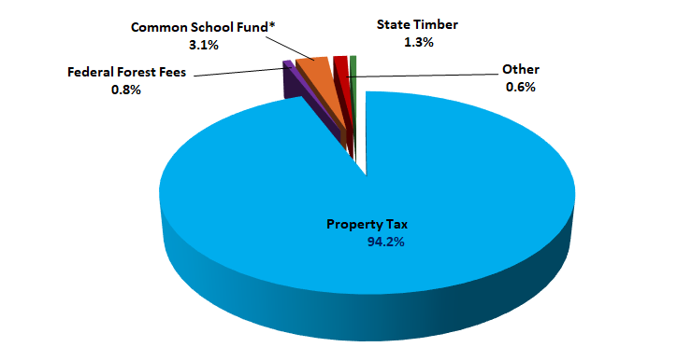
State School Fund: Overview
04
2021-23 Local Revenue
Total Estimated Local Revenue - $4.577 billion

Slide 29
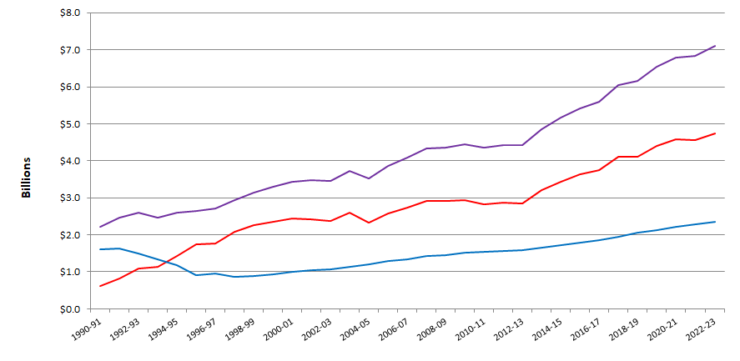
State School Fund: Overview
04
History of SSF Formula Revenue
Key: Blue (Local), red (State), purple (Formula Revenue)

Slide 30
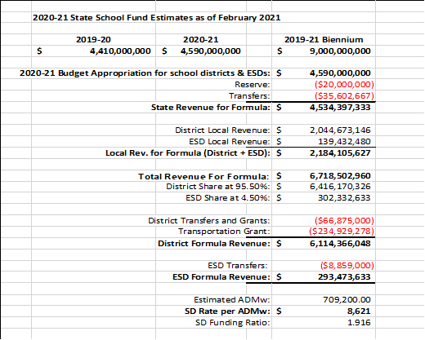
State School Fund: Overview
04
By the numbers:

Slide 31
State School Fund: Overview
04
Examples of SSF Transfers:
State School Fund Transfers | Legal Citation | Amount
Office of School Facilities | ORS 327.008(9) | $6,000,000
10th Grade Assessment | ORS 327.008(14) | $968,000
Talented and Gifted Students | ORS 327.008(15) | $350,000
Speech Pathology | ORS 327.008(16) | $150,000
Virtual School District | HB 5015 (2019) | $1,600,000
Long-Term Care & Treatment and Hospitals | ORS 343.243 | $23,000,000
Educator Advancement Fund | ORS 327.008(12) | $41,198,500
Pediatric Nursing Facilities | ORS 327.008(10) | $4,000,000
English Language Learners | ORS 327.008(13) | $12,500,000
Reduced and Free Lunch Program | HB 5015 (2019) | $3,008,973
Healthy and Safe Schools | ORS 327.008(18) | $2,000,000

Slide 32
State School Fund: Overview
04
The equalization formula for the General Purpose Grant (GPG):
•Multiply the Teacher Experience Adjustment by the school district’s adjustment factor by $25 and then add $4,500. Then multiply this result by the Extended ADMw of the school district and then by the funding ratio, and this is the GPG for the school district.
•The State School Fund Grant for a school district equals the GPG plus their Transportation Grant, which becomes Total Formula Revenue (TFR) for the school district. Then you subtract the school district’s Local Revenue from TFR and the balance becomes the school district’s State School Fund Grant – the State’s contribution.
•(GPG) plus Transportation Grant = TFR
•TFR minus Local Revenues = State School Fund Grant

Slide 33
State School Fund: Overview
04
General Purpose Grant:
(Extended ADMw x [$4,500 + ($25 x Teacher Experience Adj.)]) x Funding Ratio
Total Formula Revenue:
General Purpose Grant + Transportation Grant
State School Fund Grant:
Total Formula Revenue - Local Revenue

Slide 34
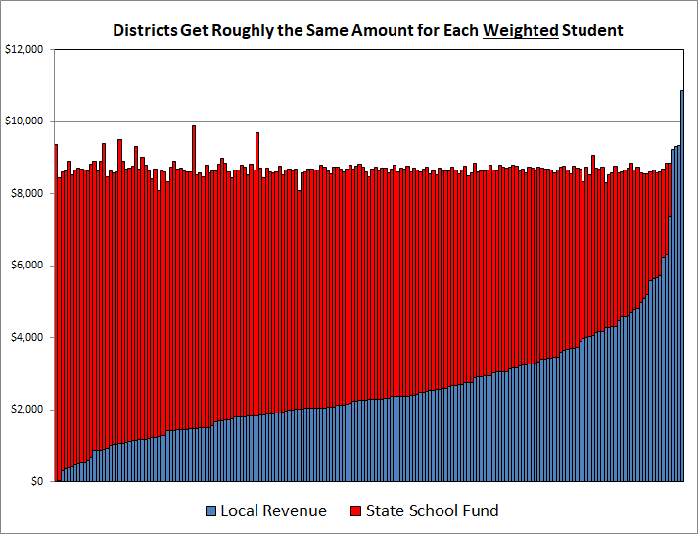
State School Fund: Overview
04
Equalization:

Slide 35
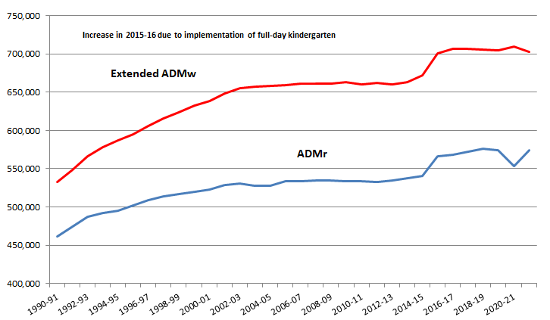
State School Fund: Overview
04
History of ADMr and ADMwx:

Slide 36
State School Fund: Overview
04
Category | Additional Weight
IEP (Spec Ed 11% ADMr cap and waiver) | 1.0
ELL (English Language Learner) | 0.5
Pregnant and Parenting | 1.0
Poverty | 0.25
Foster Care | 0.25
Neglected/Delinquent Students | 0.25
Small School Correction | 1.0

Slide 37
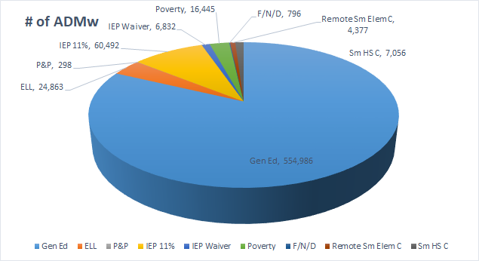
State School Fund: Overview
04

Slide 38
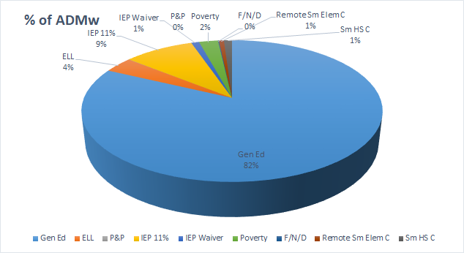
State School Fund: Overview
04

Slide 39
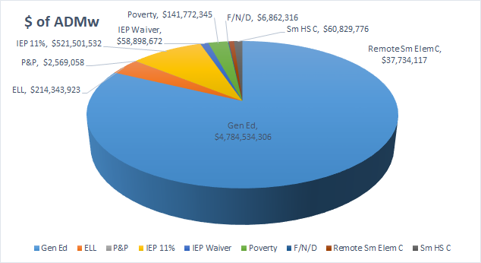
State School Fund: Overview
04

Slide 40
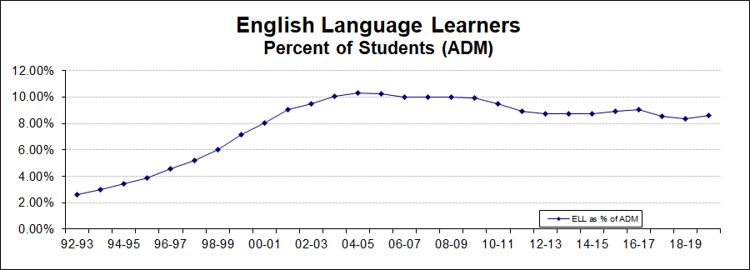
State School Fund: Overview
04

Slide 41
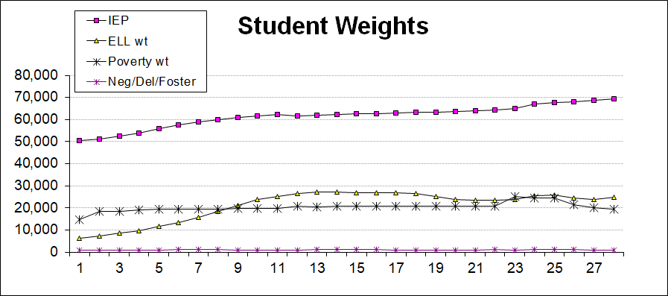
State School Fund: Overview
04

Slide 42
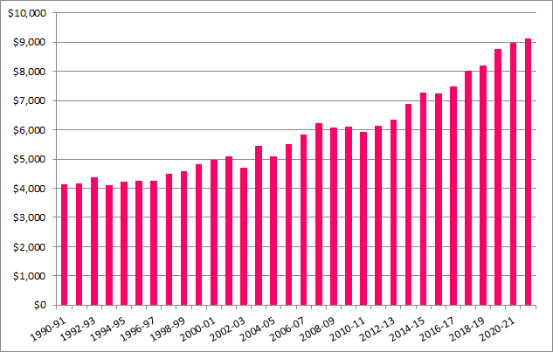
State School Fund: Overview
04
Formula Funding per ADMwx:

Slide 43
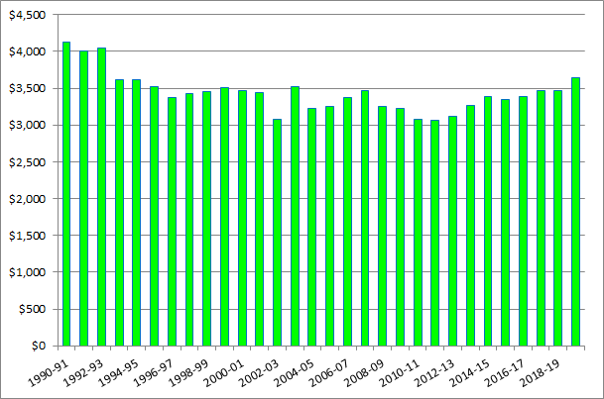
State School Fund: Overview
04
Formula Funding Per ADMw Adjusted for Inflation:
Notes:
Exhibit shows how per-student funding, adjusted for inflation, has declined over time. The measure of inflation used, labeled the Education Price Index, is a weighted average of teacher salary increases and health insurance premiums increases. This index better reflects actual price increases in the education sector than does the Consumer Price Index.

Slide 44
State School Fund: Overview
04
Currently, the State School Fund:
Is a revenue formula, which takes into account local needs and resources, and State needs and resources, and allocates funding statewide based on an equalization formula as prescribed in statute and rule.
Oregon’s equity of resources is identified in the priorities of SSF weighting and carve-outs
Is not a reimbursement grant, a block grant, nor is it an outcomes-based grant
The funding received from the SSF Grant is intended for General Operations and it is at the local school district and community levels to decide how to use their resources unless otherwise directed by the legislature.

Slide 45
Take a Stretch Break
Notes:
Rutila

Slide 46
Essential Questions
05
What questions do you have about this budget note and committee?
What goals or hopes do you have for our work together?
Notes:
Ben
Facilitators will be taking notes on the conversation. This will help the ODE team inform the structure and content of future meetings of this group.
Group 1: Ben
Paul Coakley
George Mendoza
Neelam Gupta
Jon Bullock
Cynthia Richardson
Carlos Sequeira
Group 2: Carmen
Toya Fick
Amanda Manjarrez
Kali Ladd
Heather Oliver (FACT Oregon)
Group 3: Tamara
Sonya Moody-Juardo
Jennifer Scurlock
Scott Overton
Margaret Peoples
Angie Peterman
Mike Wiltfong (observer)
Group 4: Cindy
Laurie Wimmer
Morgan Allen
Jim Green
Iris Chavez
Jessica Ventura (observer)

Slide 47
Next Steps
04
Next meeting:
Thursday, November 4 from 2pm to 5pm
Topics will include:
Student-Level Expenditure Report
Addressing Advisory Member Feedback
RFP for the research component of the work
SSF Advisory Committee Webpage: https://www.oregon.gov/ode/schools-and-districts/grants/Pages/SSFAC.aspx
Notes:
Tamara

