Slide 1
Incident Command System for Schools
Presenter
Date
Conference/Meeting Name

Slide 2
Presentation Overview
Today’s Agenda
Before we begin
Purpose of the ICS
Structure of the ICS
ICS: Key Concepts
How to apply the key concepts.
Where you fit into an ICS
Conclusion

Slide 3
Before We Begin
Coordination With Community Partners
Emergency management and first responders will be in your schools during an incident.
Prior coordination with them will ensure a smooth transition during an emergency.
Coordinate before an emergency happens so that first responders are not surprised by your school’s structure, environment or organization.

Slide 4
Purpose of ICS
Incident Command System: Why?
Inadequate management is the leading cause of incident response failures.
Clear and definable command structure ensures unity of purpose during an incident.
The ICS is part of the National Incident Management System—part of a top-down approach.
The use of ICS is a requirement for all schools and school districts receiving emergency preparedness funding.

Slide 5
Structure of ICS
Incident Command System: How it is structured.
Incident Commander
PIO
Safety
Liaison
Operations
Planning
Logistics
Finance/ Admin

Slide 6
Structure of ICS (explained)
Incident Command System: How it is structured
The ICS is adaptable and scalable—you only activate the sections you need.
The incident commander is responsible for the work of the sections that are not independently staffed.
The command staff assists and advises the incident commander.
Public information officer.
Safety officer.
Liaison officer.
The departments engage in incident response.

Slide 7
Structure of ICS (sections)
Operations Section
The operations section conducts the response.
Likely the first section that will be set up during initial response.
Planning Section
The planning section plans out the response.
Coordinates with the other sections for continued response.
Logistics Section
Responsible for supplying and providing function to the incident response.
Responsible for communications, transportation and supply staging.
Finance and Administration Section
The finance and administration section ensures the bills get paid and people get tracked.

Slide 8
ICS: Key Concepts for Schools
Common Terminology
Use plain English and avoid jargon.
Unity of Command
Each person should only report to one supervisor to avoid confusion.
Span of Control
A concept that describes the appropriate ratio of people supervised per supervisor.
Unified Command
When multiple organizations work together with independent commands they should work together to avoid conflicts of command.
Notes:
There are a number of key concepts that are embedded into the Incident Command System. These four are particularly important for schools and should be considered at every stage of the process: before, during and after an incident.

Slide 9
Common Terminology
Hold! in your room or area. Clear the halls.
First: speak clearly.
Use plain English when communicating.
First responders might not know what an “IEP” is, but they might know what you mean if you say a student has a “Personal Emergency Evacuation Plan”.
Second: Standardize with simple language.
School districts should set the policy for emergency response language for all schools.
Make your emergency drill language standard for all schools.
Share your response language and procedures with your first responders.
Secure! Get inside. Lock outside doors.
Lockdown! Locks, lights, out of sight
Shelter! Hazard and safety strategy.
Evacuate! (A location may be specified)
Notes:
The I Love U Guys foundation has developed a great set of language that aligns with the Incident Command System’s key concepts. It is called the Standard Response Protocol and printable resources are free at their website: iloveuguys.org

Slide 10
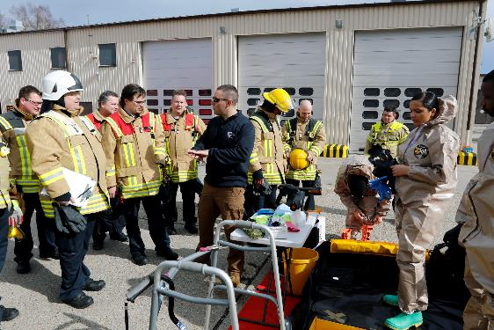
Unity of Command
People should only report to one person!
Multiple supervisors for individuals can end up confusing a response effort with contradictory instruction.
Ensure your teachers and staff know who their one person is who they report to during an emergency.

Slide 11
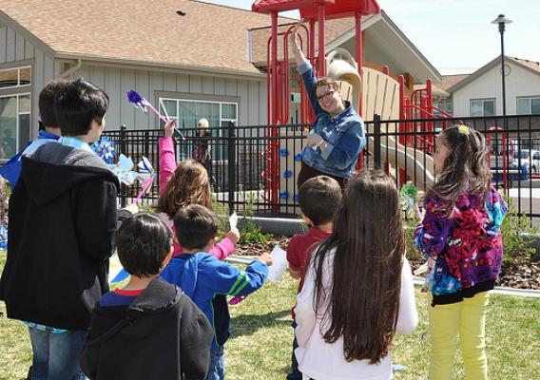
Span of Control
Golden Ratio: 1 to 5.
Having 20 or more students in a classroom is one thing; having 20 teachers report to one assistant principle is another: don’t do that!
Ways to organize this:
Have response teams that collect attendance or status for reporting.
Organize your assembly areas by teams.
English Department as one accountability team; Science Department as another…

Slide 12
Unified Command
Less impactful for schools; a big deal for districts!
The fire department owns the fire. You own the students.
District should have a plan to coordinate their response (such as communication and reunification) in a Unified Command:
Schools know how they communicate with parents.
Schools know how they transport and reunify students.

Slide 13
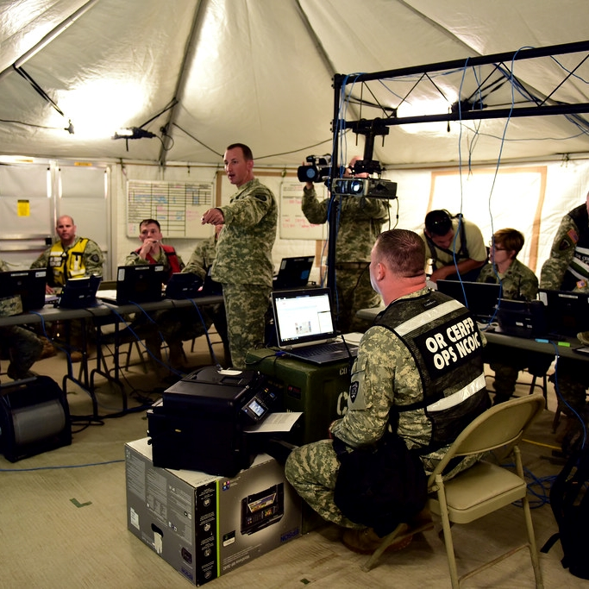
ICS: Keep in Mind
When an ICS is established for an incident or event in a school:
Know who your “Incident Commander” and team leads are before an incident (not always the principle).
The ICS structure is different from the daily administrative structure in order to avoid confusion over whom you should take direction from.
The supervisors of the Incident Command should use the correct ICS titles; these will be different from their daily school position titles.

Slide 14
Where You Fit Into ICS
Initial Response:
Eventually, police, fire, emergency medical services or another external agency will manage response to the incident.
The people already in the building will respond first: you!
You must act as a bridge from the time of initial response until first-responders arrive.
Remember:
Keep the response language simple and in plain English (first responders don’t know your acronyms).
One person only reports to one supervisor.
Don’t overwhelm your team leads or supervisors! Try to keep it to five or fewer people per supervisor.
Coordinate your activities with your first responders before, during and after.

Slide 15
Additional ICS Resources
Recommended Training Resources for Schools:
List of free online courses on ICS: https://www.oregon.gov/ode/schools-and-districts/grants/Documents/Office%20of%20School%20Facilities/SSEM/Training/Free%20Online%20Training_FEMA.pdf
Federal Emergency Management Agency Resources:
A brief (8-page) document that explains ICS in a school environment: https://training.fema.gov/emiweb/is/is100c/english/handouts/ics_for_schools.pdf

Slide 16
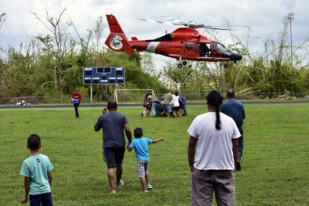
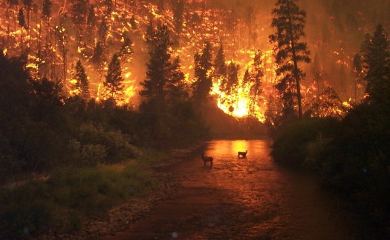
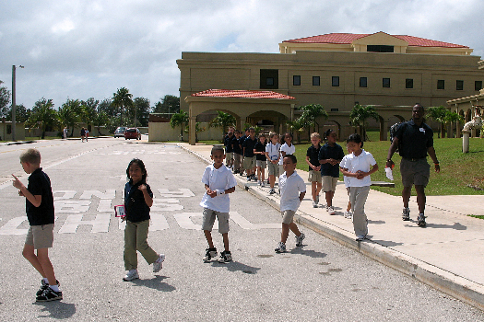
We’re Here to Help
School Safety and Emergency Management:
Provide support to the schools and school districts in Oregon for the development and implementation of high-quality emergency operations plans.
Contact:
Visit our contacts page to connect with your regional trainer.
We will come to you!

