Slide 1
Indirect Rate Calculation
Fixed with Carry-Forward
Indirect Costs + Carry-Forward
Direct Costs + Unallowed Costs
Rate %
=

Slide 2
Cost Classification
Indirect Cost Classification Matrix
Classifications: Direct, Excluded, Indirect, or Unallowed
Fund, function, and object determines the classification
OMB Circular A-87 (additional guidance)
PBAM 2010 (additional guidance)

Slide 3
Direct Costs
Can be identified specifically with a particular cost objective
Examples of direct costs incurred specifically to carry out a specific program
Employee payroll
Travel expenses
Materials/supplies
Office Expenses

Slide 4
Indirect Costs
Common or joint purpose benefiting more than one cost objective
A few examples of indirect costs
Procurement
Payroll
Personnel functions
Maintenance/operations of space
Data processing
Accounting
Auditing
Budgeting
Telephone
Postage

Slide 5
Unallowed Costs
CANNOT be charged to federal awards & included only for purposes of calculating the indirect rate.
A few examples of indirect costs
Bad debts
Contingencies
Entertainment
Fines
Penalties
General governance
Contributions/donations to outside organizations

Slide 6
Excluded
Not included in the calculation
A few examples of indirect costs
Capital outlay
Non-capitalized equipment
Debt service
Judgments (against school districts)
Internal service fund expenditures
Indirect cost recoveries
Fire prevention & safety funds

Slide 7
Carry-Forward Calculation
Based on an estimate of that period’s level of operation
Estimates using actual expenditures
Difference between estimated and actual is carried forward as an adjustment
Adjustment carried forward to 2nd FY
Odd years compared with odd years; even with even
Carry-forward adjustment is either an under or (over) recovery

Slide 8
Adjustments
2 Types of Adjustments: Mandatory & Optional*
Mandatory
General management
Contract expenditures > $25,000 (per contract per FY)
Optional
Terminal leave
Food services
Insurance
Judgments
*See Indirect Cost Plan for a complete list of mandatory & optional adjustments

Slide 9
Non Sub Award Adjustments

Slide 10
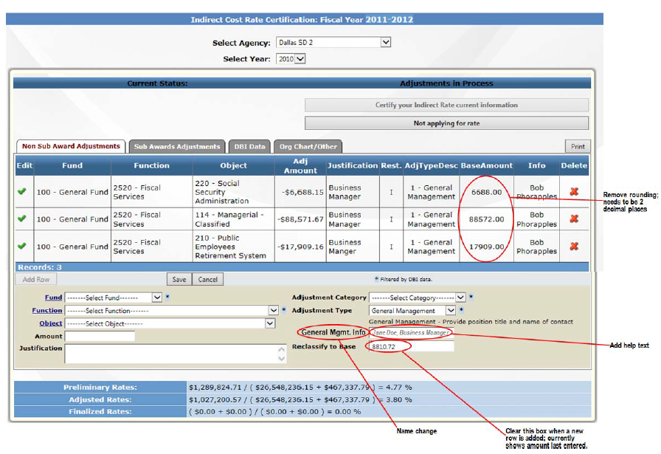
General Management Adjustment

