Slide 1
Essential Skills
Writing Work Samples
Scoring and Calibration
Notes:
The session will provide participants with an in-depth training and calibration to the Official Writing Scoring Guide; including scoring student work samples to meet the Essential Skills requirement. Discussion will include Essential Skills requirement and the procedures for work sample administration. Participants will have an opportunity to work collaboratively on applying feedback on scored samples. Participants are encouraged to bring student samples to score both independently and with colleagues as they apply new their understanding.

Slide 2

Workshop Goals
  Build background and identify changes to the update Official Writing Scoring Guide.
  Collaboratively score a writing work sample to build a common understanding of proficiency.
  Review the guidelines for administering Writing Work Samples for the purpose of Essential Skills.

Slide 3
Partners and Peers
  HS school ELA teacher
  HS school social studies teacher
  Special Education or Title I teacher
  Instructional coach
  Other
Notes:
Note: Teachers should be partnered at the beginning of greeting attendees and placed in tables or groups with like-peers. Depending upon group make-up, you may need to change categories. It is recommended when working with multiple grade level to group teachers by those bands to collaboratively work with peers on the writing scoring guides and work sample calibration activity. Allow SPED teachers flexibility in choosing the group they work most closely with in supporting students. Coaches should be placed with the grade level content band that caters to their strength to contribute to the accuracy of calibration

Slide 4
Collaborative Work Norms
Equity of voice
Active listening
Respect for all perspectives
Confidential and safe
Self-monitor use of electronics/distractions
Notes:
Opportunity to review collective group norms to ground the professional development. Facilitators can add specific language and norms adopted by the school district.

Slide 5
Workshop Goals
  Build background and identify changes to the update Official Writing Scoring Guide.
  Collaboratively score a writing work sample to build a common understanding of proficiency.
  Review the guidelines for administering Writing Work Samples for the purpose of Essential Skills.

Slide 6

Goal 1:
Official Writing
Scoring Guide
Background
Notes:
During this portion, educators will build there background around shifts and focus areas within the Official Writing Scoring Guide. One area to emphasize is the two separate writing scoring guides around Informative/Expository and Narrative. The other emphasis is the Official Writing Scoring Guide is the only instrument to be used for scoring student writing work samples for the purpose of demonstrating proficiency for meeting Essential Skills.

Slide 7
Writing Scoring Guides Descriptors & Definitions
Official Writing Scoring Guides – refers to the updated scoring guides for implementation beginning Fall 2017.
Legacy Writing Scoring Guides – refers to the previous writing scoring guides, which are not aligned the CCSS and are no longer approved.
Notes:
During this point introduce Oregon has only one Official Writing Scoring Guide, which has been adopted for full implementation starting in the Fall instructional year of 2017. This is the only Writing Scoring Guide that is approved in scoring writing samples for the use of determining proficiency for meeting the requirements of Essential Skills as an alternative means. Previous scoring guides have been transitioned to Legacy Scoring Guides.

Slide 8
What is slightly different?
Oregon Modes align with Common Core
Text Types & Purposes
Narrative Narrative, real or imagine
Expository Informative/Explanatory
Persuasive Opinion / Argumentative
Notes:
During this time, the facilitator will identify how the names have changed to align to CCSS. In addition it is important to state the Official Writing Scoring Guide has two different genre text types/purposes specific scoring guides: Narrative and Informative/Expository.

Slide 9
What has remained the same?
6-point scaled rubric.
Four “counting” traits remain the same: Ideas and Content, Organization, Sentence Fluency, and Conventions.
A score of “4 – meets the standard”. (Essential Skills and Local Performance Assessment Manual Guidelines).
Remains the sole instrument approved by the State Board for scoring Essential Skills writing samples.
Notes:
The adopted 2017 Official Writing Scoring Guide remains a 6 point rubric with a 4 indicating a meets/passing score. It is important to reiterate that the Official Writing Scoring Guide is the only instrument for scoring writing samples to meet Essential Skills.

Slide 10
What has Changed?
The Official Writing Scoring Guide includes two separate, but correlated rubrics.
  Narrative Writing
  Explanatory/Argumentative Writing
Shifts in CCSS language occur primarily in the trait areas of Ideas and Content and Organization.
The changes are primarily seen in the “higher” achievement levels of 5 or 6.
Trait 7: “Citing Sources” has become “Use of Sources”.

Slide 11
Informative / Explanatory
& Argumentative
Use of Sources
Is there evidence multiple sources were consulted to support the arguments?
Are there attributions present to acknowledge the source material?
How effectively was source material integrated into the paper?
Was the student successful at avoiding plagiarism by paraphrasing or using quotation marks?
Notes:
While reviewing the changes in the Use of Sources, these components were embedded in the Legacy Writing Scoring Guide and are only included in the Informative/Explanatory & Argumentative Writing Scoring Guide.

Slide 12

Questions or Clarifications?
Photo: Pixabay
Notes:
Respond to questions from the group, add further clarification, or create a parking lot area to clarify outstanding questions at a later time with more guidance.

Slide 13
Workshop Goals
  Build background and identify changes to the update Official Writing Scoring Guide.
  Collaboratively score a writing work sample to build a common understanding of proficiency.
  Review the guidelines for administering Writing Work Samples for the purpose of Essential Skills.

Slide 14

Goal 2:
Official Writing
Scoring Guide
& Calibration

Slide 15




Four Corners Activity
Notes:
4 Corners Activity:
Row boat – just beginning, lots of work, slow going
Motor boat – easier to get from place to place, moves faster
Speed boat – moves quickly
Yacht – can travel long distances with ease, amenities make it easy to handle various conditions

Slide 16
Guiding Questions
    Scoring guide structure?
    Scoring guide language?
    Score levels differences?
    Features of assessed writing?
Notes:
This should be a brief activity discussion. We will examine the scoring guide closely in moments.

Slide 17
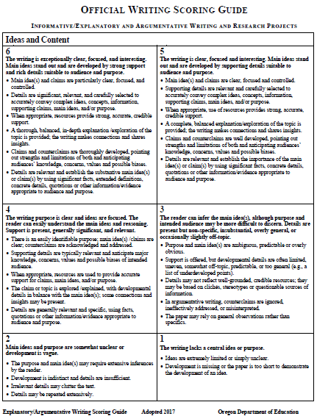
Official Writing Scoring Guide
Oregon’s Official Writing Scoring Guide
Notes:
Provide a brief overview of the scoring guide(s). We will take a deeper dive shortly. It is important to call attention to the two different Official Writing Scoring Guides: Narrative and Informative/Explanatory

Slide 18
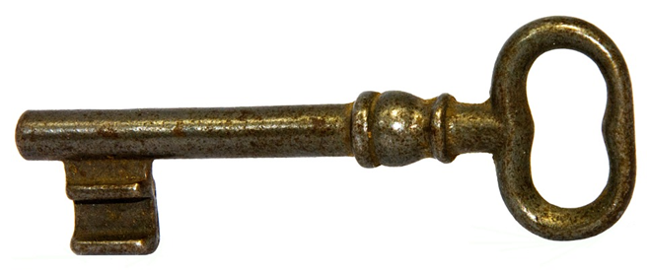
Key Features:
Six-point scale
  Analytic – six or seven traits
    Ideas and Content
    Organization
    Voice
    Word Choice
    Sentence Fluency
    Conventions
    Use of Sources

Slide 19

Ideas and Content
Purpose, main ideas
Stated opinion and reasons
Supporting details
5 – Interesting and thorough / accurate / strong and specific
4 – Adequate / clear / easy to understand
3 – Some / too general / inaccurate or not specific
Photo: Pixabay
Notes:
Direct participants to look at the scoring guide while you share key points for each of the traits. Note: There is a slide for each trait. Encourage participants to highlight key descriptors in the scoring guide as you go through each trait.

Slide 20

Organization
Order and structure
Use of transitional
strategies
Introduction and
conclusion
Sequencing
Paragraph breaks
5 – Thorough / very easy to follow / interesting
4 – Developed / makes sense
3 – Some / underdeveloped / same
Photo: Pixabay

Slide 21

Voice
Engages reader
Interest in the topic
Liveliness, sincerity, honesty,
excitement
5 – Lively / sincere / exciting / honest / very interested
4 – Parts / helps reader engage / seems interested
3 – Not/ little interest
Photo: Pixabay

Slide 22
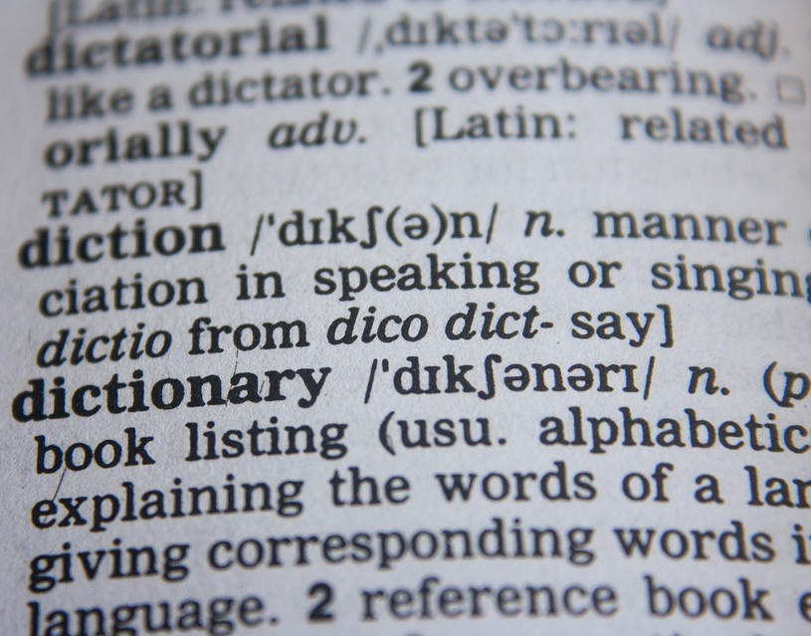
Word Choice
Accuracy and precision
of word use
Content vocabulary
Variety
5 – Interesting and precise / many rich content vocabulary words
4 – Variety of words / many content vocabulary words
3 – Little variety / repetition / some content vocabulary words
Photo: Pixabay

Slide 23

Sentence Fluency
Ease in reading out loud
Variety in sentence beginnings
Variety in sentence lengths
Variety in sentence patterns
5 – Smooth / very easy to read out loud / many different
4 – Easy to read out loud / different
3 – Parts are easy to read out loud / same
Photo: Pixabay

Slide 24
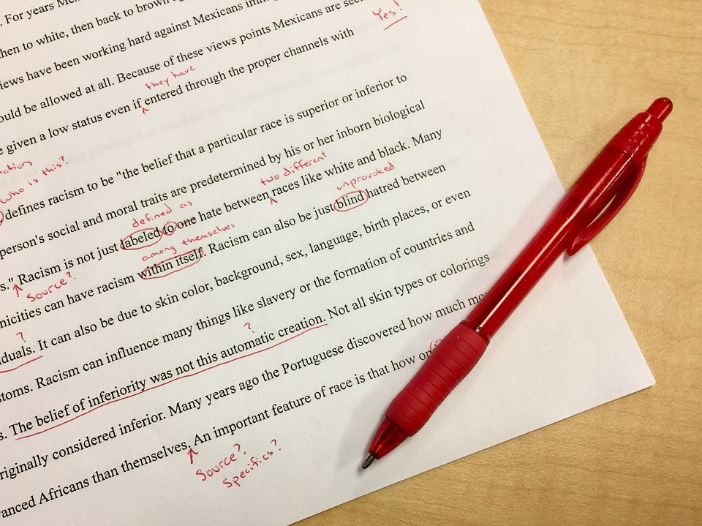
Conventions
Punctuation
Spelling
Capitalization
Grammar and usage
5 – Higher-level / correct / little need for editing
4 – Usually correct / requires some editing
3 – Some errors distract reader / much editing needed
Photo: Pixabay

Slide 25

Use of Sources
Variety of sources
Quantity and quality of
information
Accuracy
List of sources
5 – Specific information / several sources / accurately cited /uses quotations or paraphrases
4 – Uses information / several sources / accurately identified / summarizes or paraphrases
3 – Some information / mainly one source / may be incorrectly identified / may include copied text
Photo: Pixabay

Slide 26

Questions or Clarifications?
Photo: Pixabay
Notes:
Activity: Highlighting Key Feature

Slide 27
Highlighting Key Features
Examine the key language at achievement level “4” and highlight using the yellow highlighter.
Examine the key language at achievement level “3” and highlight using the pink highlighter.
Examine the key language at achievement level “5” and highlight using the orange highlighter.
Notes:
Activity: Highlighting Key Feature

Slide 28

Anchor Papers
Examples of student work that exemplify the attributes of a certain score level and that serve as a standard against which other papers or performances can be judged.

Slide 29

Gathering Evidence and Scoring
Gathering Evidence
and Scoring
Photo: Pixabay
Notes:
Participants will start by looking at Narrative writing anchor papers and then repeating the steps for Informative/Explanatory writing anchor papers.
Ideally educators will score three various levels from each genre type, however this could be streamlined to two anchor papers per genre type. The starting anchor paper is recommended to be a medium or on-level passing anchor paper with the other two being a slightly below (med-low) and slightly above (med-high) anchor paper. The purpose of choosing the on level is to firmly create a starting point for educator discussion when looking at the other two anchor papers.

Slide 30
Step 1: Individually
Read and Identify
Evidence
Ideas and Content
Organization
Voice
Word Choice
Sentence Fluency
Conventions
Use of Sources
Identify evidence related to each trait while reading the student writing.
Notes:
This slide is a reminder of the 4 traits that count towards Essential Skills Scoring Traits and Use of Sources is included in the Informative/Expository Writing Scoring Guide.
Emphasize the fact that the more familiar a person is with the language of the scoring guide they are using, the quicker the scoring process. Tell participants that you will display this side again when they get ready to score a paper. It already appears in the slide deck again at the appropriate location.

Slide 31
Step 2: Record Key Features from the Scoring Guide
Look for a preponderance of evidence to determine a score.
After you identify pieces of evidence in student essays, record any key vocabulary in the scoring guide as evidence.
Notes:
As participants read the student anchor papers, they will use the highlighted key vocabulary from the Official Writing Scoring Guide to identify the preponderance of evidence - the greater weight of the evidence to decide in favor of one side or the other.

Slide 32

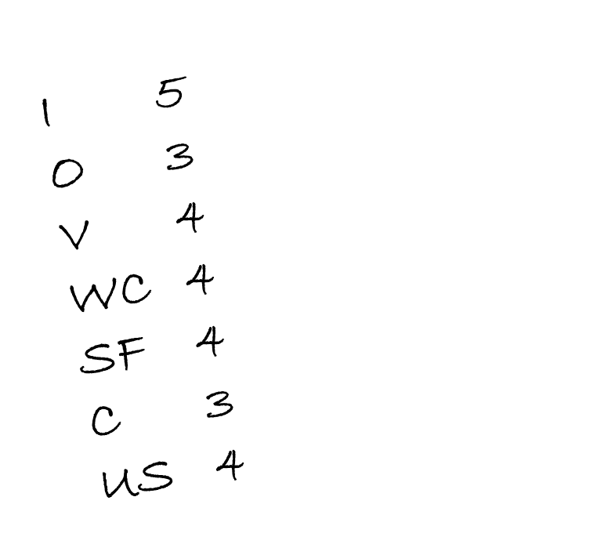
Step 3: Write
Your Scores on a Sticky Note
Notes:
Once participants have read and identified evidence, they will record their score on a sticky note to share with the team during the collaboration and justification activity.

Slide 33
Step 4: Chart Your Scores and Justify in Collaborative Group
Trait | 6 | 5 | 4 | 3 | 2 | 1
Ideas & Content |  | // | /// | /
Organization |  | // | ////
Voice |  | /// | ///
Word Choice |  | // | // | /
Sentence Fluency |  |  | /// | ///
Conventions |  |  | // | ////
Use of Sources |  | / | // | ///
Notes:
Teams will share out their scores within their group and a designated recorder will chart the teams scores. Tell participants to focus on traits with discrepancies, try to come to consensus. Each participant should support scores using both language from the scoring guide and evidence from the student writing.
Consensus may not be 100% agreement. Sometimes it is okay to agree to disagree.

Slide 34

Step 5: Compare Your Results With Scores and Commentary
Notes:
Before you show this slide, encourage participants to only look at the scores and commentary for paper A. If they look ahead at other scores they will not get an accurate picture of their own accuracy.

Slide 35

Any Questions
Photo: Pixabay

Slide 36
Individually
Read and Identify
Evidence
Ideas and Content
Organization
Voice
Word Choice
Sentence Fluency
Conventions
Use of Sources
Identify evidence related to each trait while reading the student writing.
Notes:
This slide is a reminder of the 4 traits that count towards Essential Skills Scoring Traits and Use of Sources is included in the Informative/Expository Writing Scoring Guide.
Emphasize the fact that the more familiar a person is with the language of the scoring guide they are using, the quicker the scoring process. Tell participants that you will display this side again when they get ready to score a paper. It already appears in the slide deck again at the appropriate location.

Slide 37
Repeat the Process for Sample B/C
Individually, Read and Identify Evidence
Record Key Features from the Scoring Guide
Write Your Scores on a Sticky Note
Chart Scores and Justify
Compare Your Results With Scores and Commentary
Wait for the next direction before you look at scores and commentary

Slide 38
Informative / Explanatory
& Argumentative Calibration
Individually, Read and Identify Evidence
Record Key Features from the Scoring Guide
Write Your Scores on a Sticky Note
Chart Scores and Justify
Compare Your Results With Scores and Commentary
6. Repeat the Process for Sample D
Notes:
Participants will go through a similar activity utilizing the Informative/Explanatory Writing Scoring Guide

Slide 39

Questions or Clarifications?
Photo: Pixabay
Notes:
Respond to questions from the group.

Slide 40
Workshop Goals
  Build background and identify changes to the update Official Writing Scoring Guide.
  Collaboratively score a writing work sample to build a common understanding of proficiency.
  Review the guidelines for administering Writing Work Samples for the purpose of Essential Skills.

Slide 41

Goal 3:
Administering Writing Work Samples for Essential Skills

Slide 42
What about Essential Skills?
Work Samples are still one way students can demonstrate proficiency in writing for Essential Skills.
Students produce two passing samples; one must be Informative/Explanatory or Argumentative.
Minimum score of 4 in Ideas, Organization, Sentence Fluency, Conventions.
Revision is an allowable option.

Slide 43
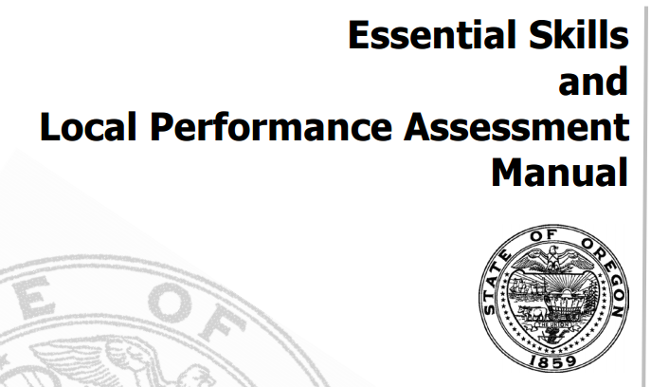
Work Sample Administration
Work Sample Administration
Notes:
Refer to ES manual for recommendations, requirements, and clarifications.

Slide 44
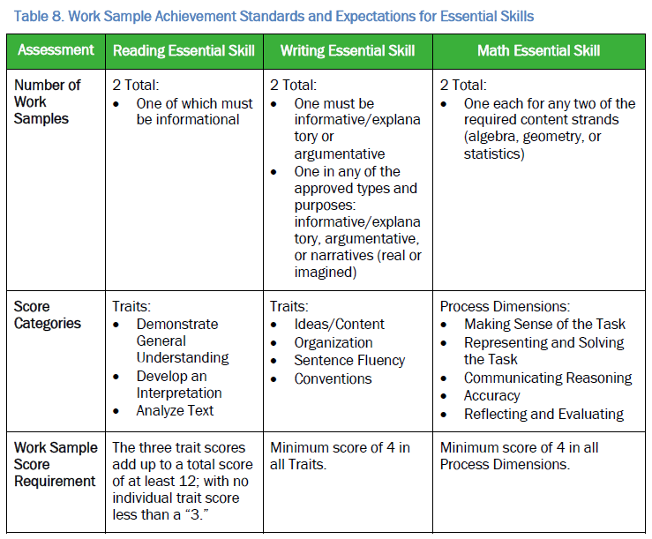

Work Sample Administration
Work Sample Administration

Slide 45
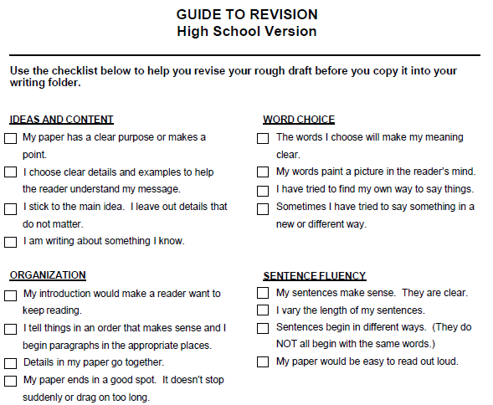
Work Sample Resources
Work Sample Resource
Universal Tool
Notes:
Inform participants this is a portion of the Guide to Revision and to access the complete version to visit the Writing Essential Skills web page.

Slide 46
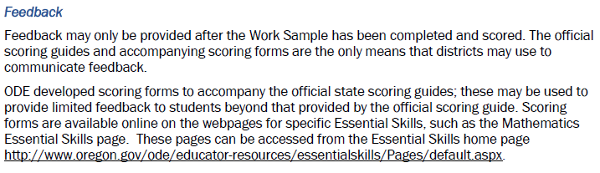
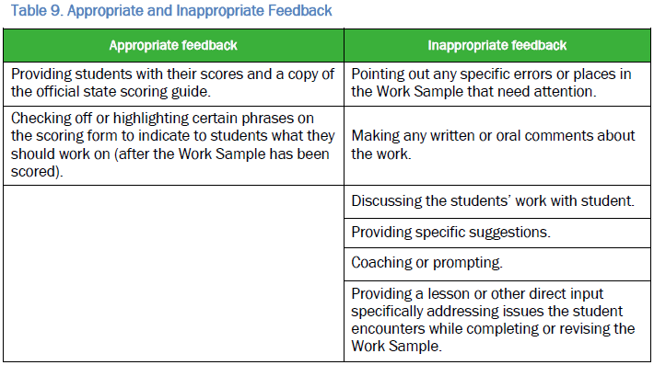
Work Sample Feedback
Work Sample Administration
Appropriate Feedback

Slide 47
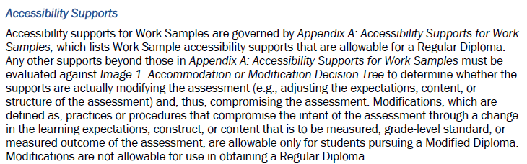
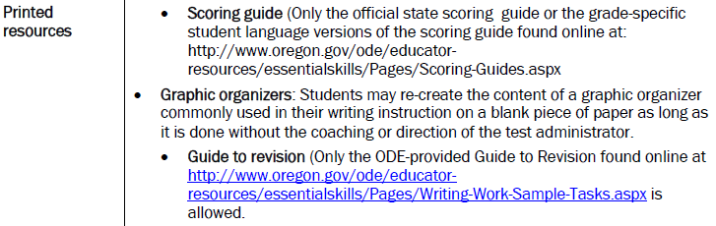
Work Sample Supports
Work Sample Administration

Slide 48
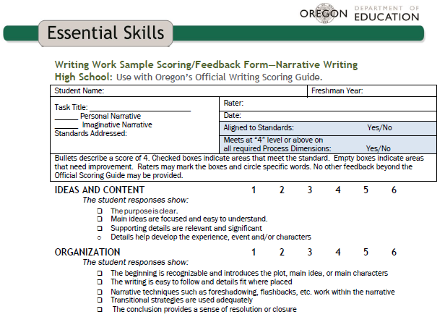
Work Sample Feedback Form
Work Sample Administration
Appropriate Feedback (Essential Skills)
Notes:
Inform participants this is a portion of the Feedback Form and there are two separate forms: Narrative and Informative/Expository.
Extended activity: Participants refer back to either a Narrative or Informative/Expository and practice highlighting a blank Official Writing Scoring Guide as a feedback tool or complete the Essential Skills feedback form.

Slide 49

Work Sample OR Skills
Work Sample Resource
Task Bank and Scoring

Slide 50

Contact Information
Contact Information
Tony Bertrand
ELA & Social Sciences
Assessment Specialist
É503-947-5832
* tony.bertrand@state.or.us

