Slide 1
Training Module 10
Remote Testing
Copyright © 2020 Cambium Assessment, Inc. All rights reserved.
Notes:
Welcome to the Remote Testing training module. This module will walk you through information and administration features of remote testing

Slide 2
Objectives
This module will explain components of remote administration requirements:
Overview of Remote Administration Testing Window | Overview of Remote Testing and Infrastructure
Student Eligibility for Remote Testing Participation | Preparing your Computer and Other Technology: Responsibilities and Expectations
Parent/Guardian Consent Requirements for Remote Testing Participation | Accessing the Remote Test Administration Certification Course
Remote Testing Administration Guidance | Checklist and Contact Information for Technical Support
Notes:
This module will provide information on the following topics:
Overview of Remote Administration Testing Window
Student Eligibility for Remote Testing Participation
Parent/Guardian Consent Requirements for Remote Testing Participation
Remote Testing Administration Guidance
Overview of Remote Testing and Infrastructure
Preparing your Computer and Other Technology: Responsibilities and Expectations
Accessing the Remote Test Administration Certification Course
Checklist and Contact Information for Technical Support

Slide 3
Overview of Remote Administration Testing Window
Notes:
Let’s start with an Overview of Remote Administration Testing Window

Slide 4
Rationale
States must assess students in order to:
Meet ESSA statewide assessment requirements
Provide data to help families, schools, districts, and the state understand and improve student academic achievement
Remote administration provides additional access to statewide assessments for schools who deliver instruction using remote, virtual, or online models
Notes:
First districts and schools are required under ESSA and Division 22 to administer the Oregon Statewide Summative Assessment.
This information provides data to help families, schools, districts, and the state understand student academic achievement and provides signals to monitor the systems at the local level and throughout Oregon to evaluate how the Oregon education system is functioning.

Slide 5
Remote Testing Test Window
Assessment | Assessed Grade | Test Window
OSAS ELA, Math, and Science | Grade 11 | 2/6/24 – 6/14/24
ELPA | K, 1, 2-3, 4-5, 6-8, 9-12 | 3/5/24 – 4/12/24
OSAS Science | Grade 5 and 8 | 3/5/24 – 6/14/24
Student Educational Equity Development Surveys (SEED) | Grade 3 – 11 | 3/5/24 – 6/14/24
OSAS ELA and Math | Grade 3 – 8 | 4/2/24 – 6/14/24
Notes:
The remote testing window will open on different dates based on the specific content areas and grade levels.
The high school OSAS remote test window for ELA, Math, and Science will open earlier than other tests or surveys. This window will open February 6th and close on June 14th
The English Language Proficiency Assessment or (ELPA) is administered to students kindergarten through 12th grade who are receiving English Learner services and has a test window of March 5th through April 12th .
You will notice the ELPA window is much shorter than the other windows. It is necessary to have all ELPA results completed by April 12th to allow for scoring and reporting to district by the end of the academic calendar and to allow districts and schools to make decisions on future English Learner services. Therefore, districts and schools should prioritize remote administration of ELPA before students begin the other Oregon Summative Assessments or survey.
Both the OSAS Science test and the SEED survey will also open on March 5th, but they will close on June 14th and finally the OSAS ELA and Math tests for students in grades 3 through 8 will open on April 2nd and close on June 14th

Slide 6
School Eligibility for Offering Remote Testing
Notes:
This next section will discuss which students are eligible to participate in remote testing.

Slide 7
Remote Testing Eligibility
Most students across Oregon will test in-person. Administration of the Oregon Statewide Summative Assessments should align to a school’s instructional model.
If a school predominantly provides students in-person instruction, students will test in-person (even individual students who may receive instruction remotely).
If a school provides a student predominantly remote or online instruction, they may offer that student summative assessments remotely.
Notes:
Most students across Oregon will test in-person.
Students whose primary instruction model was “in-person” will participate in the Oregon Summative Assessments in-person as aligned to there schools instruction model.
Students who participate remote or online instruction, may be offered the opportunity to participate in summative assessments remotely.
In certain circumstances the districts or schools might have students participate in in-person testing even if the received their instruction remotely or online. We will explain those scenarios in the next slide.

Slide 8
Remote Testing Eligibility Cont.
Even if a school that delivers remote or online instruction may not be able to offer remote testing to a given student if the following apply:
Technology limitations for the TA or the Student
(i.e., limited broadband, hardware requirements, or assistive technology)
Accessibility needs cannot be supported
(i.e., Designated or Accommodation Supports)
Student is participating in
Oregon Extended Assessment or the Alternate ELPA
Oregon’s Statewide Assessments Braille version
If any of the following apply a district/school personnel should work with the student and family to schedule the tests at an alternate location (i.e., district, or school site).
Notes:
Some districts and schools might need to make alternate in person testing opportunities for students participating in a remote or online instructional model.
If a school has…
Technology limitations for the TA or the Student such as limited broadband, hardware requirements, or assistive technology
Or if a school identifies
Accessibility needs cannot be supported such as Designated or Accommodation Supports
And if a Student is participating in either the
Oregon Extended Assessment or the Alternate ELPA or any… Oregon Statewide Assessment presented in a Braille version
They will not be able to provide remote testing and will need to work with the student and family to schedule the tests at an alternate location such as a district office or alternate school site.

Slide 9
Parent/Guardian Consent Requirements for Remote Testing Participation
Notes:
The following section describe the Parent/Guardian Consent Requirements for Remote Testing

Slide 10
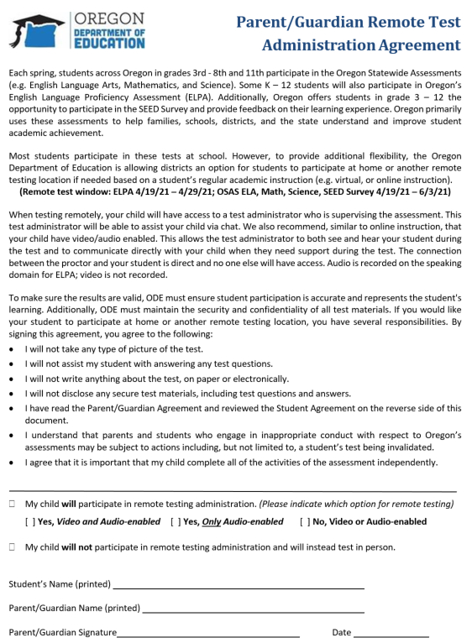
Obtaining Parent/Guardian Consent
Consent from a parent/guardian is required for a student to participate in a remotely proctored test session
Use ODE Parent/Guardian Remote Test Administration Agreement Form or the process your DTC has provided to obtain consent.
Parent will indicate if they will or will not allow for participation in remote test administration
If a child will participate in remote test administration, they will indicate whether they will have the video/audio enabled or not enabled
Student participation in remote testing does not require that a student video or audio is enabled during the test session
Notes:
Consent is required for a student to participate in a remotely proctored test session. The Oregon Department of Education has provided a consent form districts should use to get written verification of consent. Please check with your district on communication and the district’s process for gaining parent guardian permission.
Even if a student is receiving their instruction remotely or online, a parent has the right to request in-person testing for their child. The Parent/Guardian Remote Test Administration Agreement Form has two check boxes to indicate the preference for their child participating in the Oregon summative assessments. Either my child will… or My child will not… participate in remote testing
Additionally the form indicates whether the student will utilize their webcam and thus have video and audio enabled, audio only or no video or audio enabled.
Student participation in remote testing does not require that a student video or audio is enabled during the test session. However it is important to note and communicate to families that the only form of two-way communication without the video and audio or audio only enabled is an embedded chat feature within the remote testing platform and therefore technical support might be limited.

Slide 11
Parent/Guardian Consent and Remote Test Settings in TIDE
Notes:
Permissions must be set in TIDE to allow a student to participate in remote administration. TIDE also indicates if video permission has been obtained from the parent or guardian.

Slide 12
Obtaining Parent/Guardian Consent Cont.
If a parent/guardian provides consent, the permissions must be set in TIDE to allow a student to participate in remote administration.
* If no bubble has been selected in TIDE, the system will automatically default to “No”
Notes:
If a parent/guardian provides consent, the permissions must be set in TIDE to YES in the Remote Tester setting at the student level.
In some cases if there are large number of students participating in remote testing a DTC, STC, or TA might want to utilize a batch upload to the TIDE system. Please refer to the TIDE User Guide for more information on batch uploads.
Please note that all students in TIDE will have the remote tester radio buttons. It is not necessary to change this setting for all students If no bubble has been selected in TIDE, the system will automatically default to “No”
Again, the radio button must be selected yes for the remote testing functionality to work for summative assessments and/or the SEED survey and even the Oregon Interim Assessments

Slide 13
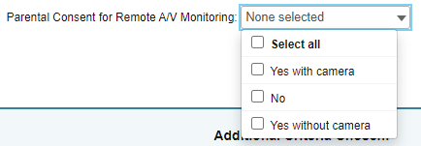
Obtaining Parent/Guardian Consent Cont.
Video permission must also be set in TIDE.
*If no drop-down has been selected in TIDE, the system will automatically default to “No”.
However, DTCs, STCs, or TAs should verify this TIDE setting is accurately set prior to remote administration based on the Parent Guardian Remoter Testing Administration Agreement Form.
Notes:
If the parent has granted permission for their child to have video or audio enabled during remote testing, the DTC, STC, or TA will need to indicate the preferences within TIDE.
Similar to the remotes testing setting… If no drop-down has been selected in TIDE, the system will automatically default to “No”.
However, DTCs, STCs, or TAs should verify this TIDE setting is accurately set prior to remote administration based on the Parent Guardian Remoter Testing Administration Agreement Form.

Slide 14
Remote Testing Administration Guidance
Notes:
In the following section we will provide some general guidance on remote test administration and distinguish differences for remote testing using the OSAS Secure Browser.

Slide 15
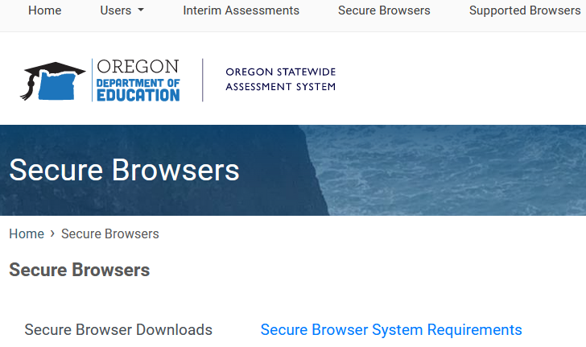
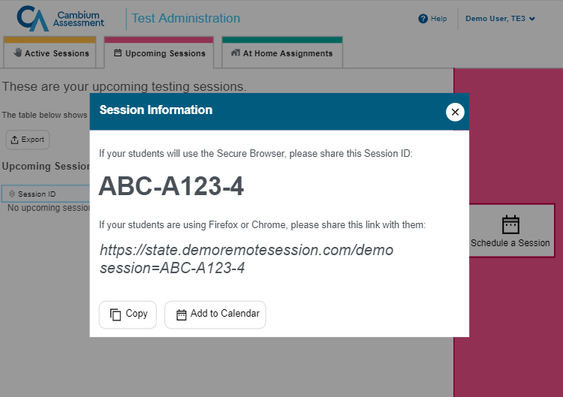
Remote Test Administration Formats within the Oregon Statewide Assessment System (OSAS)
There are two pathways for remote test administration.
OSAS Secure Browser
Remote Student Testing Web Link
Notes:
Based on the assessment or survey within the Oregon Statewide Assessment System there are two pathways for remote administration.
The first is the OSAS Secure Browser. This is the same Secure Browser students use to access the Oregon Summative Assessment in-person. The OSAS Secure Browser can be downloaded to electronic devices by visiting the www.OSASPortal.org and downloading the secure browser based on the electronic device’s operating system.
The second pathway is using a Remote Student Testing Web Link within the Test Administrator Session Manager. Specifics about creating a Remote Student Testing Web Link is covered in the Remote Testing Certification Course required for TAs managing remote testing.
We will discuss which assessments or surveys will use which pathway for remote testing in the next few slides.

Slide 16
Remote Administration: OSAS Secure Browser
All Oregon Statewide Summative Assessments are required to be administered using the OSAS Secure Browser:
ELPA
OSAS ELA
OSAS Math
OSAS Science
* The SEED Survey and Interim Assessment can be administered remotely using either the OSAS Secure Browser or the Remote Student Testing Web Link.
Notes:
All Oregon Statewide Summative Assessments are required to be administered using the OSAS Secure Browser: ELPA, OSAS ELA, Math, and Science.
The SEED Survey and Oregon Interim Assessments can be administered remotely using the OSAS Secure Browser but it is not required.

Slide 17
Remote Administration: Remote Student Testing Site
The SEED Survey and Interim Assessment are the only two components that can be administered remotely using a Remote Student Testing Web Link.
The SEED Survey also allows a remote assignment feature, which is explained in the Remote Testing Certification Course
* Oregon Statewide Summative Assessments (ELPA, OSAS ELA, OSAS Math, and OSAS Science) CAN NOT be administered using a Remote Student Testing Web Link.
Notes:
As previously mentioned, when a TA is creating a test session within the OSAS Portal, they will be able to schedule a remote testing session. This allows the user to obtain a Remote Student Testing Web Link which can then be shared with students who do not have the secure browser loaded on their device. The Remote Testing Certification Course required for remote administration will provide further guidance for creating
The SEED Survey and Oregon Interim Assessment are the only two components that can be administered remotely using a Remote Student Testing Web Link.
The Oregon Statewide Summative Assessments (ELPA, OSAS ELA, Math, and Science) CAN NOT be administered using the Remote Student Testing Site and again must be administered using the OSAS Secure Browser only. If a district is unable to load a secure browser on the student’s device, they will need to arrange an alternate “in-person” opportunity.

Slide 18
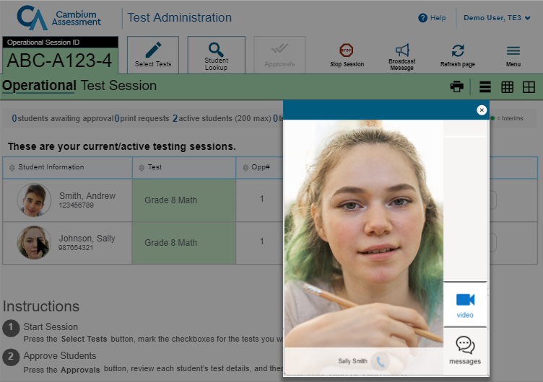
Remote Administration Guidance: Proctoring to A Group of Students
ODE and Cambium Assessment recommend that a TA test no more than five students at a time during one active remote session.
TAs will be able to communicate with a
group or individual students via chat
or video/audio if enabled.
Specific guidance is provided in the Remote Testing Certification Course
Notes:
It is recommend that a TA test no more than five students at a time during one active remote session. This will allow a TA to be able to remotely support students experiencing any testing or technical difficulties quickly and avoid disrupting students. ODE will continue to monitor district/schools needs and adjust recommendations accordingly.
TAs will be able to communicate with students based on the Parent/Guardian Consent Form and how the student’s settings have been recorded in TIDE. Again the parent must allow for use of video/audio, or audio only. If neither of these options have been allowed, the TA will need to utilize the chat platform.
The group chat feature is also another tool a TA can use for communicating with all students who are participating in an remote testing session.
The Remote Testing Certification Course required for remote administration will provide further directions on how to use these tools.

Slide 19
Remote Administration Guidance: Remote Testing and Assessment Sessions
Once a student begins a remote test, they must complete that test in its entirety in the remote format.
If a student changes their location and tests at an in-person site, they will still need a remote testing session to complete their test started remotely.
The remote ELPA is broken out by domain. Each of these domain testing instances will require the student to log in anew.
Reading
Writing
Listening
Speaking
Notes:
Once a student begins a remote test, they must complete that test in its entirety in the remote format. If a student changes their location and tests at an in-person site, they will still need a remote testing session to complete their test started remotely.
For instance, if a student begins their OSAS Science Assessment in a remote testing session, they will need to have the TA create a remote session ID so that they can complete their OSAS Science Assessment
It is also important to note that unlike the in-person ELPA, the remote version of the ELPA is broken out by domain in which each of these testing instances appear as a separate tests with the student needing to log back into the system.
For example, if a student starts the ELPA Reading domain, they will complete all components of the ELPA Reading domain and press end test. They will then need to once again log back into the remote testing platform and select the next ELPA domain, writing and be approved by the TA to begin this domain of the ELPA. The same will be true for starting the listening domain and the speaking domain.

Slide 20
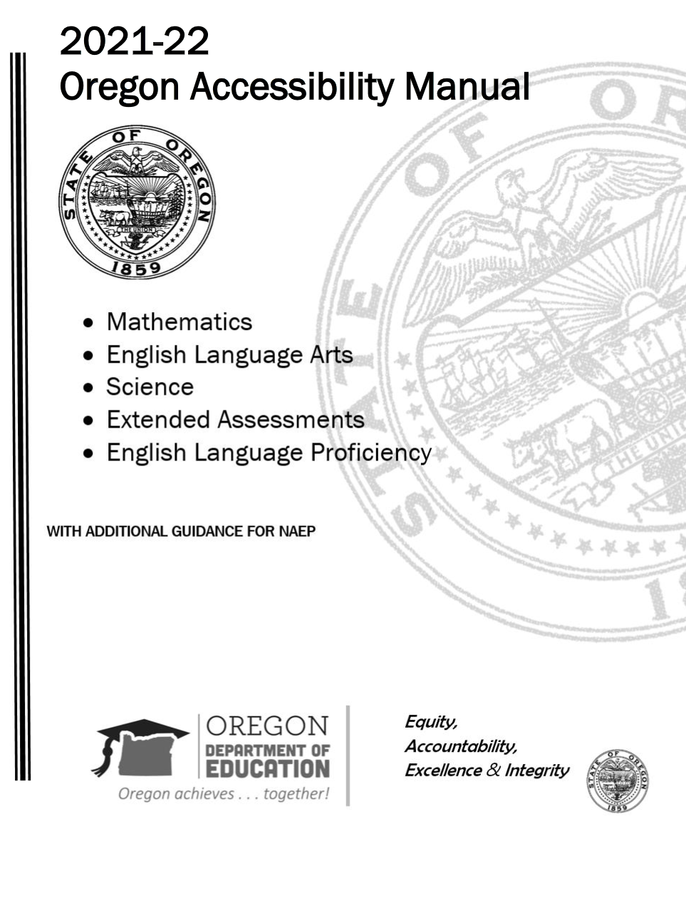
Remote Administration Guidance: Accessibility Supports
It is the responsibility of the District/school to ensure that all students have the appropriate accessibility supports in place during remote test administration (This includes accommodations within an IEP or 504).
For Oregon’s Statewide Assessments, districts and schools may only make available to students the universal tools, designated supports, and accommodations that are included in the OAM.
* If access to necessary technologies cannot be provided to students at home, districts should work with their families to determine other options for taking the test.
Notes:
It is the responsibility of the District/school to ensure that all students have the appropriate accessibility supports in place during remote test administration (This includes accommodations within an IEP or 504).
As a reminder if supports, including assistive technology cannot be provided remotely a district should work with the family for in-person testing options.
Just as with in-person testing, the Oregon Accessibility Manual or OAM applies to remote testing. For Oregon’s Statewide Assessments, districts and schools may only make available to students the universal tools, designated supports, and accommodations that are included in the OAM.

Slide 21
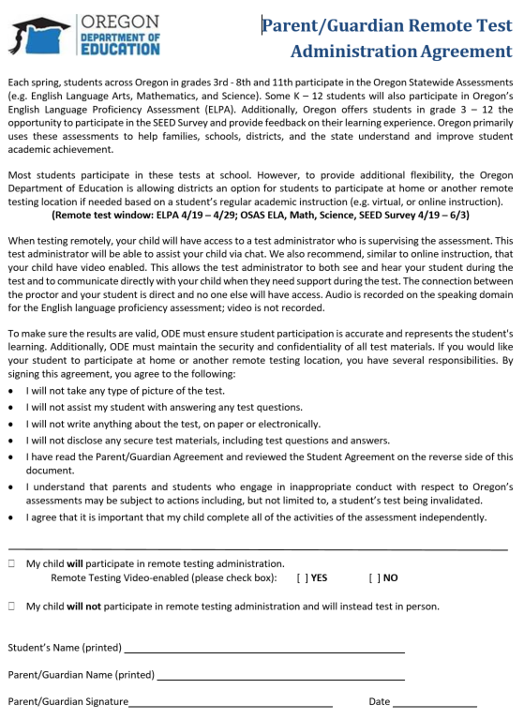
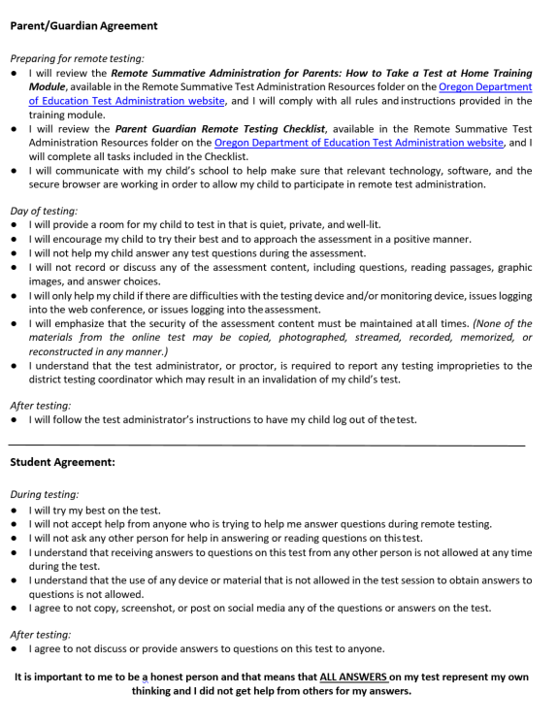
Remote Administration Guidance: Test Improprieties
Improprieties are behaviors prohibited during test administration, because they give a student an unfair advantage or they compromise the secure administration of the assessment.
All test improprieties must be immediately reported to the DTC, even if you are unsure of the exact situation.
When a test impropriety involves a student test, the district must ensure that the student discontinues remote testing pending the DTC’s investigation.
If test improprieties occur during administration of a remote test, ODE may invalidate impacted tests, although invalidation will not occur automatically.
Notes:
Just as with in-person testing, test administrators are also responsible for monitoring testing improprieties.
Improprieties are behaviors prohibited during test administration
If a test administrator has observed or identified a testing impropriety based on the action of a student or their family member, they are to follow the same guidance that is included in the Test Administrator Manual.
The Parent/Guardian Remote Test Administration Agreement Form signed by the parent or guardian includes information about testing improprieties and on the back of the form there is both a Parent/Guardian Agreement and a Student Agreement that outline appropriate behavior and unacceptable behavior during remote testing.

Slide 22
Overview of Remote Testing and Infrastructure
Notes:
The following section provides a brief overview of the remote testing platform infrastructure, TIDE, technical communication. The Remote Testing Certification Course required by TAs administering remote test sessions will provide more training and information about the functionality of the remote testing platform.

Slide 23
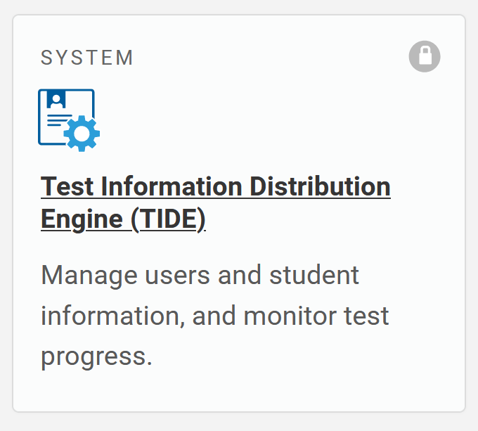
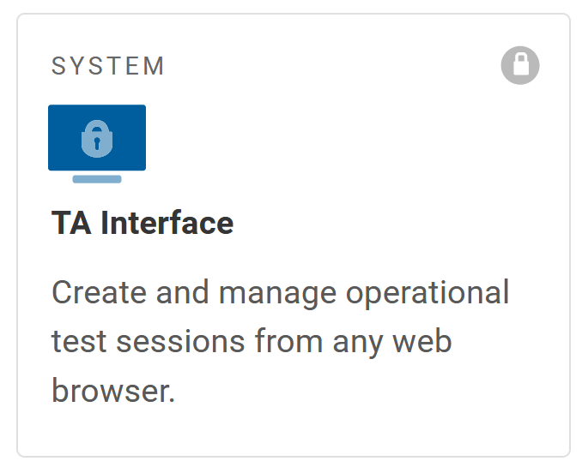
Overview of Remote Testing
No additional software is needed to enable the remote testing capabilities for proctors. (Must be activated in TA TIDE settings)
Proctors log in to the same test administration site (OSAS Portal) they would use if students were testing in the classroom, or in-person.
From this site, proctors will select a remote test session or an in-person test session
Proctors can also schedule sessions in advance and provide a link for students to join the session when it starts
Remote students should use the Secure Browser to access the same testing website they would access in school
If it is not possible to install the Secure Browser on a student's device, districts/schools should work with families to arrange for in-person testing.
Notes:
The OSAS online testing system has been upgraded to allow proctors to administer tests to students who are remote and not at school. No additional software is needed for test administrators to enable the remote testing capabilities for remote sessions.
However, TAs will need to complete and pass the Remote Testing Certification Course. Once a TA has completed this requirement the Remote Proctoring setting will be automatically activated in the TA’s TIDE settings.
Again it is important to complete the Remote Testing Certification Course prior to trying to start a remote testing session.
Proctors log in to the same test administration site they would use if students were testing at school. From this site, proctors can select a remote test session or an in-person session. Proctors can also schedule sessions in advance and provide a link for students to join the session when it starts.
This functionality is covered in the Remote Testing Certification Course
Remote students should use the Secure Browser to access the same testing website they would access in school, and the test takes place the same way it would if everyone were together in the classroom.
If the Secure Browser is not already installed on a student's device, and if it is not possible to install the Secure Browser on a student's device, districts/schools should work with families to arrange for in-person testing.
The Secure browser is required to remotely participate in the ELPA, OSAS ELA, Math, and Science Assessments

Slide 24
Testing Infrastructure
Students should participate via Secure Browser
TAs securely share login (i.e., SSID and Session ID) and test information (i.e., dates, student supports, etc.) beforehand
If not already installed, district needs to install the secure browser or facilitate family installation
All Oregon Statewide Summative Assessments must be administered using the OSAS Secure Browser
* The SEED Survey and Interim Assessment can be administered remotely using the OSAS Secure Browser, but it is not required.
Notes:
Since the infrastructure of the remote testing platform operates in the same manner as the in-person testing system, TAs will need to ensure students have their SSID#s for logging into a remote testing session and the Remote Testing Session ID.
Additionally, TAs should share information about the test date and time, and communicate what student supports have been activated based on the student’s needs and allowable supports included in the OAM.
Please note the Test Administration Manual has more information about how to share secure information remotely.
Since all Oregon Statewide Summative Assessments must be administered using the OSAS Secure Browser, if not already installed, district needs to install the secure browser or facilitate family installation.

Slide 25
Testing Infrastructure Cont.
Test administrators access remote testing via normal test delivery system
The remote or hybrid option for summative tests will not be enabled until 4/11/22
When students are remote, test administrators can interact via:
Video (if enabled)
No audio without video
Chat (message to individual student)
Broadcast (message to all students in test session)
Screen sharing feature (Note: Screen share not available on Apple Mac or iPad devices)
* Specific guidance is provided in the Remote Testing Certification Course
Parents/Guardians will indicate whether they give permission for the video-enabled webcam option. Video/webcam use must be set in a student’s TIDE settings prior to remote testing.
Notes:
Test administrators will use the same testing platform in the OSAS portal. There will be a radio button to indicate whether the testing session is an “in-person” session or a “remote” session. Please note even if a test administrator selects the remote radio button for summative assessments or the SEED Survey they will not be operational the remote system is enabled and launches remote capabilities.
Again parents/guardians must allow permission for a student to enable their video and/or audio. These settings must updated at the student level in TIDE.
In addition to Video/Audio tools, TAs can uses the chat, broadcast, and screen sharing features. (Note: Screen share is not available on Apple Mac or iPad devices)
These features are all covered in the Remote Testing Certification Course.

Slide 26
Preparing your Computer and Other Technology: Responsibilities and Expectations
Notes:
The next few slides explore responsibilities and expectations for administering assessments or surveys remotely. We will briefly cover some actions and considerations: Before testing, During testing, and After testing

Slide 27
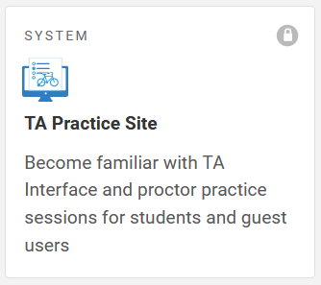
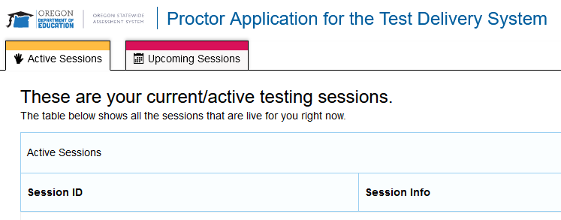
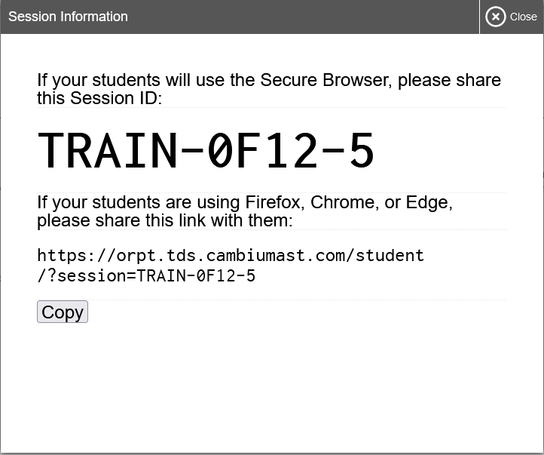
Ensuring that Proctor and Remote Student Have the Proper Hardware
Before administering a remote test session, ensure you and your students have the following hardware and that it functions properly:
TA computer has a secure web browser installed, access the test administration site (OSAS Portal)
TA computer has a built-in or plug-in webcam, microphone, and speaker
If necessary a TA can practice logging into a remote testing session by accessing the TA Practice Site. This will allow both the TA and the student to test that hardware is operating appropriately and confirm that all settings have been updated in TIDE.
Notes:
The technology requirements to administer assessments remotely are almost exactly the same as those used for testing done in a classroom, except proctors and students will generally also need a webcam, microphone, and speaker.
Before administering a remote test session, ensure you and your students have the necessary hardware and that it functions properly:
Your computer or iPad has a conventional web browser installed so you can access the OSAS Portal test administration site.
Your computer has a built-in or plug-in webcam, microphone, and speaker for communicating with students during a remote test administration session
If necessary a TA can practice logging into a remote testing session by accessing the TA Practice Site. This will allow both the TA and the student to test that hardware is operating appropriately and confirm that all settings have been updated in TIDE.

Slide 28
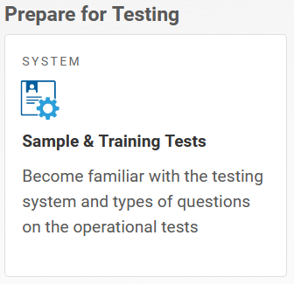
Ensuring that Proctor and Remote Student Have the Proper Hardware
Before administering a remote test session, ensure your students have the following hardware and that it functions properly:
Each remote student’s testing device has a Secure Browser installed so they can access the testing interface
Each remote student’s testing device has a built-in or plug-in microphone, speaker, and webcam, if approved
Remember: use of a student camera requires parent or guardian consent
Notes:
The technology requirements to administer assessments remotely are almost exactly the same as those used for testing done in a classroom, except proctors and students will generally also need a webcam, microphone, and speaker.
Before administering a remote test session, ensure your students have the necessary hardware and that it functions properly:
Each remote student’s testing device has the Secure Browser installed so they can access the testing interface.
Each remote student’s testing device has a built-in or plug-in webcam, microphone, and speaker, required only for students whose families have approved the use of remote video.
As a reminder, use of a student camera requires parent or guardian consent. As mentioned on the previous slide, students are also able to log into a sample test and practice using the remote testing features such as video, chat, and screen share.

Slide 29
Consider Students Use of Assistive Technologies
Students who use assistive technologies during instruction should have access to the same or comparable approved assistive technologies when they take a test remotely
District/school technology coordinators should work with families who are remote testing to set up any necessary assistive technologies
If access to necessary technologies cannot be provided to students testing remotely, districts should work with their families to determine other options for taking the test
Notes:
Students who use assistive technologies during a test when that test takes place at school need access to the same assistive technologies when they take a test from home.
District technology coordinators should work with families who are remote testing to set up any necessary assistive technologies.
If access to necessary technologies cannot be provided to students at home, districts should work with their families to determine other options for taking the test.

Slide 30
Before Testing
 | Responsibilities Before Testing
ODE | Establish remote testing policy Develop an effective remote testing platform Develop and release remote testing training and guidance for districts, test administrators, and families
Districts | Consider the appropriateness of remote testing Review all remote administration documents posted at ODE - Test Administration web page Identify and communicate internally with TAs who will need to complete the Remote Testing Certification Course Develop a system of who is responsible for collecting parent permission forms and updating the Student TIDE settings prior to remote testing
Teachers/Test Administrators | Complete the Remote Testing Certification Course if planning to proctor any remote assessments Read all other remote testing documentation the district provides (as required) Ensure students have the opportunity to practice using the remote administration site Double check all students are listed with the corrects accommodations and settings in TIDE, including whether the student is eligible for remote testing (primary responsibility with DTC or STC) Talk with families of remote testing students beforehand Communicate test information securely with students
Notes:
The following table provides some actions that occur before testing.
In addition to completing this training module, any educator that is planning to proctor a remote testing session must also complete the Remote Testing Certification Course to have their TA TIDE Account activated for remote testing.
It is also important to share test information with families and students such as the testing dates, SSID number, and the Session ID number for the remote testing sessions.

Slide 31
Responsibilities and Expectations Student Directions
The remote testing platform provides two-way communication once students have logged in their test.
Any communication needs required prior to student log-in should be completed using the local learning management system (LMS) (e.g., Zoom, Google Classroom, etc.).
Communication needs such as student directions should be shared via a LMS and prior to students logging into the remote testing secure browser.
It is important that TAs review these directions with students prior to testing.
The directions are organized to ensure that students understand which test they are taking and correctly log in to the proper test.
Notes:
The remote testing platform provides two-way communication once students have logged in their test. However, this two-way communication is not active until a student has fully completed the log in process. Therefore any communication required prior to testing such as test directions should be communicated using the local learning management system or LMS such as Zoom, google classroom or other systems.
Reviewing the student directions is important prior to testing to ensure students are familiar with the assessment and they have logged into the correct assessment and session. Though a student can not have another application running while they are in the secure browser, the TA can have an active session and the LMS running in the background in case a student or family is having log in difficulties and needs technical support. Again the student will have to close out of all applications before launching the secure browser.

Slide 32
During Testing
 | Responsibilities During Testing
ODE | Provide support to the field Communicate any updates/issues/changes/etc. Monitor districts for reported testing improprieties
Districts | Support teachers, test administrators, students, and families testing remotely Ensure all administration policies continue to be followed Make sure students are assessed as identified by parent/guardian permissions Investigate and report any testing improprieties identified during testing
Teachers/Test Administrators | Monitor and support students participating in the assessment Provide technical assistance as needed to support hardware and/or the remote testing platform Immediately respond to any test improprieties following the guidelines in the Test Administration Manual Monitor testing progress to ensure all students have the opportunity to complete their assessment
Notes:
During the test Remote TAs will primarily spend their time monitoring student progress through the test session platform. The TA should monitor any student who has activated the “Hand Raised Feature”. This feature will be covered during the Remote Testing Certification Course.

Slide 33
After Testing
 | Responsibilities After Testing
ODE | Receive and consider feedback from stakeholders about the remote testing experience Ensure test completion is displayed in TIDE and reported in the Centralized Reporting System Analyze and publish the statewide assessment data
Districts | Analyze test participation to ensure identified students have completed their assessments as outlined by parent guardian testing permission. Work with teachers and test administrators to make certain that their post-testing responsibilities are complete Coordinate internally as needed to analyze and report statewide summative assessment data.
Teachers/Test Administrators | Make sure test materials used remotely are returned/destroyed Ensure any test incidents are reported appropriately, again as outlined in the Test Administration Manual Review student supports for future assessment supports or guidance
Notes:
After Testing the Remote TAs will communicate the status of a students testing progress with families and communicate any additional feedback about the remote testing experience to either the school testing coordinator or district testing coordinator to inform future enhancements to the remote testing system.

Slide 34
Accessing the Remote Test Administration Certification Course
Notes:
Throughout this training the Remote Test Administration Certification Course has been referenced as a requirement for remote testing and for additional information. This next section will discuss how to access the course.

Slide 35
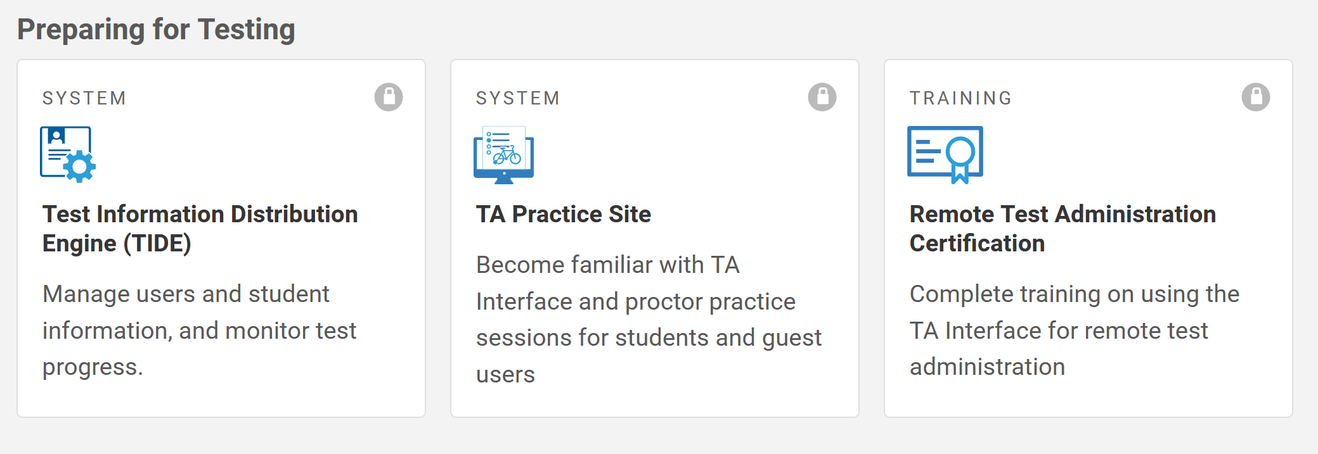
Remote Test Administration Certification Course
To administer tests to students who are remote, TAs must complete the and pass the Remote Test Administration Certification Course.
This course is only required for those TAs that will be administering the remote testing session.
The course will walk you through how
to administer remote assessments to
students and can be accessed via the
OSAS Portal under the Test Administrators tab.
Notes:
To administer tests to students who are remote, TAs must complete the and pass the Remote Test Administration Certification Course.
This course is only required for those TAs that will be administering the remote testing session.
The course will walk you through how to administer remote assessments to students and can be accessed via the OSAS Portal under the Test Administrators tab.

Slide 36
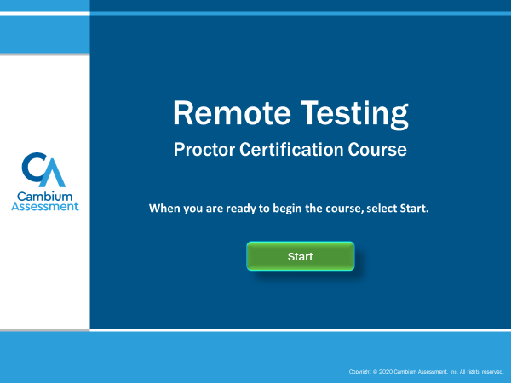
Remote Test Administration Certification Course Cont.
The Remote Test Administration Certification Course explains how TAs can:
Prepare your computer, webcam, microphone, and speakers before testing.
Access the remote proctoring test administration site from home.
Schedule a remote test or modify a scheduled remote session.
Convey remote test session information to remote students.
Join and begin a remote session that was scheduled in advance.
Communicate with and assist remote students during a test session.
Pause and Stop a remote test session.
Notes:
The Remote Test Administration Certification Course explains many topics such as
Preparing your computer before testing.
Accessing the remote proctoring test administration site
Scheduling a remote test session.
Communicate remote test session information to remote students.
Join and begin a remote session.
Communicate with and assist remote students during a test session.
And finally pause and stop a remote test session.

Slide 37
Checklist and Contact Information for Technical Support
Notes:
The last section will provide a quick checklist for remote testing and contact information for technical support

Slide 38
Quick Checklist: Preparing for Remote Proctoring
Parent has completed and returned the ODE Parent/Guardian Remote Test Administration Agreement Form or permission using the process your DTC has provided to obtain consent.
Both Parental Consent for Remote Testing and video attribute has been set in TIDE.
All Student Test Settings and Tools have been set in TIDE.
TA has taken (and passed) Remote TA Certification Course.
Diagnostic Checks have been completed and verified – TA’s and Student’s Machine.
Test Session date & time set with student (and parent).
Notes:
The following list provides a quick checklist to complete before a remote test session.
Verify the Parent/Guardian has completed and returned the ODE Parent/Guardian Remote Test Administration Agreement Form or permission using the process your DTC has provided to obtain consent.
BOTH Parental Consent for Remote Testing and/or video attribute has been set in TIDE.
All Student Test Settings and Tools have been set in TIDE.
TA has taken (and passed) Remote TA Certification Course.
Diagnostic Checks have been completed and verified – TA’s and Student’s Machine.
Test Session date & time set with student (and parent) and all log in information has been shared.

Slide 39
Contact Information and Technical Support
If you need additional information or have questions, please contact your District Testing Coordinator (DTC) or consult the resources posted on the ODE Test Administration website under the Remote Testing Resource section
For Content Specific Support or Questions, please refer to the ODE Assessment Help webpage.
If you need technical assistance, you can contact the OSAS Help Desk
Email: osashelpdesk@cambiumassessment.com
Customer Support Phone: 1 - (866) 509 - 6257
Customer Support Fax: 1 - (877) 218 - 7663
Notes:
Please refer to the following for contact information and technical support
If you need additional information or have questions, please contact your District Testing Coordinator (DTC) or consult the resources posted on the ODE Test Administration website under the Remote Testing Resource section
For Content Specific Support or Questions, please refer to the ODE Assessment Help webpage.
If you need technical assistance for remote testing, you can contact the OSAS Help Desk by email or phone.

