Slide 1
Oregon Statewide Assessment System Science State Test Training
Required for DTCs, STCs, and Science TAs
Notes:
Welcome to the OSAS Science State Test training module, required for all district and school test coordinators, as well as Science test administrators.

Slide 2
Module Topics
Scheduling
Administration
Resources
Notes:
The three topics we will be covering in this module include: scheduling, test administration, and additional resources.

Slide 3
Scheduling
Ensure students have sufficient time and resources to complete the test.
Notes:
Planning for test scheduling ensures students have sufficient time and resources to complete the test.

Slide 4
Test Window
2023-24 Statewide Test Window for both in-person and remote administration:
Grade 11: February 6, 2024 – June 14, 2024
Grades 5 & 8: March 5, 2024 – June 14, 2024
TAM, Appendix A
Notes:
-The OSAS statewide test windows for the current academic year are listed on this slide.
-Each test opportunity is subject to a 20-day expiration period which begins the moment the student first logs into the test.
For more test window information, please see Appendix A of Oregon’s Test Administration Manual, and for more information on pause rules and test expirations, refer to Section 6.4.

Slide 5
Test Requirements
The OSAS Science Test is required to be given to every student in grades 5, 8, and 11.
Grade 10 students may challenge up to the Grade 11 test. Banked passing scores fulfill the Grade 11 requirement.
TAM, Appendix A: Test Schedule
Notes:
Students in grades 5, 8, and 11 take the OSAS science test, with the expectation that at least 95% of students participate. This requirement is the same as previous years.
Students in Grade 10 who have completed advanced course work in science may “challenge up” and bank a passing score to fulfill their Grade 11 testing requirement.
Test administrators should contact their district test coordinator regarding the challenge up process. District test coordinators who need assistance should contact their ESD Partner.
Finally, Grade 12 students who did not get their Grade 11 opportunity may also test.
More information about requirements for statewide testing can be found in Appendix A of Oregon’s Test Administration Manual.

Slide 6
Test Opportunities
Students in grades 5, 8, and 11 will have one annual opportunity for the OSAS Science Test.
TAM, Section 5.1: Testing Time and Recommended Order of Administration
TAM, Appendix B: Student Inclusion
Notes:
Students in grades 5, 8, and 11 will have one OSAS Science Test opportunity in that academic year.
More information about testing time and recommended order of administration can be found in Section 5.1 of Oregon’s Test Administration Manual. Student inclusion information can be found in Appendix B.

Slide 7
Administration
Ensure equitable access for all students.
Notes:
Planning for Test Administration ensures equitable access for all students

Slide 8
Test Administration
Monitor to ensure that students only have access to the accessibility supports listed in the Oregon Accessibility Manual
Cover or remove instructional visual stimuli/posters from the testing environment
If breaking up the test into multiple sessions, allow students to finish all presented items on the screen before pausing the test.
If students pause the test for fewer than 20 minutes, they will be able to review or change answers to items already completed.
If students pause the test for more than 20 minutes, they will no longer be able to return to previously completed items when they log back in.
TAM, Section 2.4: Secure Handling of Printed Test Materials and Note Paper
TAM, Section 6.4: Pause Rules and Test Expirations
TAM, Section 7.3: Testing Over Multiple Sessions or Days
Notes:
During testing, students may only access materials explicitly identified in the detailed list of content area accessibility supports found in the Oregon Accessibility Manual. For example, students may not access materials such as class notes, electronic translation devices, or cell phones during testing.
Before a test is paused, students should be allowed to finish responding to the items presented on the screen, if possible.
If the student pauses the test for fewer than 20 minutes, they will be able to review or change any items they’ve already completed when they resume the test.
If a student pauses for more than 20 minutes, they will not be able to return to the previously completed items when they log back into the test.
It is important to note that if a student pauses the science test for more than 20 minutes while working in a cluster item they did not previously complete, they will be allowed to continue working through that item when they resume the test because it had not yet been completed.
For more information on test administration, consult the sections of Oregon’s Test Administration Manual referenced at the bottom the slide.

Slide 9
Scratch Paper
Scratch paper is a non-embedded universal tool available to all students.
PLEASE NOTE: Scratch paper used for notes on the OSAS Science Test can be retained and securely stored between test sessions.
TAM, Section 2.4: Secure Handling of Printed Test Materials and Note Paper
Notes:
Scratch paper is a non-embedded universal tool that should be made available to all students throughout the duration of the test. Scratch paper may be retained between test sessions to allow students access to their notes for any tasks still in progress. If retained, scratch paper must be securely stored between test sessions.
When retaining scratch paper, TAs should direct students to write their names (or other appropriate identifying information) on the paper, then collect and inventory the paper at the end of each test session.
Retained scratch paper must be kept in a securely locked room or cabinet that can only be opened by authorized staff. Upon completion of the test, scratch paper must be securely destroyed.
More information about secure handling of test materials can be found in Section 2.4 of the TAM.

Slide 10
Resources
Adequately prepare both teachers and students.
Notes:
Oregon provides several support resources that can adequately prepare both teachers and students

Slide 11
Sample Tests
Sample tests can be found in the OSAS Portal
Organized by grade level
Provide example questions
Include all embedded universal tools, designated supports, accommodations, and language supports
Sample tests can be used to communicate to teachers and students the importance of practicing with science item types.
Item types include questions and simulations to assess the three dimensions of NGSS (Disciplinary Core Ideas, Science and Engineering Practices, Cross-cutting Concepts)
OSAS Portal
Notes:
The OSAS science sample tests are available on the OSAS Portal at osasportal.org. Sample tests provide examples of the types of test items students will see in each grade band of the OSAS Science Test, and should be used to help students become more familiar with the format of the test. The sample tests also allow an opportunity for test administrators and students to try out accessibility supports before using them on the actual OSAS Science Test.
In addition to the sample tests, the OSAS Portal also includes links to the calculators students will encounter in the science assessment. The calculators embedded in the OSAS Science Tests are the same ones embedded in the OSAS Math Tests in grades 6 and up.

Slide 12
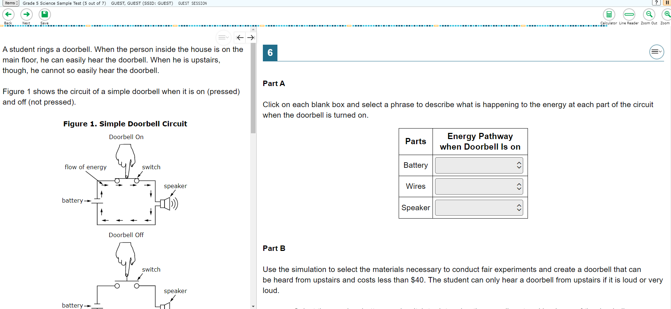
NGSS Sample Cluster/Task Item
Testing Portal
Notes:
It’s very important that students have time to practice with science item types. Before testing begins, point out the grouping of information on the left hand side of the screen and the questions on the right hand side of the screen. There can be a lot of information for students to process on a single screen. Some students will interact with items that contain simulations. Students should practice with these items in the sample test to familiarize themselves with some of the technical aspects of simulations,` and become more comfortable manipulating the simulations prior to sitting down to take the actual test.
While they can be used to inform teaching and learning, sample tests should never be used to evaluate student academic performance.

Slide 13
Online OSAS Science Test Resources
Test Administration Manual (TAM)
Oregon Accessibility Manual (OAM)
OSAS Portal (Sample Tests)
OSAS Science Blueprint Summary
Item Specifications
Notes:
Several resources exist to support teachers and students in understanding and preparing for the OSAS Science Test.
The Test Administration Manual, Oregon Accessibility Manual, and OSAS Portal have been referenced on previous slides and are linked here.
Links to the science test blueprint summary and item specifications are also provided here. These resources can help teachers better understand the OSAS Science Test and inform their instruction to better prepare students for success.

Slide 14
Q&A Discussion
What are the local considerations and challenges around scheduling the OSAS Science Test within your school or district?
What are some effective approaches you could use to address these challenges?
What resources or strategies do you plan to use to prepare for administering the OSAS Science Test?
Notes:
This is an optional point in the required training to pause and discuss these or other questions, as well as to ask questions of your District or School Test Coordinator.
Suggested activities:
-Small groups: use post-its to capture local considerations and challenges, one per sheet. Mount post-its.
-Large group: facilitate review/summary of considerations/challenges from across the large group
-Small groups: share effective approaches, look at artifacts
-Large group: facilitate share out, writing down approaches via chart pack
-Small group or individual: use note organizer to capture take-homes, next steps

Slide 15
Thank you!
Mariela Salas Bao, Ed.D.
Science Assessment Specialist
mariela.salas.bao@ode.oregon.gov
Notes:
We’ve reached the end of the OSAS Science State Test training module.
Please reach out to your District or School Test Coordinator, or the specialist on this slide with questions.
Thank you for your attention!

