Slide 1
Test Security Training
Oregon Statewide Assessment System (OSAS)
Required for DTCs, STCs, and TAs
Notes:
This is the test security training module for Oregon’s statewide assessment system, required for all district and school test coordinators, as well as all test administrators.

Slide 2
Topics
Secure Testing Environment Requirements
Handling Secure Printed Test Materials
Identifying and Preventing Improprieties
Reporting Improprieties
Notes:
The topics that this module will cover include the requirements for a secure testing environment, handling and disposal of hard copies of secure test materials, identifying and preventing testing improprieties and irregularities, as well as reporting any potential improprieties or irregularities.

Slide 3
Secure Testing Environment Requirements
A secure testing environment is needed to ensure the assessment data used for accountability purposes are valid and accurate, that test items can be used across years to allow for year-to-year comparability as well as protect investment in test development, and that no student receives an unfair advantage or disadvantage during testing.
Notes:
The first topic is secure testing environment requirements, which is important for multiple reasons. First, we must ensure the results of the assessment are valid for accountability purposes by having consistency in administration practices across schools and districts. Second, maintaining the security of test items (questions) and stimuli (reading passages) is necessary so that these items and stimuli can be used in future years to maintain measure comparability and use the results to identify trends in performance. Ultimately, the goal of maintaining a secure testing environment ensures that no students have an unfair advantage or disadvantage during testing. Section 2.2 of the TAM addresses the requirements for maintaining security of the test environment.

Slide 4
Secure Test Environment
Security refers to:
Who has access to secure test materials
What students can see and hear while testing
What resources students can access while testing
A secure environment refers to the conditions under which tests are administered, not a specific location
TAM, Section 2.2: Security of the Test Environment
Notes:
Test security generally involves who has access to secure test materials, what students can see and hear while testing, and what resources students can access while testing. To ensure a secure test environment, there are requirements that must be met in preparation for testing, during testing, and once testing has been completed. Table 10 included in Section 2.2 of the TAM provides a list of requirements that must be met during these three phases to maintain the security of test materials and the security and validity of student responses from start to finish, and is an excellent resource to consult at each phase. Please note that a secure testing environment refers to the conditions under which the tests are administered and do not imply or require a specific location. Within the same school, a secure testing environment could be created in multiple locations, such as a classroom, library, small conference room, or multi-purpose room. A secure testing environment is expected for all tests, every testing session.

Slide 5
Impropriety Considerations in the Testing Environment
Academic content visible in the testing environment
Student talking
Untrained TA
TA leaving the testing environment (students unsupervised)
Coaching
Non-allowable resource
Notes:
Testing improprieties can be eliminated with sufficient training and understanding. Each year, ODE receives reports of materials having been left up on the walls in classrooms that may have provided students in those rooms with an unfair advantage. This oftentimes affects multiple classrooms of students. Please cover or remove instructional materials or other academic resources on the wall. Failure to cover or remove these instructional materials can result in entire classrooms of students being invalidated. The other considerations listed here are also avoidable with appropriate practice and training. Please make sure that you understand what TAs and students are allowed to do nor not allowed to do during testing. Consult the TAM for additional information.

Slide 6
Handling Secure Test Materials
Printed assessment materials include secure test items and/or reading passages that need to be handled properly so that the test items can be used across years to allow for year-to-year comparability as well as protect investment in test development.
Notes:
Now it is time to review how to Handle Secure Test Materials.

Slide 7
Reminder of Requirements
Ensure only the student and authorized staff have access
Maintain chain of custody from printing to shredding, using consistent protocols to collect and inventory all materials
Ensure all materials are securely destroyed:
at the end of each test session (printed items and stimuli, notes, and scratch paper)
upon test completion (for ELPA, ELA and Mathematics PT items, and paper/pencil Oregon Extended assessments)
TAM, Section 2.4: Secure Handling of Printed Test Materials
Promising Practices Webpage
Notes:
Section 2.4 of the TAM specifically addresses the requirements in place around handling secure printed test materials, including printed items and stimuli, student notes and rough drafts, and scratch paper. It is critical each school have protocols in place, and ensure they are followed, that ensure only the student and authorized staff who have signed an Assurance of Test Security form have access to these secure materials. This is referred to as maintaining a secure chain of custody of printed secure materials, from printing or writing (in the case of scratch paper) to secure disposal. This protocol should include both test administrators and non-TAs who may be assisting with the storage and/or destruction of secure materials. ODE has posted a promising practice around maintaining the security of printed test materials to the link at the bottom of the slide.
[TCs may insert local policies/protocols for maintaining security of test materials at this point in the training.]
It is also important that all individuals who will be handling secure test materials, including students, understand what must be securely destroyed immediately following the end of each test session and what may be securely retained between sessions until the student completes that test. Please refer to Section 2.4 of the TAM for a complete description of these criteria.

Slide 8
Identifying and Preventing Improprieties
Ensures all student results are valid and can be submitted for scoring and that no student receives an unfair advantage or disadvantage during testing.
Notes:
Next we will review how to Identify and prevent Improprieties.

Slide 9
Reminder of Requirements
An impropriety is any behavior that is prohibited because it gives students an unfair advantage or disadvantage, or compromises the security or validity of the test
Improprieties can be:
Committed by a student or an adult
Intentional or accidental
Affect a single student or a group of students
Strategies to prevent improprieties:
Know the rules and make sure students know the rules
Check the test environment to make sure it meets the security criteria
Ensure the test environment and the students are closely supervised
When in doubt, check the TAM and seek clarification before testing!
TAM, Section 3: Appropriate Test Preparation and Practices
Notes:
An Impropriety is any behavior that is prohibited because it gives students an unfair advantage or disadvantage, or compromises the security or validity of the test. This includes behaviors committed by either adults or students, whether intentionally or by accident. Section 3.0 of the TAM provides explanations and examples of common adult- and student-initiated test improprieties. Note that the examples given in the TAM are not exhaustive.
The following practices can go a long way toward preventing many improprieties. Since a large majority of improprieties are adult-initiated, preventative protocols and procedures can be highly effective.
Ensure all adults and students are aware of the testing environment rules and expectation before testing begins. This can help to prevent many accidental improprieties by both adults and students.
Check the test environment to make sure it is secure before, during, and after testing. This includes checking ahead of time to ensure there are no non-allowable resources posted or available for students, that there is sufficient spacing and visual barriers between student testing stations, and that the environment is quiet and void of distractions (e.g., no through traffic, restricted access to authorized individuals only)
Finally, TAs need to closely supervise the test environment while testing is in progress to make sure that the environment remains secure and that students are following the rules.
Always check the TAM and seek clarification before testing begins if there is any doubt about whether a particular resource or behavior is permissible, either for students or adults.

Slide 10
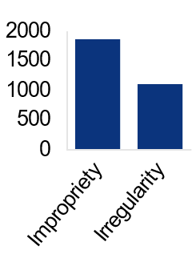
Most Improprieties are Adult Initiated
Sample data from prior school year
Notes:
As mentioned on prior slides, our impropriety data consistently shows that about two-thirds of improprieties are adult-initiated. This presents us with important training opportunities that we need to make sure are well understood by STCs and TAs. ODE receives about 1,500 testing impropriety reports per year, which often include multiple improprieties. The number of tests impacted by impropriety reports fluctuates from year to year.

Slide 11
Impropriety Types
Sample data from prior school year
Notes:
ODE tracks the type of impropriety reported in an effort to understand the critical areas of concern that can be emphasized during training. The most common improprieties are mishandling secure materials, accidental submissions, technology issues, and testing outside of the test window. While all improprieties are concerning, we continue to receive reports of non-allowable resources being provided as well. If non-allowable resources were a single category, they would rate among the top five most common impropriety categories. Please work with your staff to decrease these inappropriate practices. ODE for our part continues to work on decreasing those that result from technology challenges.

Slide 12
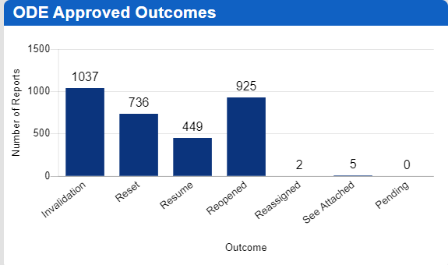
Impropriety Responses
Sample data from prior school year
Notes:
How does ODE typically respond after receiving impropriety reports? In most cases, ODE determines that the event did not impact the construct being measured – resulting in a resume testing determination. Less than one half of one percent of the tests administered in Oregon need to be invalidated because of the impropriety identified. ODE is often able to reset or reopen student’s assessments. In 2022-23, the No Impact category was renamed to "Resume Testing". See TAM Section 3.0 for details.

Slide 13
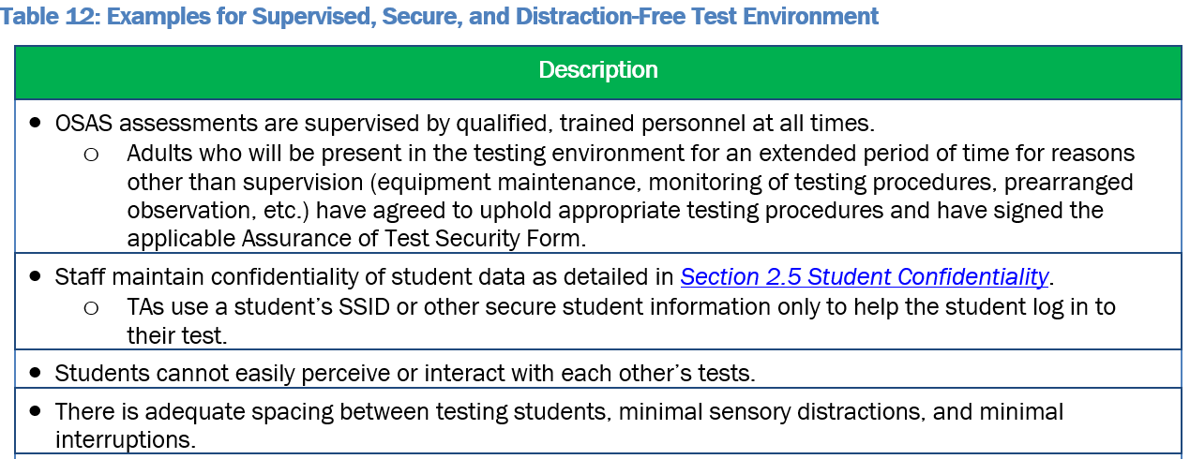
Avoiding Test Improprieties
Notes:
The tables in Sections 3.0 of the TAM provide multiple, though not exhaustive, examples of test practices which will reduce the likelihood of an impropriety. These examples should be reviewed with all test administrators. Please emphasize the importance of covering up materials that are posted on the walls, whether in classrooms, computer labs, libraries, or other testing locations. If there is any doubt, please cover it up.

Slide 14
Q&A Discussion
What are the local considerations and challenges around maintaining test security within your school or district?
What are some effective approaches you could use to avoid adult-initiated improprieties in your school or district?
What are some effective approaches you could use to avoid student-initiated improprieties in your school or district?
What resources do you plan to use to assist you in maintaining test security?
Notes:
This is an optional point in the required training to pause and discuss the questions provided or a locally developed set of relevant questions. If you would like to pause, please pause now.
Suggested activities:
-Small groups: use post-its to capture local considerations and challenges, one per sheet. Mount post-its.
-Large group: facilitate review/summary of considerations/challenges from across the large group
-Small groups: share effective approaches, look at artifacts
-Large group: facilitate share out, writing down approaches via chart pack
-Small group or individual: use note organizer to capture take-homes, next steps

Slide 15
Reporting Improprieties
Immediate reporting gives the student the best opportunity to continue testing with no impact.
Notes:
Now we will review how to report improprieties.

Slide 16
Reminder of Requirements
Immediately report all potential test improprieties, even if you are unsure of all of the details
Pause the student’s test pending the DTC’s investigation and authorization from ODE
DTCs are responsible for submitting the report to ODE
TAM, Section 3.5: Reporting Test Improprieties and Irregularities
Notes:
When a potential test impropriety or irregularity occurs, it is essential that the first course of action is to pause all impacted tests until the incident is reported, investigated, and resolved. Any potential test impropriety or irregularity must be reported up the chain of communication so that the incident may be investigated in a timely manner and the appropriate outcome identified as quickly as possible. Typically, TAs or other staff who may observe what they believe to be a test impropriety or irregularity report the incident to their STC. STCs then report to the DTC, who makes the formal initial report of a potential test impropriety or irregularity to ODE Test Security. The DTC is responsible for coordinating with ODE and conducting any necessary investigation.
[TCs may insert local policies/protocols for internally reporting potential test improprieties and irregularities at this point in the training.]
Immediately pausing tests impacted by a potential test impropriety or irregularity and not resuming testing before the DTC’s full investigation and confirmation from ODE regarding the outcome mitigates impact on students. In some cases, allowing a student to continue testing before resolving the issue can significantly limit the options available to that student. Resuming testing before resolution can make the difference between whether the tests impacted can be reset and remain valid or must be invalidated and that testing opportunity lost to the student or students. If there is any doubt about whether an incident or behavior is permissible, either for students or adults, always check the TAM and/or seek clarification.

Slide 17
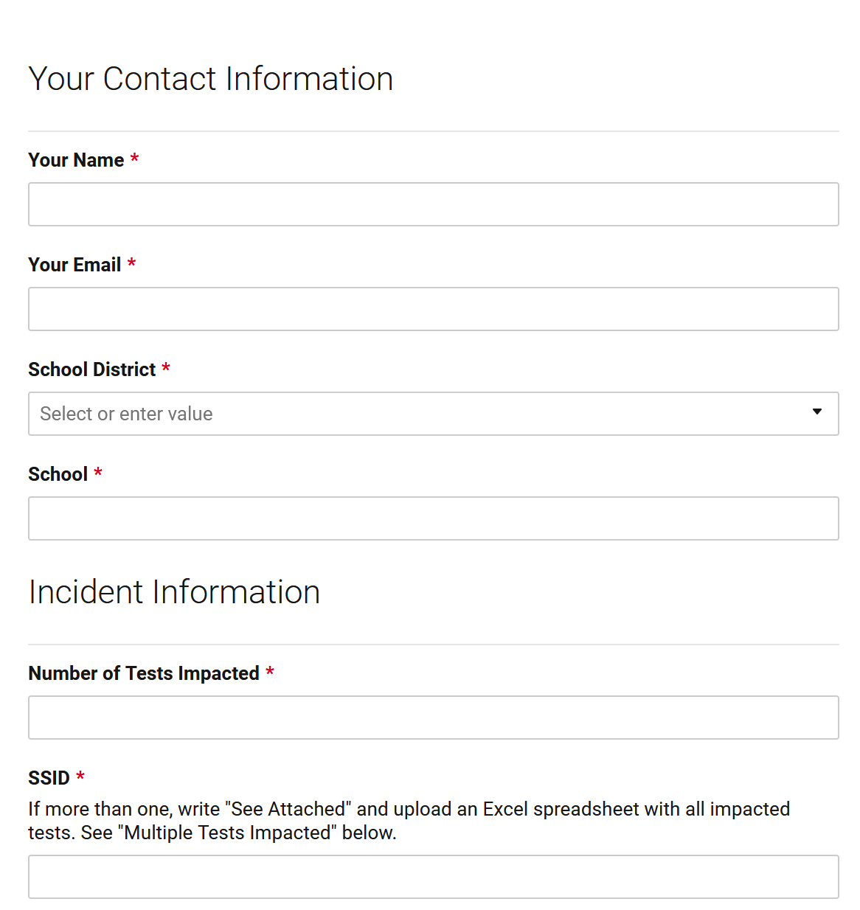
Reporting Process (For DTCs Only)
DTCs use a web form to submit all potential test improprieties and irregularities
How-to document and tutorial available on Test Administration web page
TAM, Section 3.5: Reporting Test Improprieties and Irregularities
Test Impropriety Report Form
Notes:
DTCs must submit an initial report for all potential test improprieties to ODE within one day of learning of the potential test impropriety. Similarly, DTCs must report all test irregularities that impact either test security or test validity. Based on the initial report, ODE may request further investigation by the DTC, in which case the DTC must provide results to ODE within 30 calendar days. These expectations are unchanged from previous years
DTCs submit their initial report electronically using an online form available at the link shown at the bottom of the slide. A step-by-step guide and how-to slides are also available at this link to assist DTCs with using the online form and submission process.

Slide 18
Potential Consequences
Impacted tests may be invalidated, meaning the student loses their test opportunity
When appropriate, tests may be reset
Significant breaches of security could result in disciplinary action by the Teacher Standards and Practices Commission (TSPC) or the district
TAM, Section 3.5: Consequences of Test Improprieties and Irregularities
Notes:
When an impropriety occurs, ODE will work with the DTC to confirm the appropriate outcome. Potential outcomes are summarized in Table 14 of Section 3.6 of the TAM, shown here on this slide. Although ODE works to mitigate impact on students, due to the severity of the incident the impacted tests must be invalidated. Under certain conditions, as described in Table 14, it is possible that a test may be eligible to be reset, reopened, or that testing may resume without further action. As mentioned earlier, allowing a student or students to continue testing before the appropriate outcome is determined may negatively impact the options available, even eliminating the possibility of resetting or reopening a test.

Slide 19
Q and A Discussion
When a test impropriety or irregularity occurs, what are the immediate steps that you need to take based on your role in your school or district?
Based on your role in your school or district, if you become aware of a potential test impropriety or irregularity, who do you need to report it to?
What resources will you use to assist you in responding to a test impropriety or irregularity?
Notes:
This is an optional point in the required training to pause and discuss the questions provided or a locally developed set of relevant questions. If you would like to pause, please pause now.
Suggested activities:
-Small groups: use post-its to capture local considerations and challenges, one per sheet. Mount post-its.
-Large group: facilitate review/summary of considerations/challenges from across the large group
-Small groups: share effective approaches, look at artifacts
-Large group: facilitate share out, writing down approaches via chart pack
-Small group or individual: use note organizer to capture take-homes, next steps

Slide 20
Online Resources
Test Administration Manual
Oregon Accessibility Manual
Promising Practices to Avoid Improprieties
Test Security Assurance Forms
Test Impropriety Report Form
Notes:
Finally, on this slide additional resources available to assist you in your role throughout the year are listed. This concludes the test security module.
[TCs may insert locally developed resources relating to test security at this point in the training.]

