Slide 1
Test Administrator Training
Oregon Statewide Assessment System (OSAS)
Required for DTCs, STCs, and TAs
Notes:
This is the test administrator training module for Oregon’s statewide assessment system, required for all district and school test coordinators, as well as all test administrators.

Slide 2
The Right Assessment for the Right Purpose
The Oregon Department of Education is committed to working with community partners to increase assessment literacy
The Right Assessment for the Right Purpose provides information in the following areas:
Shared understanding of a balanced approach to assessment
Common definitions for assessment types and purposes
Appropriate and inappropriate uses of assessment data
Critical considerations about testing time for our statewide summative assessments
Notes:
The Oregon Department of Education developed a guidance document in 2019 ”The Right Assessment for the Right Purpose”. This guidance document is available on the Assessment Team’s website within the Test Administration Resources section. The document provides definitions for critical terms in our Oregon Statewide assessment System (OSAS) and in other areas where Oregon students are assessed in terms of academic achievement, behavior, or other constructs as part of their instructional programs.
The document also addresses current questions and appropriate uses and, perhaps just as importantly, misuses of statewide summative assessment data. It is critical that educators in Oregon use assessments for the purposes for which they are designed and have sufficient technical adequacy documentation.
It is published with the intended goal of beginning conversations about assessment literacy, which we know will evolve and increase in accuracy and complexity over time.

Slide 3
Required Summative Modules for TAs
Test Administrators
Accessibility Supports
Test Security
English Language Arts and Mathematics Administration*
OSAS Science Administration*
ELPA Summative Administration*
Interim Administration and Test Security*
SEED Survey*
Remote Test Administration*
*Only required for TAs administering this assessment, or, in the case of the Interim Remote Administration, administering the assessment in this manner
TAM, Section 1.5: Training Requirements
Notes:
This training module is the first of the required modules for Test Administrators, which should be followed with the training modules that cover accessibility supports and test security. Additionally, TAs are required to review the module(s) for the specific assessment(s) they will be administering. Each training module is intended to provide an overview of the major topics as well as an orientation to the manuals and other resources available to support TAs before, during, and after testing.

Slide 4
Topics
Roles and responsibilities
Ensuring student participation
Testing environment
Test administration resources and tools
Notes:
This training module includes an overview of the roles and responsibilities for test administrators, student participation in statewide assessments, testing environment requirements, and additional resources.

Slide 5
TA Roles and Responsibilities
Before testing:
Provide students with an opportunity to take the sample test
Review student IEPs or education plans to identify appropriate test formats and accessibility supports
Make arrangements for students who are not testing
During testing:
Ensure that students receive the appropriate test
Enforce test environment requirements
After testing:
Check participation reports to ensure all eligible students have completed testing
Roles and Responsibilities
TAM, Section 6: Planning for Test Administration
Notes:
The responsibilities of a test administrator are not limited to testing day. Preparation before testing should include providing students with an opportunity to become familiar with testing format, consulting all relevant documentation for identifying which students to test and which accessibility supports to provide, as well as making arrangements for students who are not testing such as students who finish earlier than their peers during a testing session. During testing, it is the TA’s responsibility to ensure students receive the appropriate test and actively monitor students to maintain a secure testing environment. After testing, TAs can check participation reports to monitor student progress and completion of tests.

Slide 6
Student Participation
ensures representation of all students in assessment results.

Slide 7
Participation in Required Summative Tests
English Language Arts Grades 3 – 8, & 11: General or Extended English Language Arts Tests
Mathematics Grades 3 – 8, & 11: General or Extended Mathematics Tests
Science Grades 5, 8, & 11: General or Extended Science Tests
English Language Proficiency Grades K-12: ELPA Summative
TAM, Section 8: ELA & Mathematics; TAM, Section 9: Science
TAM, Section 10: ELPA Summative; TAM, Section 11: Extended
Notes:
The expected participation by grade level for each tested subject is shown on this slide. Please note that participation requirements are set by federal statute and a 95% threshold is expected for subject areas, except the English Language Proficiency Assessment (ELPA) where every student meeting the inclusion requirements is expected to participate.

Slide 8
Opt-Out and Parent Requests for Exemption
Opt-out: ELA and Math only
Parent request for exemption: All other tests
Reasons of disability or religion only
Examples of Appropriate Communication Posting ODE’s Opt-out form on district/school website Sending ODE’s opt-out form through Parent emails or a Parent newsletter Making ODE’s opt-out form available at district or school offices. | Examples of Inappropriate Communications Initiating a discussion of ODE’s opt-out form or process with parents, adult students, or non-adult students during working hours Repeatedly reminding parents, adult students, or non-adult students to submit ODE’s opt-out form during working hours Encouraging students to submit ODE’s opt-out form during working hours
Notes:
The Student Assessment Bill of Rights permits parents to annually opt their student(s) out of statewide summative assessments in English Language Arts and Mathematics. This right applies to both general and alternate (Oregon Extended) assessments.
For all other required statewide assessments (OSAS Science, ELPA Screener, ELPA Summative, Alt ELPA, and the ORExt Science Assessment), parents may request that their student be exempted from state testing based on either disability or religion. NOTE: Appropriate school personnel must evaluate and approve the parent request.
As a reminder, this is an annual process and prior year forms and exemptions expire at the end of the testing window.
While districts may communicate with parents using existing communication protocols, it also important that parents, adult students, or non-adult students are not subjected to undue influence by educators or staff during working hours.
The table shown here provides a few examples of appropriate and inappropriate communications.

Slide 9
Opt-Out and Parent Requests for Exemption
Opt-out and exemption requests may be made at any time before the end of the test window, even if the student has partially or fully completed the test. | A signed form (opt-out) or district-approved written request (exemption) is always required before taking action Notify STC or DTC immediately of any opt-out or exemption request and provide form or written request to DTC.
Administering a test which has an opt-out or exemption request is an irregularity and must be immediately reported to the STC or DTC. | If the student has already begun or completed testing, this constitutes a testing irregularity and must be reported as such to your STC or DTC, even if the test was administered in good faith. Wait for confirmation from DTC before testing or resuming testing for concerned student(s).
Consult with your DTC about district policies regarding blocking tests which have opt-out or exemption requests that are received prior to testing.
Notes:
Opt-out and exemption requests may be made at any time before the end of the test window, even if the student has partially or fully completed the test.
Administering a test which has an opt-out or exemption request is an irregularity and must be immediately reported to the STC or DTC.
In order to honor an opt-out or exemption, an employee of the district must have physically or electronically received a signed form (opt-out) or district-approved written request (exemption)
Verbal communication of the request does not meet the documented requirement.
Please note districts must retain student records, such as parent-submitted opt-out forms, for at least three years after the record was created.
Notify STC or DTC immediately of the opt-out or exemption request and provide form or written request to DTC.
If received prior to testing, please consult with your DTC about district policies regarding blocking tests which have opt-out or exemption requests that are received prior to testing.
If the student has already started or completed testing, this constitutes a testing irregularity and must be reported as such to your STC or DTC, even if the test was administered in good faith.
In the case that a student is actively testing, please have the student stop testing and wait for confirmation from DTC before resuming testing for the concerned student.

Slide 10
Planning that Impacts Participation
Refer to your school’s test schedule and ensure that students take the right test at the right time
Verify the test settings for your students before testing begins
Check IEPs and 504 Plans as applicable to identify supports
Check TIDE to ensure that test settings match the students’ identified supports
Note: Additional test administration factors will apply for some students. See Appendix B in the TAM for more information.
TAM, Section 6: Planning for Test Administration
Appendix B TIDE User Guide
Notes:
Locally developed testing schedules that adhere to the statewide assessment windows should guide TAs as to which assessments will be administered to which students and when. Consult the locally developed testing plans to ensure students are administered the right test at the right time.
Prior to testing, TAs must be aware of which supports students will need and that all preparations have been made to ensure those supports are available during testing. Awareness and planning in these areas contribute to increased student participation.
Consult Section 6: Planning for Test Administration in the TAM for more information. In addition to Section 6, Additional test administration factors will apply for some students. See Appendix B: Student Inclusion in the TAM for more information.

Slide 11
Q&A Discussion
What are the local considerations and challenges around monitoring student participation within your school or district?
What are some effective approaches you could use to ensure all eligible students are tested in your school or district?
What resources do you plan to use to assist you in monitoring student participation?
Notes:
This is an optional point in the required training to pause and discuss the questions provided or a locally developed set of relevant questions. If you would like to pause, please pause now.
Suggested activities:
-Small groups: use post-its to capture local considerations and challenges, one per sheet. Mount post-its.
-Large group: facilitate review/summary of considerations/challenges from across the large group
-Small groups: share effective approaches, look at artifacts
-Large group: facilitate share out, writing down approaches via chart pack
-Small group or individual: use note organizer to capture take-homes, next steps

Slide 12
Test Environment
ensures validity of student results and that no students have an unfair advantage or disadvantage during testing.

Slide 13
Requirements
Supervision at all times by a trained TA
Remove or cover educational materials posted on the walls that might provide students with an advantage
Quiet environment void of distractions
Only accessibility supports listed in OAM made available to students
Limited interaction with students
Read student directions
Administer accessibility supports appropriately
No coaching
TAM, Section 2.2: Security of the Test Environment
Notes:
After the trained TA sets up the testing session and students begin testing, those students must be supervised by the TA until the end of the testing session. The testing environment must be quiet and void of distractions or educational materials posted on the walls that might provide students with an advantage. Students may only have access to supports from the Oregon Accessibility Manual that are administered according to the rules set out in the manual. TAs need to limit their interaction with students to ensure consistency in testing environments across schools and districts. This includes reading the student directions verbatim, following the TAM and OAM, and never coaching students. To facilitate this limited interaction during testing, it is a best practice to prepare students before testing by explaining what will be allowed and what will not be allowed in the testing environment. A secure testing environment will be addressed in more depth in the test security training module.

Slide 14
Oregon Testing Portal
The web based system that is used for testing, test settings, and progress monitoring reports.

Slide 15
Accessing the Testing Portal
Testing Portal URL: osasportal.org
Register to receive alerts when announcements or resources are posted on the portal
TA user account provides access to:
TIDE (view and edit student test settings)
TA Interface (used to administer tests)
Centralized Reporting System (view participation and performance reports)
TIDE User Guide
TA User Guide
CRS User Guide
Notes:
The Oregon Statewide Assessment System (OSAS) Portal is accessible to adult users by visiting osasportal.org. Students only use osasportal.org to access the sample tests. Announcements that impact the portal or testing are posted to the landing page and anyone may register to receive automatic alerts for these announcements.
A TA user account includes access to multiple components within the OSAS Portal. The Test Information Distribution Engine (TIDE) is used to view and edit student test settings as well as monitor testing progress. The TA Interface is used to create a testing session to administer tests. The Centralized Reporting System (ORS) is used to view performance reports. TA user accounts are granted by TCs after the completion of the annual required training and submission of a signed Assurance of Test Security form. Please consult your locally developed processes and procedures for obtaining an OSAS Portal user account for the current school year.

Slide 16
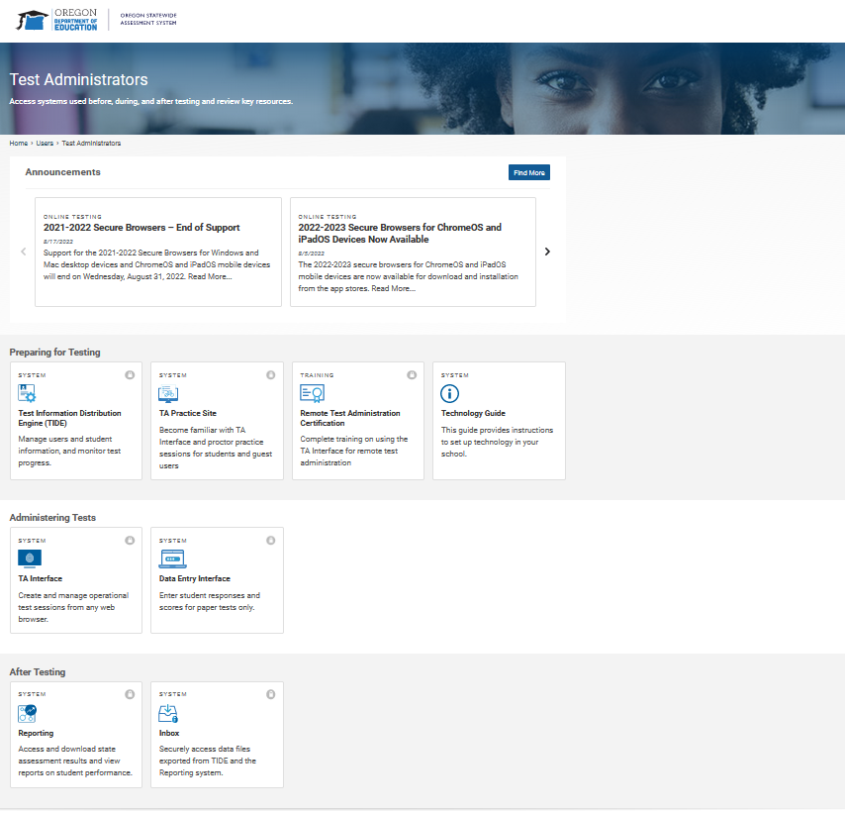
Accessing the Testing Portal, cont.
Section 1: Preparing for Testing
Section 2: Administering Tests
Section 3: After Testing
Notes:
Here is a screenshot of the options presented to a TA after selecting Test Administrator on the OSAS Portal landing page. In section 1 a user may select TIDE to edit student settings or access the training site to build familiarity with the testing interface before administering an operational test, in section 2 TAs will set up an active operational testing session and administer tests using the TA interface or access the ELPA Braille data entry interface, section 3 allows the user to access reports to view participation and performance results.

Slide 17
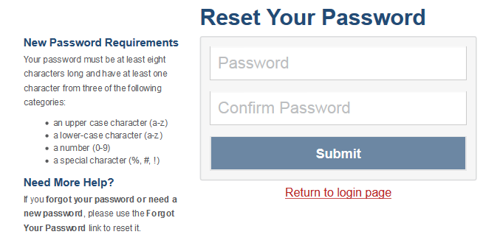
Resetting Your Password
Testing Portal
Notes:
This is a screenshot of the Reset Your Password page.
As mentioned before, TA user accounts are granted by TCs after the completion of the annually required training. User accounts granted during a previous school year have been rolled over into the new academic year. Once the TC creates your account TIDE sends you an activation email. This email contains a link that takes you to the Reset Your Password page in TIDE where you can set up your password for logging in to TIDE and other applicable Cambium systems. This link expires 15 minutes after the email was sent. If you do not set up your password within 15 minutes, you need to request a new link. If you do not receive an activation email, check your spam folder. Emails are sent from donotreply@cambiumast.com, so you may need to add this address to your contact list.
You need to request a password reset in any of the following situations:
You forgot your password.
You didn’t activate your account within 15 minutes of receiving the activation email.
The TIDE administrator locked your account.
To request a password reset:
Click either of the links included in the activation email, or go to the TIDE Login page and click Forgot Your Password? The Reset Your Password: Find Account page appears.
Enter your TIDE email address, and click Submit.
If you have already activated your account, your security question appears. Enter the response to the security question, and click Submit. TIDE sends you an email containing a link to reset your password.
If you have not yet activated your account, TIDE sends you an email containing a link to reset your password.

Slide 18
Overview of Test Delivery System
TA Interface
Administer online tests, track progress, and manage students testing in your session
Adjust test settings for individual students before they are approved to start the test
Approve and submit print requests from students
Student Interface
Secure online test that must be accessed via a secure browser
General Education Student Interface
Braille Interface
TA User Guide
Notes:
TAs access the test delivery system through the OSAS Portal. The student interface can only be accessed through the current-year secure browser. The secure browser for all supported operating systems can be downloaded from the OSAS Portal.

Slide 19
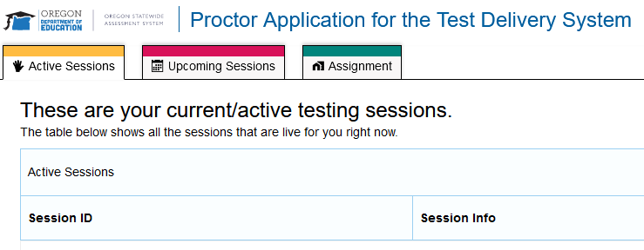
TA Proctor Application at a Glance
Used to create and manage test
Summative Assessments
ELPA Assessment and Screener
SEED Survey
TA User Guide
Notes:
The TA interface is accessed through the Test Administration option in the OSAS Portal. The screenshot shown on this slide is the Proctor Application landing page TAs will see when first logging into the Test Delivery System.
TAs will create a test session by selecting the Start a New Session Now button in the lower right hand corner of the landing page.
The green Assignment tab at the top of the page is an available remote option for administering the SEED Survey. For more information specific to administering the SEED survey using the assignment option, please refer to the SEED Survey Training Module 9.

Slide 20
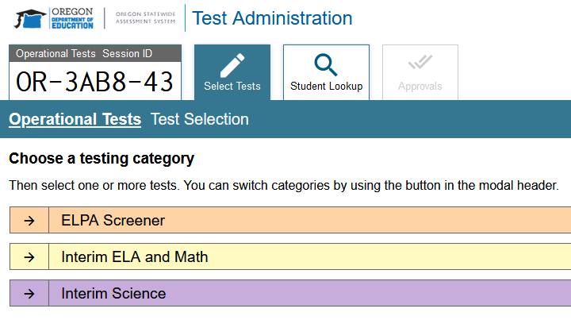
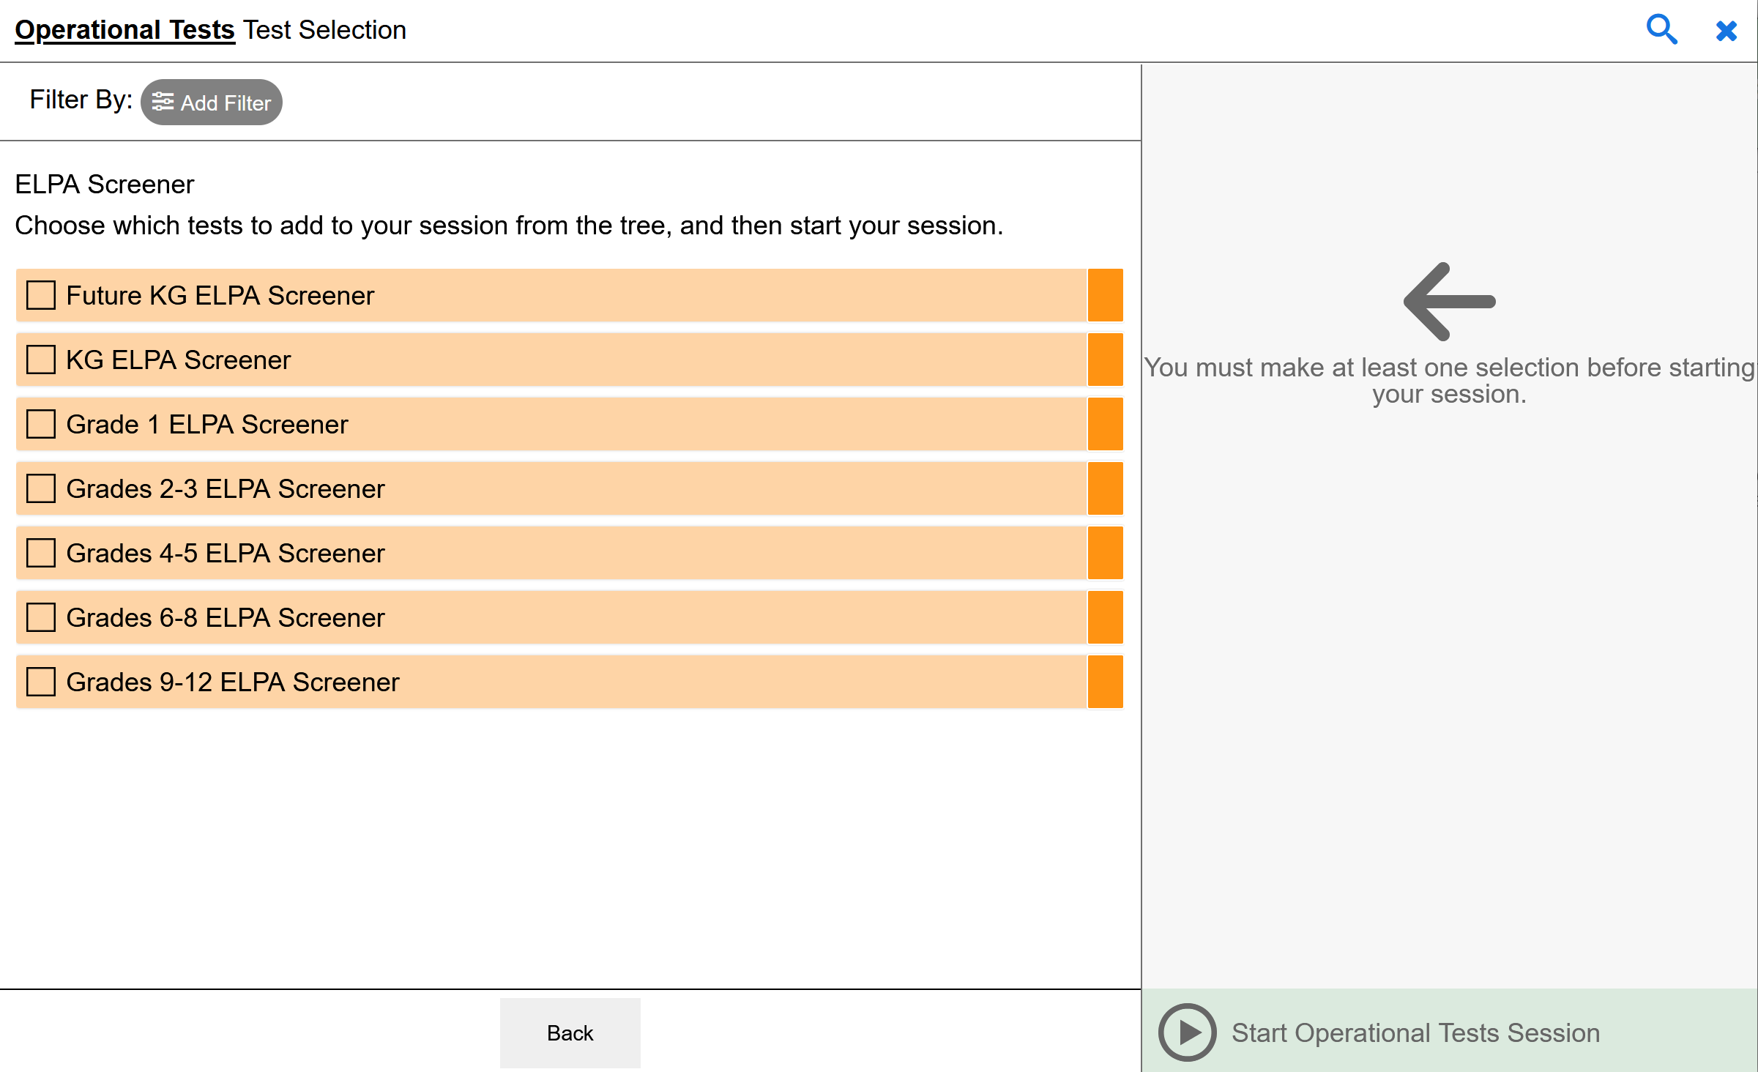
Creating a Test Session
Create and Manage Test Sessions
List of available tests automatically displays upon logging in
Click Expand All to see more detail
Select the tests for inclusion in the session and click [Start Session]
TA User Guide
Notes:
To create a testing session, the TA selects Create and Manage Test Session. Then a list of available tests will automatically display. Click on the plus symbol to expand any test to see more detail and locate the specific grade level and/or test that will be administered during the testing session. Only select the specific tests that are expected to be taken by students during the testing session to avoid students from accidentally starting the incorrect test.

Slide 21
Managing a Test Session
System generates Session ID that students will use to log in
Test sessions automatically expire upon TA logout
Sessions cannot be resumed
Students may resume a paused test in any new test session that includes the applicable test subject and grade
Example: TA creates a test session for students on Tuesday. To resume testing on Wednesday, the TA will create another test session for students to resume testing
TA User Guide
Notes:
To create a testing session, the TA selects Create and Manage Test Session. Then a list of available tests will automatically display. Click on the plus symbol to expand any test to see more detail and locate the specific grade level and/or test that will be administered during the testing session. Only select the specific tests that are expected to be taken by students during the testing session to avoid students from accidentally starting the incorrect test. After the TA selects Start Session, the system will automatically generate a unique testing session ID that students will need in order to log in. The test session will remain open until ended by the TA or when the TA logs out. Once a session is ended, it may not be resumed and a new session must be started. Students may resume a paused testing in any new test session as long as the applicable test is included in the session. For example, if a TA creates a test session for students on a Tuesday, to resume testing the next day the TA will need to create a new test session for students to resume testing. Also, a new test session is needed for each new group of students if a TA is testing different groups of students in the same day.

Slide 22
TA Interface at a Glance
Used to create and manage test sessions and approve students
All information is visible on one screen
Test Session ID
Students needing approval to start testing
Students with tests in progress
Print requests
TA User Guide
Notes:
The TA interface is accessed through the Test Administration option in the OSAS Portal. The screenshot shown on this slide is an example of a sample test session. It is through this interface that a TA can view the session ID, which student need approval to begin testing in the session, those who have tests in progress, and which students have submitted a print request. The following slides will walk through setting up a testing session.

Slide 23
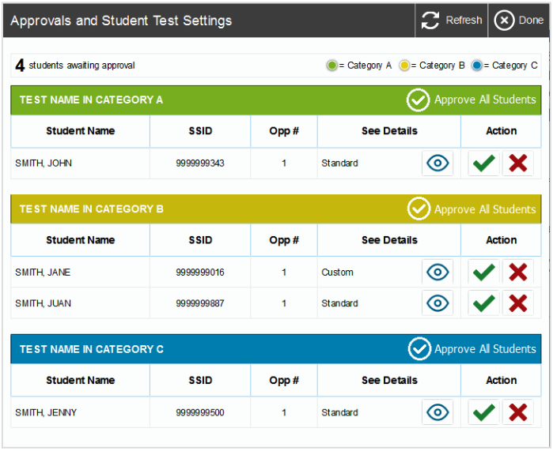
Student Test Settings
Student Test Settings and Approvals
The number in red next to the Approvals button shows the number of students waiting for approval
Clicking on the Approvals button brings up the list of students who need to be approved to test.
TA User Guide
Notes:
After a test session is set up and students log in, the TA must approve students before they will be able to begin testing. A TA may approve all students at once or one at a time. This final confirmation is an important step as it is the last opportunity the TA has to ensure each student is beginning the correct test and that all settings are correct.

Slide 24
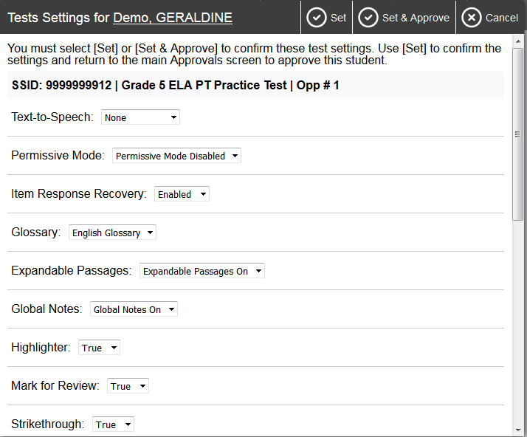
Looking at Student Settings
TA User Guide
Notes:
The student settings may be accessed by clicking on the view or eye symbol. This will open a new window where all settings can be viewed and some may be changed. Please consult the proper documentation and the OAM when changing accessibility support settings for students. After a student begins a test, the options for addressing any errors are drastically reduced. Errors in test settings caught after a student begins a test may constitute an impropriety and result in invalidation of the student’s test and loss of the students’ testing opportunity.

Slide 25
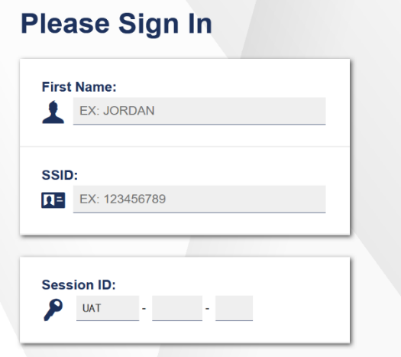
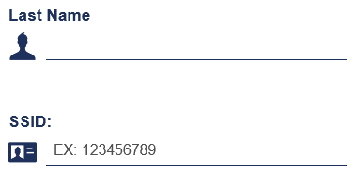
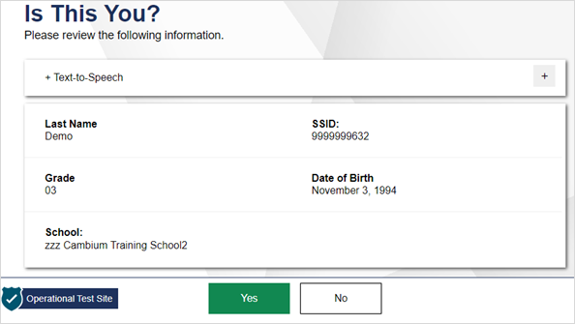
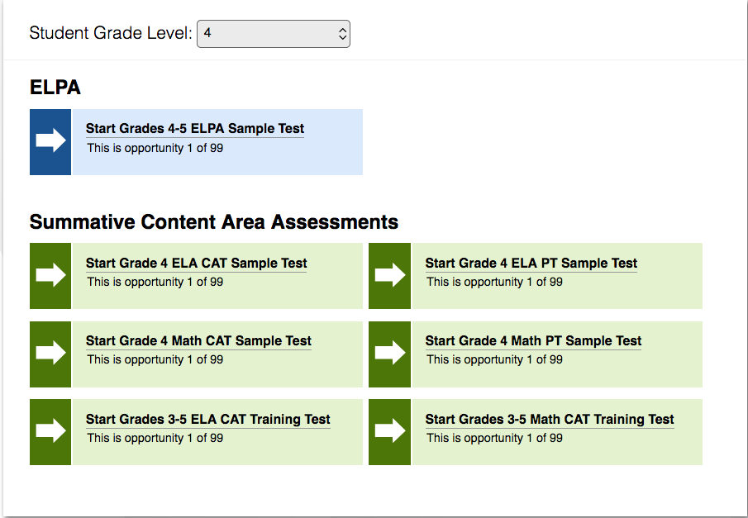
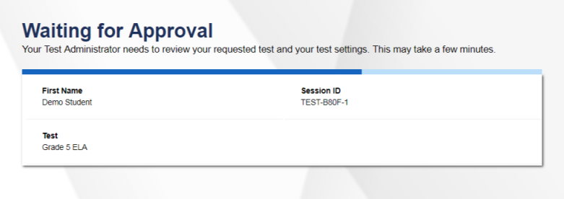
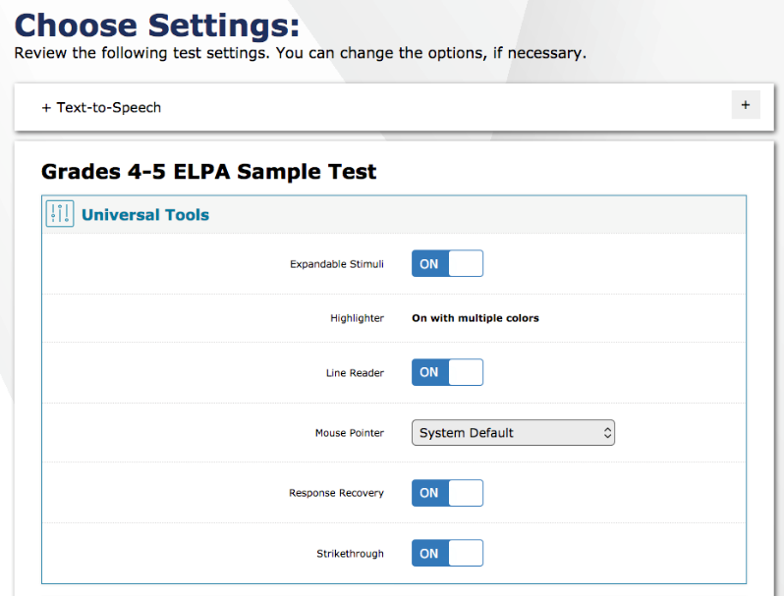
Student Log-in
1
2
Log in using Last Name, SSID, Session ID
Confirm identity – “Is This You?” screen
Last Name (same as in SSID upload), Enrolled Grade, DOB, School, SSID
Select Test
Student will see available tests by subject
TA Approval required to start test
Confirm test -- “Is this your test?” screen
3
4
5
TA User Guide
Notes:
This slide shows the 5-step student login process with screenshots of what the student will see at each step. Note in step 1 that each student will need the unique session ID. Also, student names must be typed in exactly how the name is entered in the system. After signing in, additional information, such as the student’s birthday and school, will be displayed so that the student can confirm they are logging into their own account. Once confirmed, the student will be presented with a list of tests that they have access to. It is important to be aware that students will not be able to select a test if it was not included in the session, even if that student is eligible for that test. After the student selects the test, they will be shown the “waiting for approval” screen until the TA approves their test. After approval, the student will be shown one more confirmation screen that will include the test settings. This is the final opportunity for the student to ensure they have the correct settings.
As a note, for Science and ELPA assessments, instead of the Audio Playback Check page, students will see a Sound and Video Playback Check page that will ask students to verify that they can view the sample video and hear its associated sound.

Slide 26
Q&A Discussion
What are the local considerations and challenges around use of the Testing Portal?
What resources do you plan to use to assist you in using the Testing Portal?
Notes:
This is an optional point in the required training to pause and discuss the questions provided or a locally developed set of relevant questions. If you would like to pause, please pause now.
Suggested activities:
-Small groups: use post-its to capture local considerations and challenges, one per sheet. Mount post-its.
-Large group: facilitate review/summary of considerations/challenges from across the large group
-Small groups: share effective approaches, look at artifacts
-Large group: facilitate share out, writing down approaches via chart pack
-Small group or individual: use note organizer to capture take-homes, next steps

Slide 27
Related Reading Requirement by Role
User Role | Description
Test Administrator | Sections 1 – 7 of the TAM Sections 8 – 11 of the TAM based on the tests the TA will administer Appendix A: Statewide Test Schedule of the TAM Appendix B: Student Inclusion The Oregon Accessibility Manual (OAM)
Notes:
Here are the reading requirements for test administrators.

Slide 28
Test Administration Resources
Test Administration Manual
Oregon Accessibility Manual
Right Assessment Right Purpose
Promising Testing Practices
TA User Guide
Remote Testing User Guide
ODE Interim Assessment page
Sample and Training Tests
Notes:
Finally, the links to the resources referenced on previous slides are provided here. This concludes the test administrator training module.

