Slide 1
Instructional Hours
Required Instructional Time / OAR 581-022-1620
Definition of Instructional Time / OAR 581-022-0102(30)
Credit Options / OAR 581-022-1131

Slide 2
Why Instructional Hours?
Division 22 Standards include 2 rules on instructional time:
OAR 581-022-1620 – required instructional time per year,
OAR 581-022-1131 – minimum hours per high school credit.
Over the past year:
Complaint filed against Portland Public Schools alleging the district was out compliance with the two instructional hours rules;
State Board received 13 requests for waivers of the instructional hours rules; and
2013-14 Division 22 assurances showed that several schools are not in compliance with instructional hours rules.
Last Spring, ODE staff reported to the State Board that ODE recognized that OAR 581-022-1620 and OAR 581-022-1131 are not perfectly aligned and ODE would undertake a process to review and revise the two rules during the 2014-15 school year.

Slide 3
Timeline
June and July 2014 – Research
August-October – Meet with Stakeholders to engage in policy discussions designed to elicit feedback to guide ODE in drafting rule revisions
Stakeholder Group
SACSE
Community Advisory Group
American Indian Alaska Native Advisory Panel
October 24 – First presentation to the State Board
November 21 – Public Hearing
December 11 – Second presentation to the State Board
January 11 – Proposed adoption vote by State Board

Slide 4
Proposals to the State Board
Require that districts ensure at least 90% of all students are scheduled to receive the minimum instructional hours;
Increase instructional time for students in K-3 grade;
Improve Oregon’s definition of instructional time; and
Bring OAR 581-022-1620 and OAR 581-022-1131 into alignment by eliminating the 130 hours requirement for a credit.

Slide 5
Year | Hours Required | Definition of Instructional Time
2015-16 | Each school district shall ensure that at least 80% of all students in the district are scheduled to receive the following minimum hours of instructional time per school year: (a) Grade 12 – 966 hours; (b) Grade 9-11 – 990 hours; (c) Grades K-8 – 900 hours. | Removed from definition of instructional time: Parent Teacher conferences Non-academic assemblies Non-academic field trips Can be counted as instructional time in 2015-16: Professional Development Inclement Weather
2016-17 | Each school district shall ensure that at least 85% of all students in the district are scheduled to receive the following minimum hours of instructional time per school year: (a) Grade 12 – 966 hours; (b) Grade 9-11 – 990 hours; (c) Grades K-8 – 900 hours. | Removed from definition of instructional time: Professional Development Inclement Weather
2017-18 | Each school district shall ensure that at least 90% of all students in the district are scheduled to receive the following minimum hours of instructional time per school year: (a) Grade 12 – 966 hours; (b) Grade 9-11 – 990 hours; (c) Grades K-8 – 900 hours.

Slide 6
Minimum Required Instructional Hours
Current Law
Proposal
Each school district shall annually adopt and implement a school calendar which provides its students at each grade level with the following minimum number of instructional hours:
Grades 9-12 – 990 hours;
Grades 4-8 – 900 hours;
Grades 1-3 – 810 hours;
Grade K – 405 hours.
Each school district shall ensure that at least 90%* of all students in the district are scheduled to receive the following minimum hours of instructional time per school year:
Grade 12 – 966 hours;
Grades 9-11 – 990 hours;
Grades K-8 – 900 hours.
* Phased in over 3 years

Slide 7
Grades 1-3 Instructional Hours 2013-14 Instructional hours data are from the 2013-2014 school year Division 22 forms. This is self-reported data from each school district and is the only year of data available.
Districts
Instructional Hours

Slide 8
Current Rules – What counts as instructional time?
The following can be counted as instructional time:
Classroom instructional time
School assemblies
Student orientations
Testing
Parent-teacher conferences
Field trips
Outdoor school
Work-study periods
Other activities required of students as part of the student's academic program
Study periods or advisory periods where student attendance is required and instructional assistance is provided
The following cannot be counted as instructional time:
Study periods where student attendance is not required or no instructional assistance is provided
Transportation to and from school
Passing time between classes
Noninstructional recess
Lunch periods
Student and staff activities related to the opening and closing of the school year
Grade reporting
Program planning
Staff meetings
Other classroom and building management activities

Slide 9
Current Rules – Approved Reductions
By action of the local school board, a district may reduce the required instructional hours by the following:
Snow Days and Facility Failures –up to 14 hours.
Professional Development – up to 30 hours.
Seniors – up to 30 hours.

Slide 10
Proposed Rule – New definition of Instructional Time
“Instructional Time” means time scheduled for purposes of instruction, assessment, and other student learning activities, where direct interaction is maintained between a student and a licensed or registered teacher or an educational assistant who is assigned instruction-related activities and is working under the supervision of a licensed or registered teacher as required under OAR 581-037-0015. Time that a student spends passing between classes, at recess, in non-academic assemblies, on non-academic fieldtrips, and participating in optional school programs shall not count as instructional time.

Slide 11
Proposed Rule – Tighten up the definition of instructional time over a two-year period
Removed from definition of instructional time in 2015-16:
Parent Teacher conferences
Non-academic assemblies
Non-academic field trips
May no longer be counted as instructional time in 2016-17:
Professional Development
Inclement Weather

Slide 12
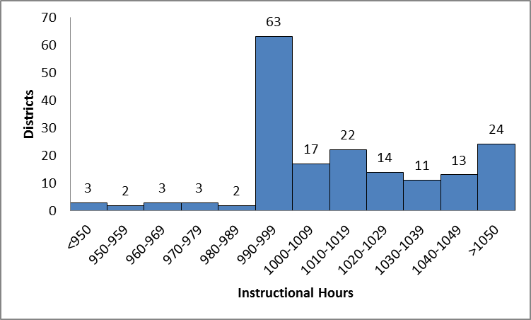
Grades 9-12 Instructional Hours 2013-14 Instructional hours data are from the 2013-2014 school year Division 22 forms. This is self-reported data from each school district and is the only year of data available.
Notes:
What will be the impact on districts as they try to add more hours?

Slide 13
Current Rule – Credit Options
Districts must offer students the option of earning each credit required for the diploma or modified diploma by successfully completing classroom or equivalent work in a course of at least 130 clock hours.
Districts may also offer the option of earning credit through proficiency under OAR 581-022-1131(4). However, even if the District chooses to offer credit pursuant to OAR 581-022-1131(4), the District must still offer courses of 130 clock hours as required by section OAR 581-022-1131(2).

Slide 14
Proposed Rule – Credit Options
Eliminate 130 hours requirement
Successfully completing classroom or equivalent work that meets common curriculum Goals and Academic Content Standards required by OAR 581-022-1210 is one way to earn a credit
Maintains all proficiency based options for earning credit

Slide 15
Concerns Raised By Stakeholders:
State accountability versus local control
Increase in elementary school hours – cost to districts
CTE instruction – does this fit in definition of instructional time?
Cultural education – does this fit in definition of instructional time?
Is 90% the appropriate benchmark and should it apply district wide or to each school within the district?
Should three be a waiver process to have things such as Professional Learning Community time counted as instructional time?
How should we count instructional time for students who are receiving instruction through a post secondary institution?

Slide 16
Concerns Raised By Stakeholders:
Impact on parent teacher conferences if no longer counted as instructional time
Impact on Professional Development if no longer counted as instructional time
Impact on kids of color – do we have data to fully understand how this proposal would impact kids of color?
What is the appropriate timeline for implementing this proposal?
After session?
Impact on collective bargaining agreements

Slide 17
Policy Questions
Does the State Board agree with the proposal to move from districts providing a calendar of 990 hours to districts ensuring at least 90% of all students are scheduled to receive the minimum instructional hours?
Should the State Board increase the instructional hours requirement for the early grades (K-3)?
Does the State Board agree with the decision to eliminate the reductions for parent-teacher conferences, professional development, and inclement weather?
If the State Board of Education adopts changes to the minimum required hours of instructional time rule (OAR 581-022-1620), when should these changes be implemented?
Does the State Board agree with the proposal to eliminate the 130 seat hours requirement from OAR 581-022-1131?

Slide 18
Year | Hours Required | Definition of Instructional Time | ADM – “Tenths Method”
2015-16 | Each school district shall ensure that at least 80% of all students in the district are scheduled to receive the following minimum hours of instructional time per school year: (a) Grade 12 – 966 hours; (b) Grade 9-11 – 990 hours; (c) Grades K-8 – 900 hours. | Removed from definition of instructional time: Parent Teacher conferences Non-academic assemblies Non-academic field trips Can be counted as instructional time in 2015-16: Professional Development Inclement Weather | Through the Division 22 Assurance process, Districts will be required to report the percentage of fully enrolled students in grades 9-12.
2016-17 | Each school district shall ensure that at least 85% of all students in the district are scheduled to receive the following minimum hours of instructional time per school year: (a) Grade 12 – 966 hours; (b) Grade 9-11 – 990 hours; (c) Grades K-8 – 900 hours. | Removed from definition of instructional time: Professional Development Inclement Weather | Through the Division 22 Assurance process, Districts will be required to report the percentage of fully enrolled students in grades 9-12.
2017-18 | Each school district shall ensure that at least 90% of all students in the district are scheduled to receive the following minimum hours of instructional time per school year: (a) Grade 12 – 966 hours; (b) Grade 9-11 – 990 hours; (c) Grades K-8 – 900 hours. |  | Funding based on tenths model is fully implemented

